Slide 1
THIS SHOW THAT WE CALL 2020
LANDLORD TENANT ISSUES TODAY
TENANTS &
YOUR SALE
LISTINGS – WHAT
CAN YOU DO?
Federal,
State, county,
& city
Protections
LEASING
CONCERNS &
APPROACHES
FOR TODAY

Slide 2
Tenant Protections
Overlapping Legislation
FEDERAL
COUNTY
city
CDC Eviction Moratorium
CARES Act
Any Rent Control – LA County
Emergency & Temporary Health Orders – LA County
Any Rent Control – City of LA, Inglewood, Culver City, Burbank, Long Beach, Santa Monica, Beverly Hills
Emergency & Temporary Health Orders – LA County
STATE
AB 1482
AB 3088
Emergency & Temporary Health Orders

Slide 3
FEDERAL LEVEL PROTECTIONS
CARES ACT
CDC EVICTION MORATORIUM
The Coronavirus Aid, Relief, and Economic Security (CARES) Act provides certain protections from eviction and late fees due to nonpayment of rent for most tenants in federally subsidized or federally backed housing.
The CARES Act protections apply to you if:
You receive federal rental assistance from a voucher or grant program
You or your landlord receive assistance through federally-subsidized housing programs
Your rental home or apartment building has a federally-backed mortgage
From March 27 to July 24, 2020, if you were covered by the CARES Act protections, your landlord or housing authority:
May not file a legal action to evict you for nonpayment of rent or other fees or charges
May not charge fees, penalties, or other charges related to nonpayment
Must give you a 30-day notice to vacate (leave the property), but no sooner than July 25, 2020
In some situations (generally single-family homes), the eviction protections have been extended until December 31, 2020 for loans backed by the FHA, VA, USDA, and Fannie Mae or Freddie Mac.
In addition, if your landlord is getting CARES Act relief from mortgage payments on your home, then you may be protected from eviction for a longer period.
These CARES Act protections do not apply if:
Your landlord filed a lawsuit to evict you before March 27, 2020. In this situation, you might still receive eviction protection offered by your state or local jurisdiction.
You are being evicted for reasons other than nonpayment of rent or fees and charges related to nonpayment of rent. For instance, your landlord can still evict you for breaking other agreements in your lease.
Rent payments are still due
Even if the CARES Act eviction moratorium or a state or local eviction moratorium applies to you, rent payments are still due on the usual date. If you can, continue to pay your rent to avoid eviction in the future.
On September 1, the CDC issued an order halting residential evictions through December 31, 2020. The order is not in effect until it is published in the Federal Register. It is scheduled for publication September 4. The order applies to just about all residential renters in Wisconsin. That’s very different from the previous federal moratorium, which only protected people residing in properties with federally backed financing or receiving federal assistance.
One of the most important things to know is that protection under the order is not automatic. It applies to a residential tenant who has provided their landlord a declaration containing certain assurances:
That the individual used best efforts to obtain all government assistance for rent/housing.
That the individual (i) has an income less than $99,000 in 2020 ($198,000 for joint filers), (ii) was not required to report income in 2019, or (ii) received a CARES stimulus check.
That the individual is unable to pay full rent because of a substantial loss of work/income/hours, or extraordinary out-of-pocket medical expenses.
That the individual is making best efforts to make timely partial payments.
That an eviction would likely leave the individual homeless or forced into a congregate living setting because they lack another available housing option that would not increase their housing costs (i.e. there is not a cheaper rental option).
The order includes a declaration form for renters to use. Declarations do not go to the federal government – just the landlord. Individuals must make these declarations under the penalty of perjury, and each adult listed on a lease must complete the declaration. Violators of the order can face criminal penalties.
Here is what the moratorium does not do:
It does not relieve rent payments
It does not prevent late fees/penalties
It does not prevent eviction for other reasons
It does not affect foreclosure actions
It does not protect people residing in hotels/motels or like properties

Slide 4
WHY HAVEN’T I HEARD MUCH ABOUT THE CDC EVICTION MORATORIUM?
Gov. Newsom: CDC eviction ban does not apply in California
September 2, 2020
Gov. Gavin Newsom today said the national eviction moratorium announced this week by the U.S. Centers for Disease Control will not apply in California because the Golden State already has stronger eviction protections in place.
The CDC is exempting locations with “the same or greater level of public-health protection than the requirements listed in this Order.”
“Our protections are not impacted by those federal rules and regulations,” Newsom said during a press conference today. “Our protections go a little farther than the federal government. There is no income cap as the federal government currently has.
“Again, ours go through Feb. 1 of next year. They don’t expire at the end of this year.… And California, again, is leaning in more aggressively than we believe in any other state in this country.”

Slide 5
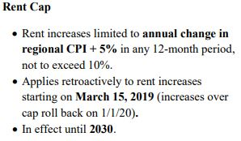
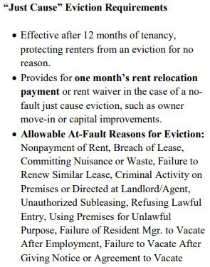
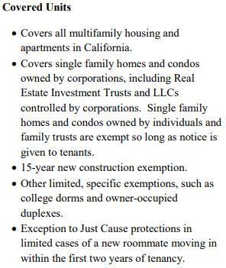
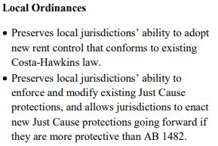
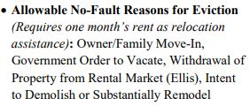
STATE LEVEL PROTECTIONS
AB 1482 (Chiu) – Tenant Protection Act of 2019
The Tenant Protection Act of 2019 was signed by Governor Newsom on October 8th, 2019 and takes effect on January 1, 2020. The law limits how much rents can be increased and the allowable reasons for evicting tenants in covered units:

Slide 6
I’M A SUPER BUSY AGENT – WHAT’S MY TAKE AWAY?
All tenants in units covered by the bill must receive a notice explaining the just cause and rent cap protections. In addition, an owner claiming an exemption under the single-family home or condo exemption must provide a written notice to the tenant. For a tenancy existing before July 1, 2020, this notice may be provided in the rental agreement. For any tenancy commenced or renewed on or after July 1, 2020, this notice must be provided in the rental agreement.
If the owner does not provide the required notice, then the property is NOT exempt from just cause or the rent cap.
The notice language must read:
“This property is not subject to the rent limits imposed by Section 1947.12 of the Civil Code and is not subject to the just cause requirements of Section 1946.2 of the Civil Code. This property meets the requirements of Sections 1947.12 (d)(5) and 1946.2 (e)(8) of the Civil Code and the owner is not any of the following: (1) a real estate investment trust, as defined by Section 856 of the Internal Revenue Code; (2) a corporation; or (3) a limited liability company in which at least one member is a corporation.”

Slide 7
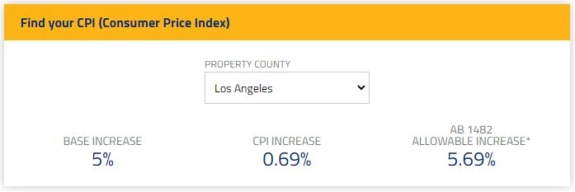
WHAT ELSE….?
Get Your Allowable Rent Increase Right

Slide 8
AB 3088 CRTA (Covid-19 Tenant Relief Act)

Slide 9
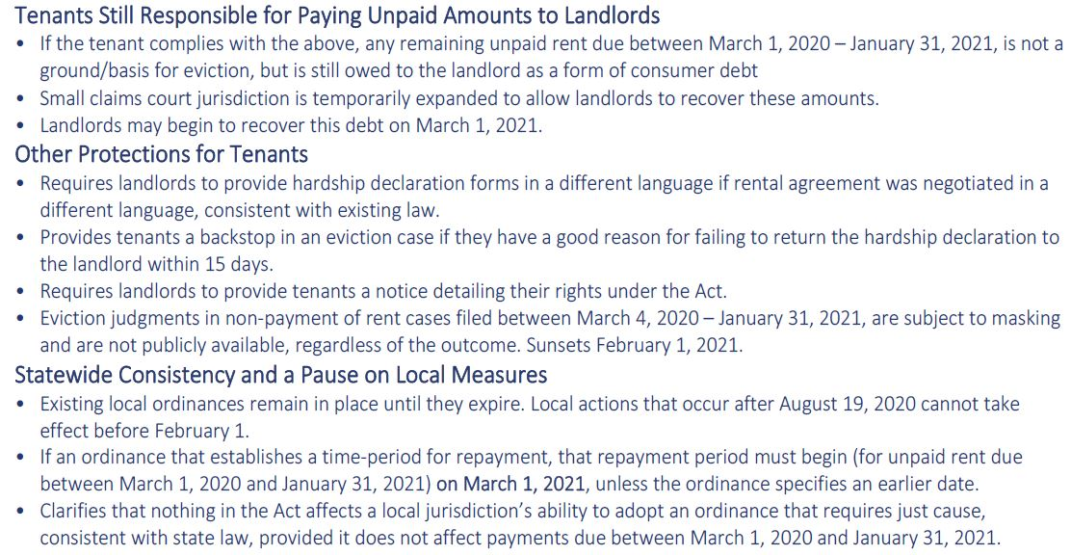

Slide 10
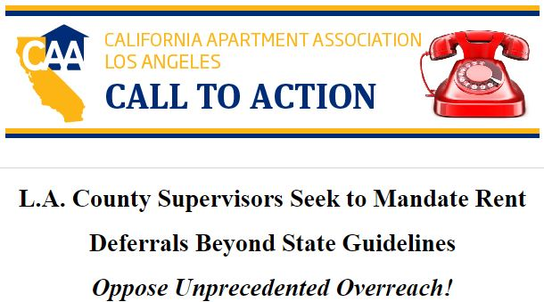

Slide 11
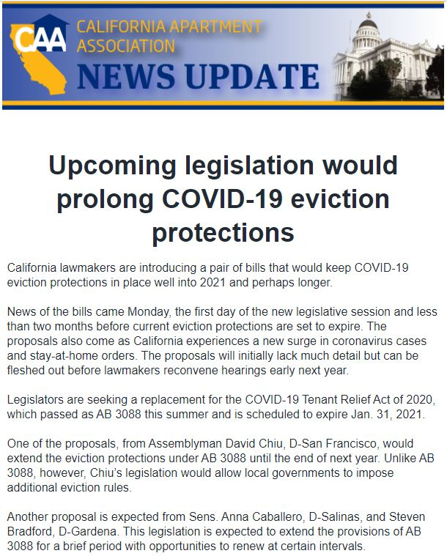

Slide 12
AGAIN WITH THIS GUY…..
Emergency & Temporary Health Orders
https://covid19.ca.gov/?utm_source=google&utm_medium=cpc&utm_campaign=ca-covid19response-august2020&utm_term=ca%20stay%20at%20home%20order&gclid=Cj0KCQiAzsz-BRCCARIsANotFgP6Snk3wpXQfz0wEheMFkui4N5JKqI9FF29M15ivKEs-90uYpyxTkQaAg6yEALw_wcB
https://www.cdph.ca.gov/Programs/CID/DCDC/Pages/COVID-19/Regional-Stay-at-Home-Order-.aspx#

Slide 13
WHAT’S LA COUNTY DOING?
https://library.municode.com/ca/los_angeles_county/codes/code_of_ordinances?nodeId=TIT8COPRBUWARE_DIV3HO_CH8.52REST

Slide 14
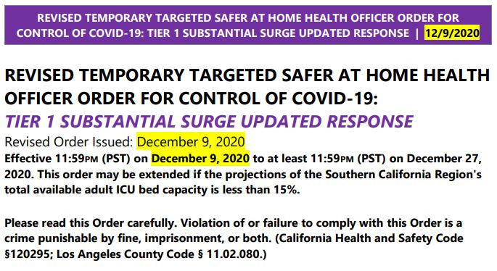
LA COUNTY DPH EMERGENCY HEALTH ORDERS
http://www.publichealth.lacounty.gov/
http://publichealth.lacounty.gov/media/Coronavirus/docs/HOO/HOO_SaferatHome_SurgeResponse.pdf

Slide 15
CITY LEVEL PROTECTIONS
Rent Controlled Cities
Remember that these local cities have some form of rent control:
Los Angeles (City)
Inglewood
Beverly Hills
https://hcidla.lacity.org/RSO-Overview
https://www.cityofinglewood.org/DocumentCenter/View/15458/ORDIANCE-20-03_signedcopy
http://www.beverlyhills.org/departments/communitydevelopment/rentstabilizationdivision/?NFR=1
Culver City
Long Beach
Santa Monica
https://www.culvercity.org/City-Hall/Reports-policies-local-laws/Interim-Rent-Control-Measures
http://www.longbeach.gov/lbds/hn/
https://www.smgov.net/rentcontrol/
Burbank
https://www.burbankca.gov/departments/community-development/housing-economic-development/housing/the-burbank-landlord-tenant-commission

Slide 16
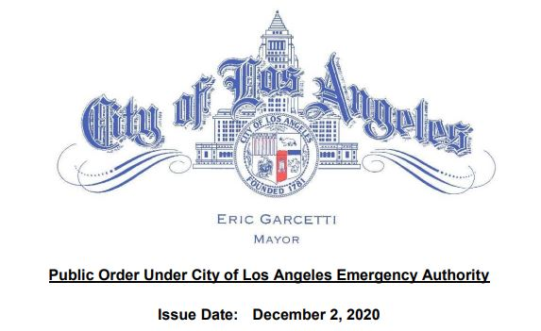
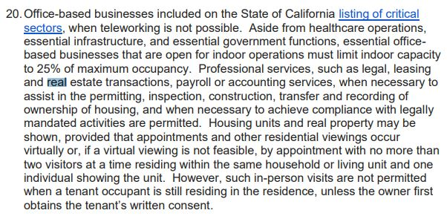
CITY LEVEL PROTECTIONS
CITY OF LOS ANGELES EMERGENCY HEALTH ORDERS
https://www.lamayor.org/sites/g/files/wph446/f/page/file/20201202%20Mayor%20Public%20Order%20Targeted%20SAH%20Order_1.pdf

Slide 17
TENANTS AND YOUR LISTINGS
Has the owner served the AB 1482 exemption notice?
Are the Owner and Tenant on good terms?
Can you help the Tenant find other housing?
Is the owner willing to help with relocation/moving costs even if not mandated?
Avoid escalations.
Do NOT get into a de facto property management situation.
Do not serve notices, even if otherwise allowable.
ALWAYS follow COVID showing rules. https://www.carcovidupdates.org/

Slide 18
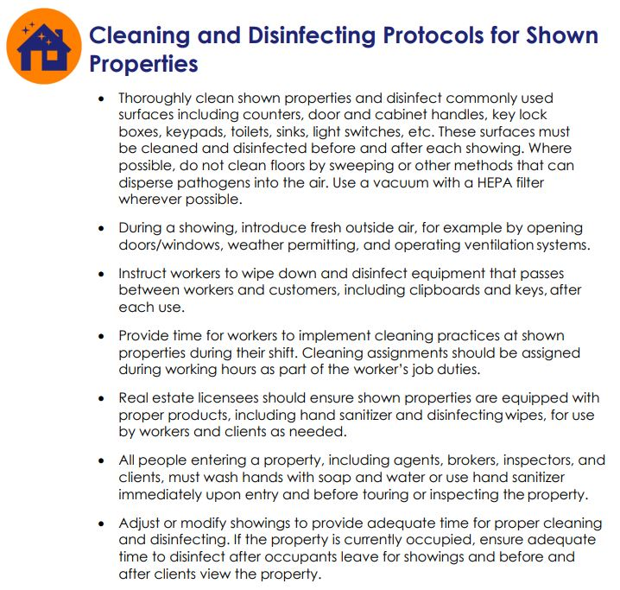
https://files.covid19.ca.gov/pdf/guidance-real-estate--en.pdf

Slide 19
HOW TO HANDLE NEW LEASES
Leasing these days can be nerve-racking. Here are some tips:
Now is NOT the time to be flexible with applicants. If they don’t meet criteria, dump them. Consider Job, Income, Savings, Residential History, etc.
Tenant non-payment protections are likely to be extended past January 31, 2021!
Always run your own screenings. Do not accept one given to you by the tenant or their agent.
Consider charging 6 months rent upfront (the minimum initial prepaid rent that California allows.
Do NOT cover any unnecessary utilities or services.
Do NOT include parking with apartments and even some SFRs.
Do NOT prorate the first month’s rent. Second month is prorated.
Do NOT cover/warranty appliances and personal items of owners.
Always issue rules and regulations for Tenants.
Do NOT forget to check the exemption box on the RCJC is it applies. This is CRITICAL!!!

