Slide 1
Notes:
Drag and drop the image in the placeholder
Send to back the image (Right click/Arrange/Send to back )

Slide 3
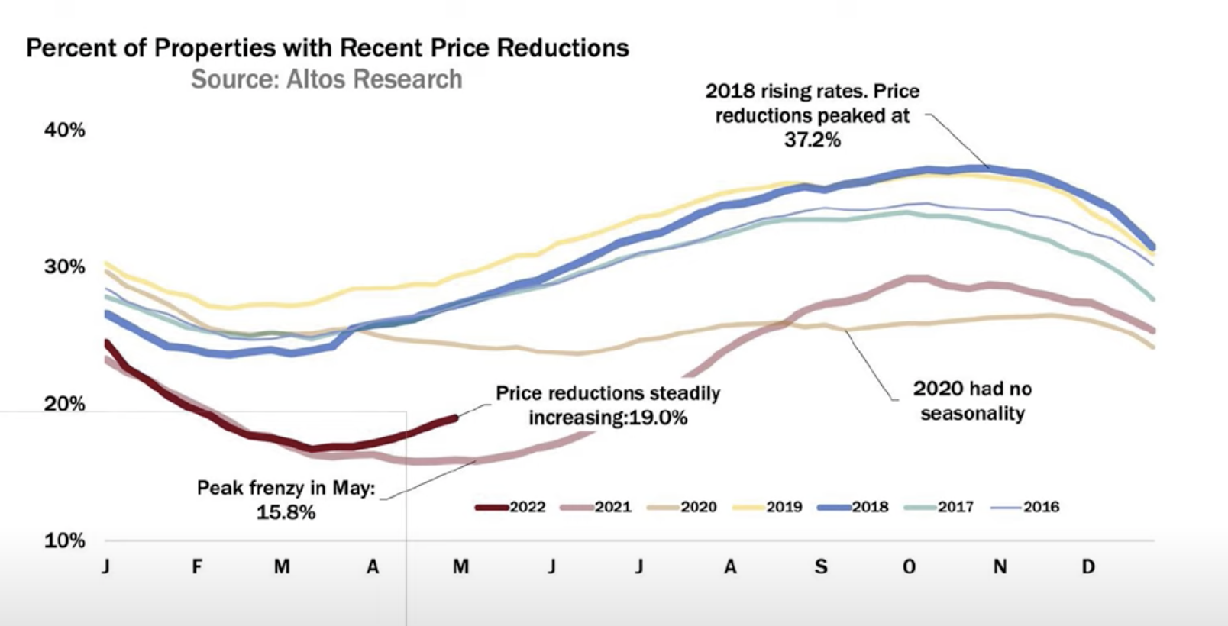

Slide 4
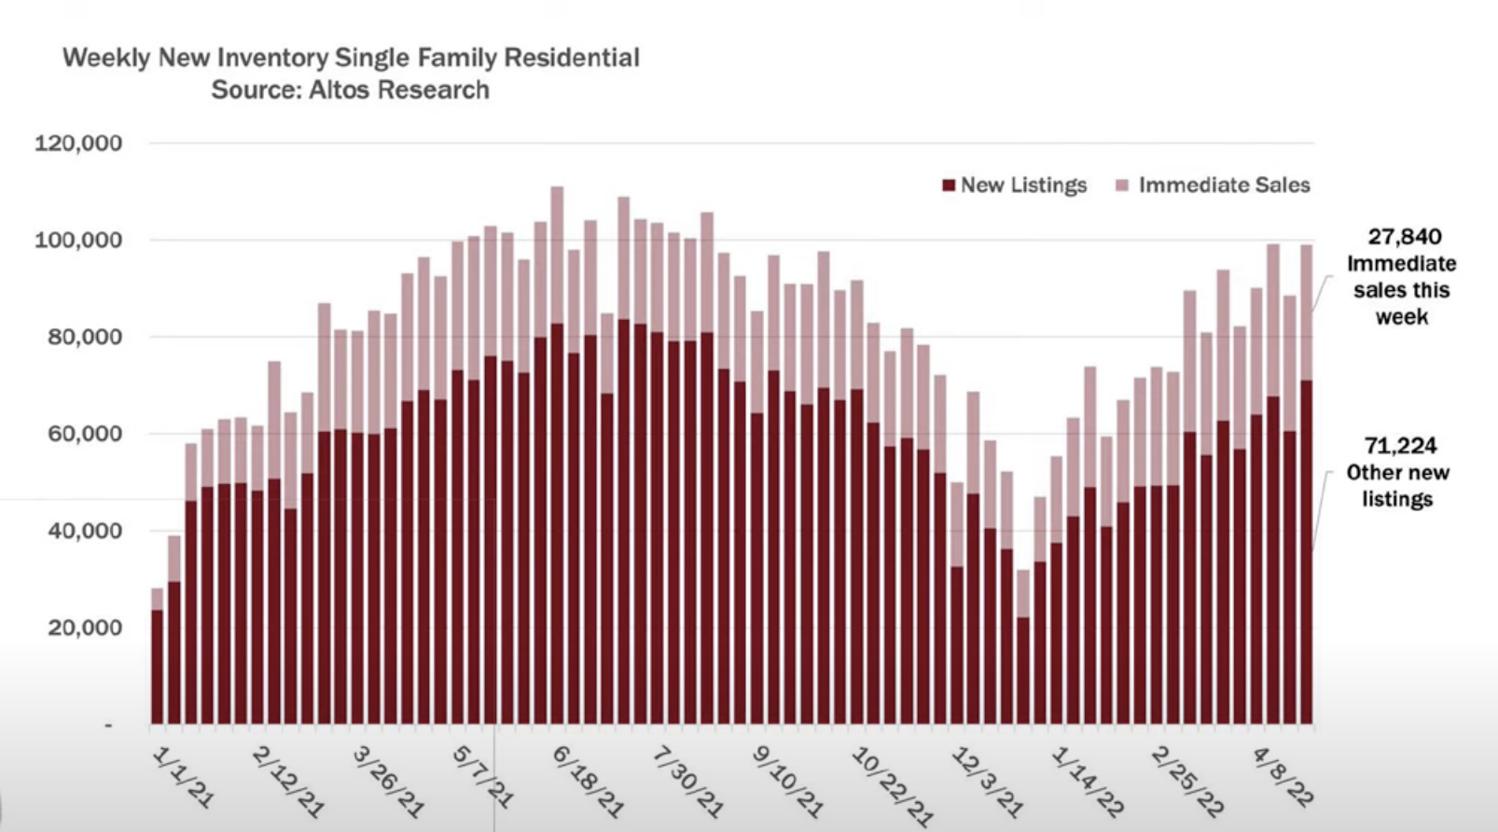

Slide 5
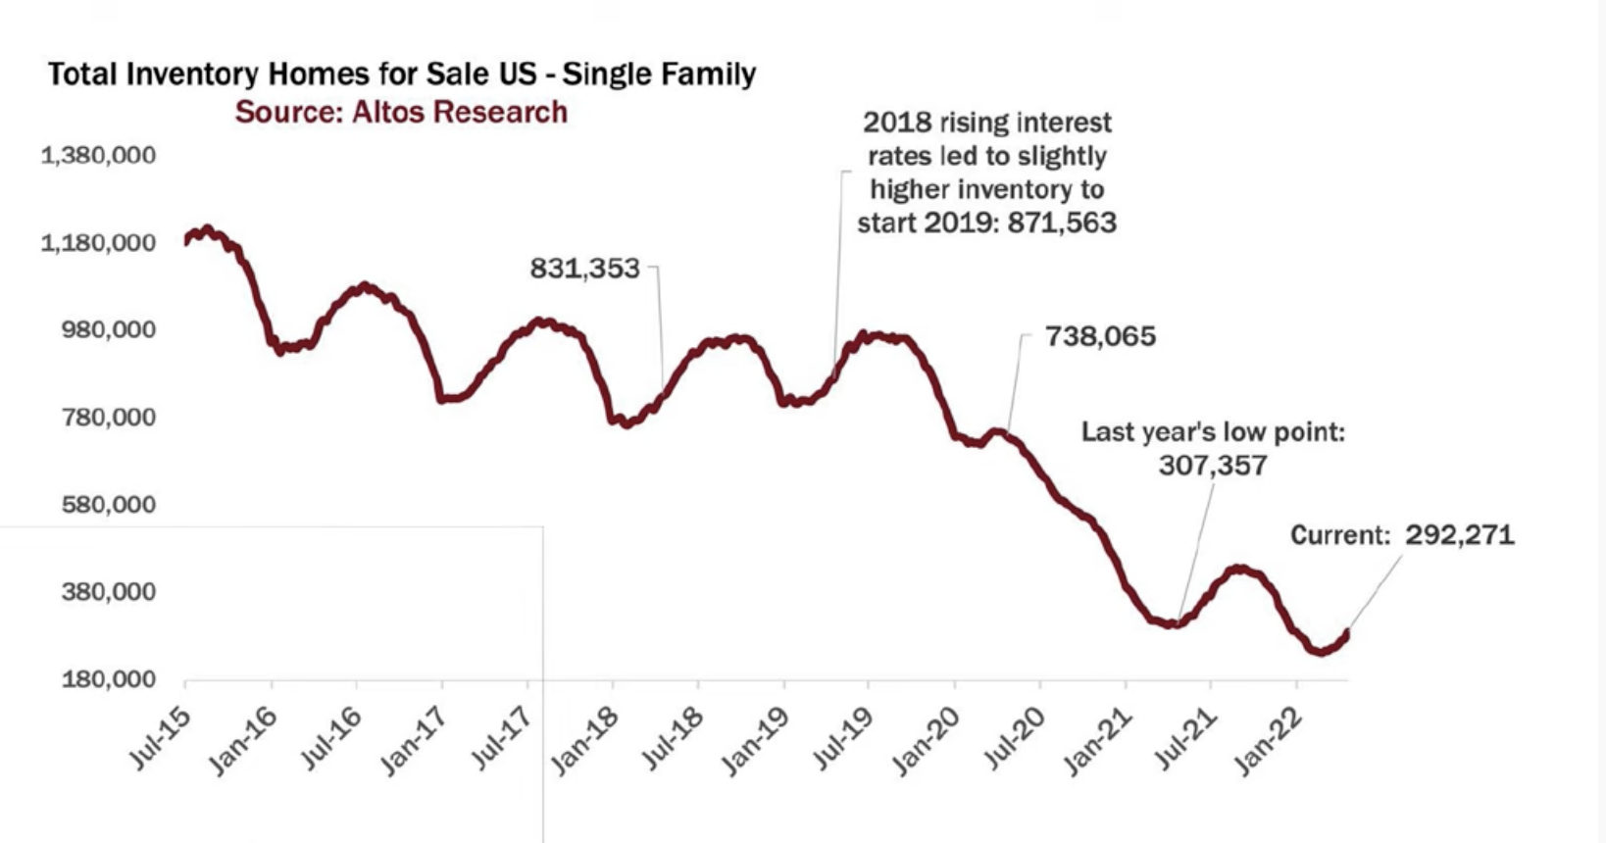

Slide 6
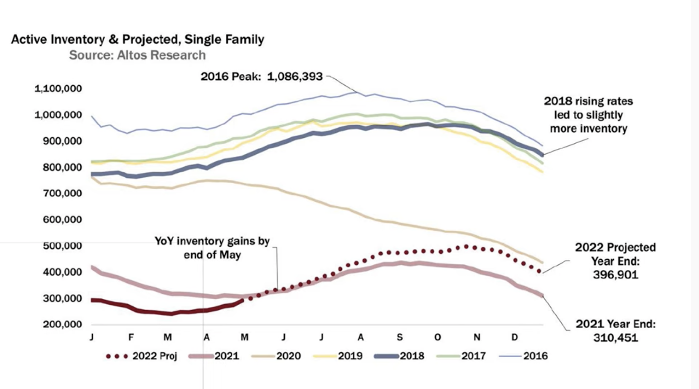

Slide 7
Notes:
Drag and drop the image in the placeholder
Send to back the image (Right click/Arrange/Send to back )

