Slide 1
RE/MAX ESTATE PROPERTIES
TOP PRODUCERS
MARCH 2022
Presented by James Sanders

Slide 2
TOP AGENTS + TOP TEAMS
MANHATTAN BEACH

Slide 3
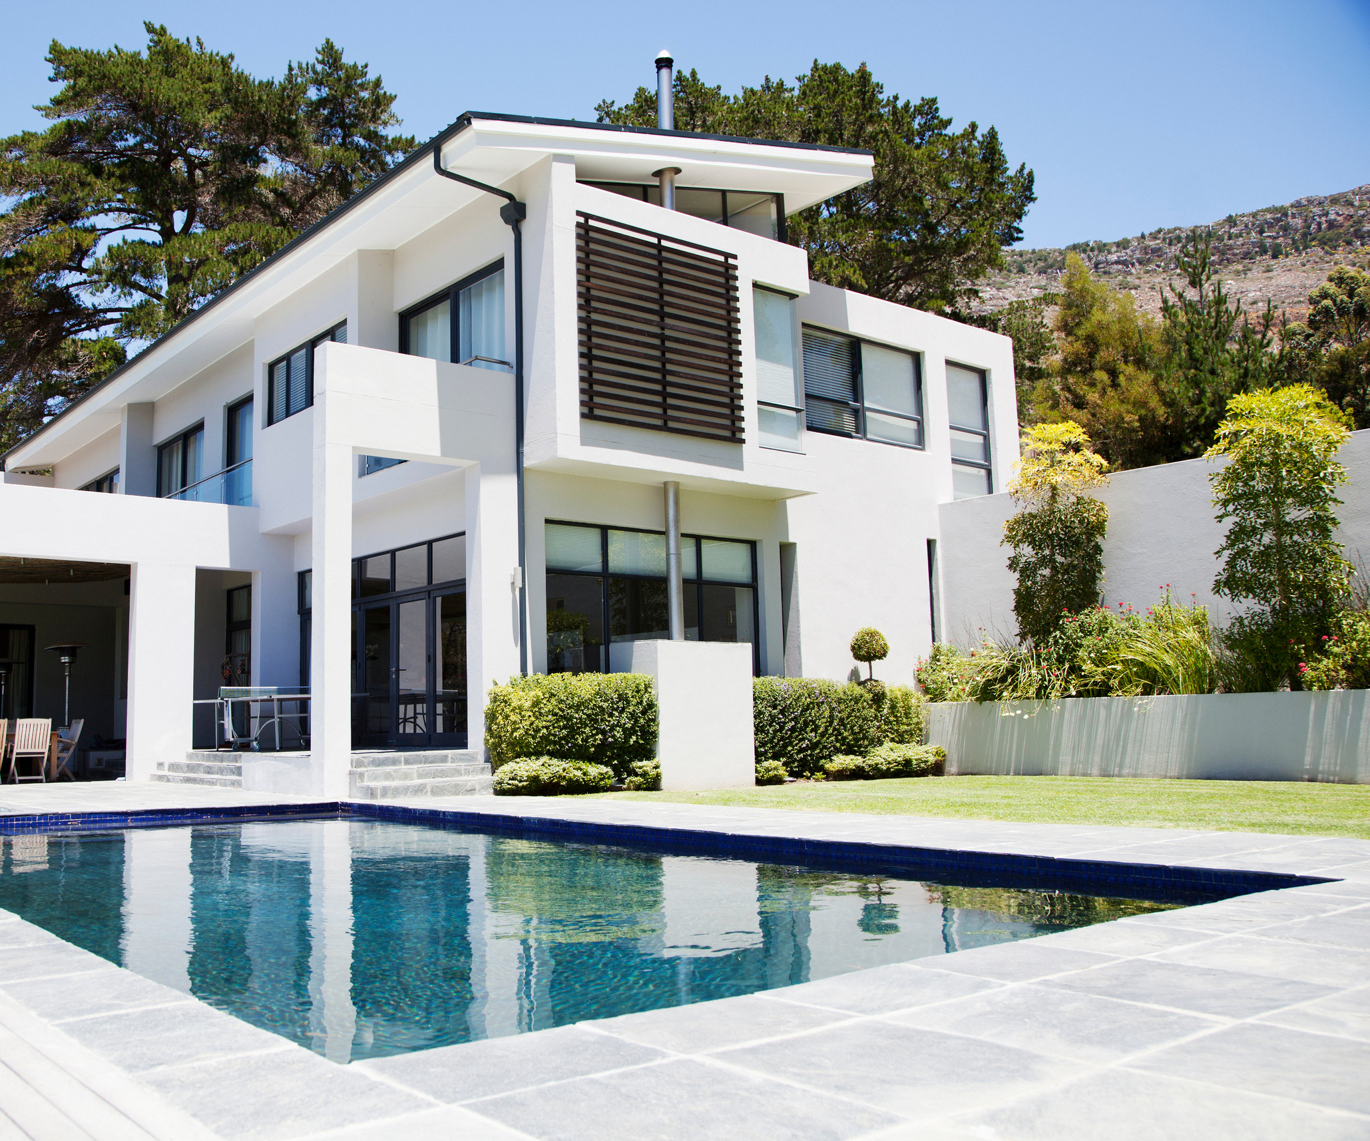
MANHATTAN BEACH
Top Solo Agents
#1
Pamela Salzillo
Victoria Babilonia
Ross Moore
#2
#3

Slide 4
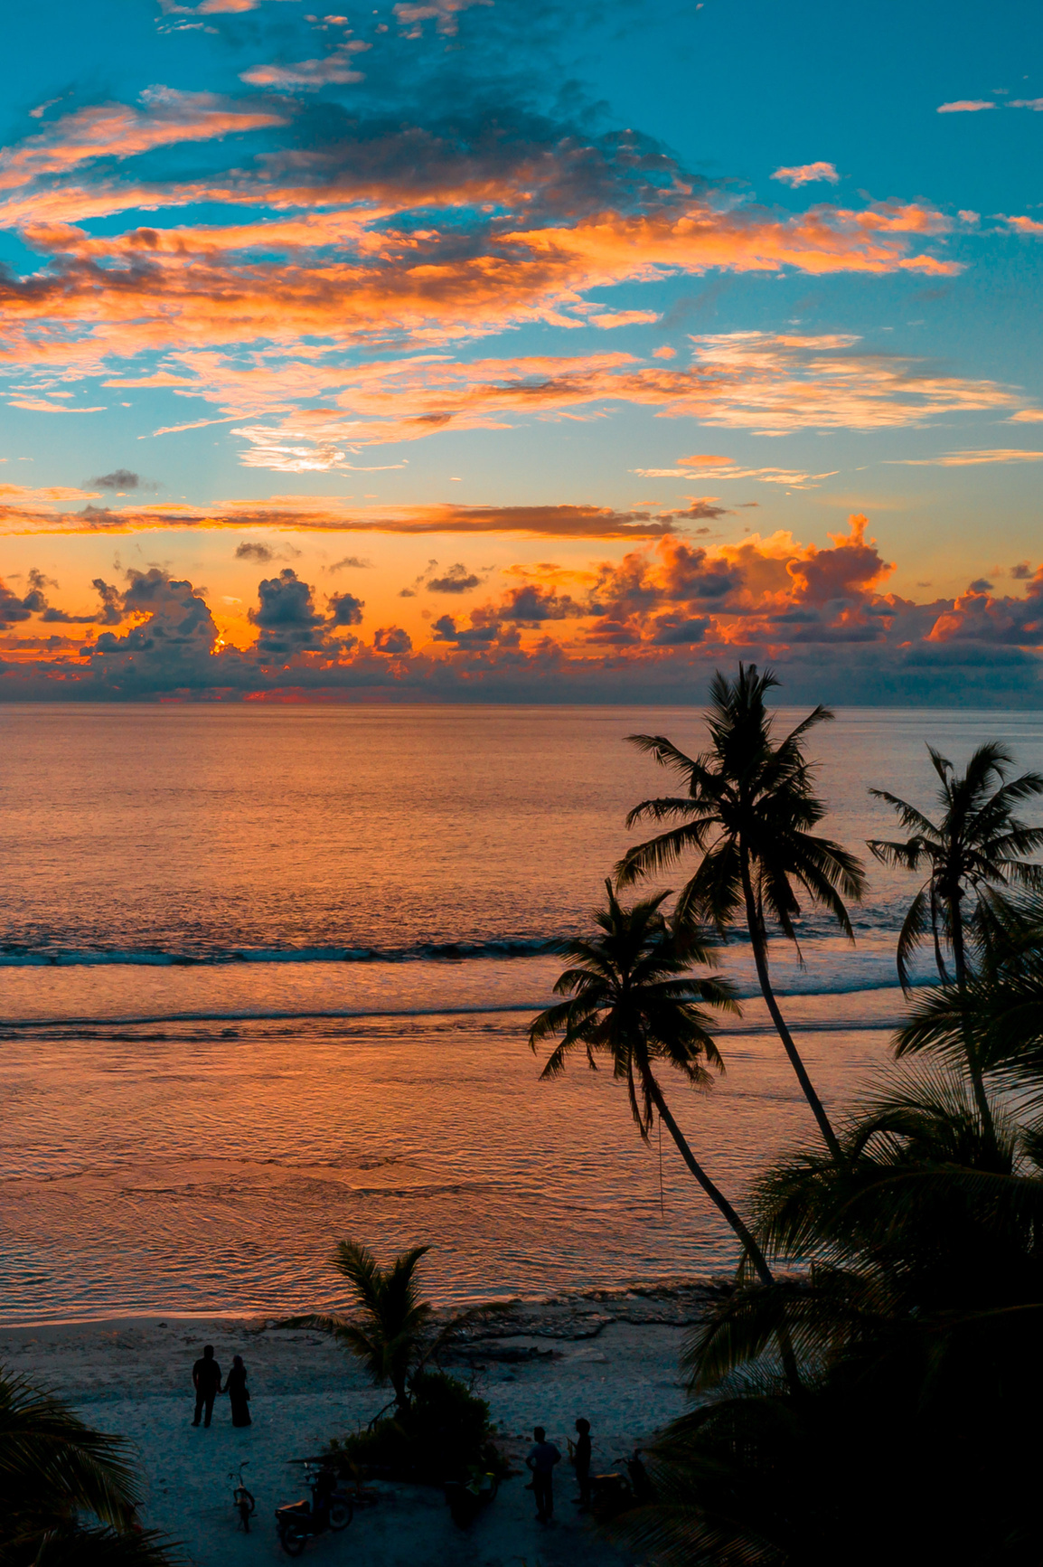
MANHATTAN BEACH
Top Teams
#1
The DOR Group

Slide 5
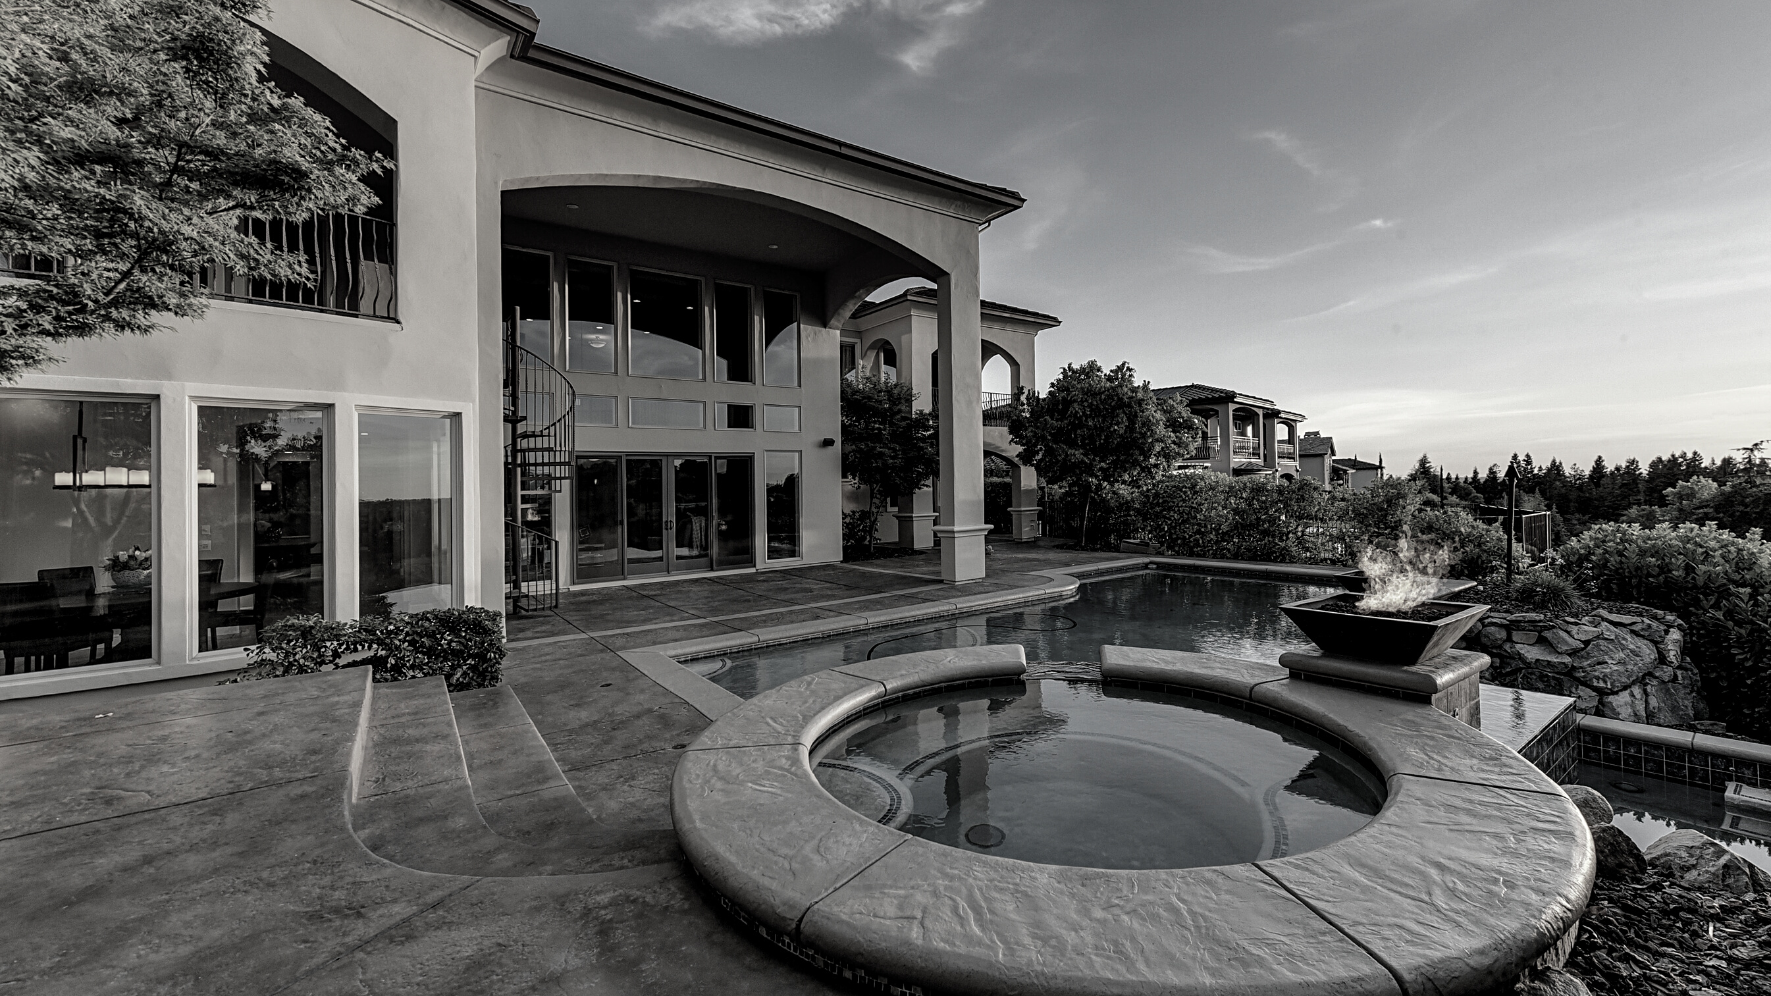
TOP AGENTS + TOP TEAMS
EL SEGUNDO

Slide 6
EL SEGUNDO
Top Solo Agents
#1
Bill Ruane

Slide 7
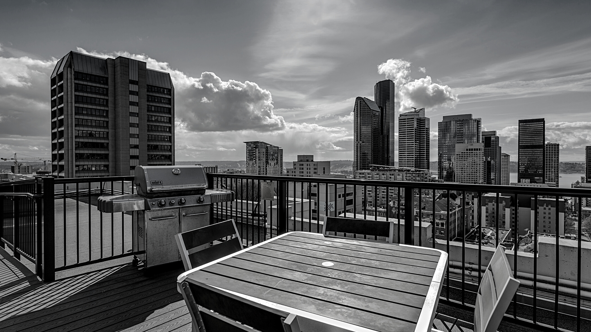
TOP AGENTS + TOP TEAMS
VENICE/ MARINA DEL REY

Slide 8
VENICE/ MARINA DEL REY
Top Solo Agents
#1
David Fowler
Michael Kayem
J.D. Songstad
#2
#3

Slide 9
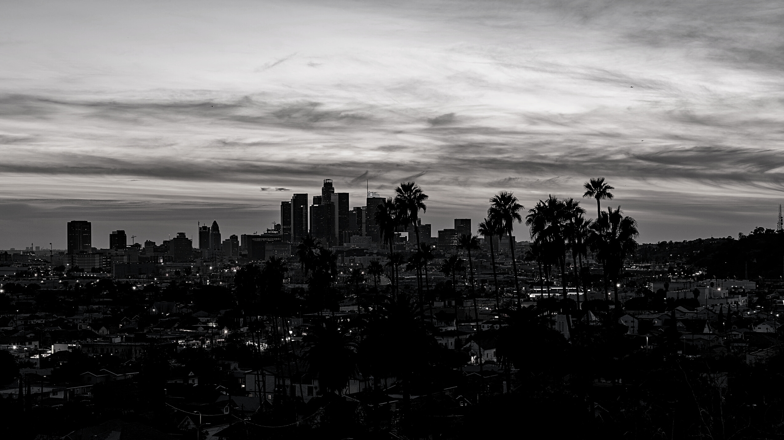
TOP AGENTS + TOP TEAMS
WEST LOS ANGELES

Slide 10
WEST LOS ANGELES
Top Solo Agents
#1
Elizabeth Marquart
John Capiro
Jeff White
#2
#3

Slide 11
WEST LOS ANGELES
Top Team
#1
Rory Posin & Kristian Bonk

Slide 12
TOP AGENTS + TOP TEAMS
BEVERLY HILLS

Slide 13
BEVERLY HILLS
Top Solo Agent
#1
Mary Chiu

Slide 14
TOP AGENTS + TOP TEAMS
HIGHLAND

Slide 15
HIGHLAND
Top Solo Agents
#1
Devra Zandell
David Keller
Charles Fisher
#2
#3

Slide 16
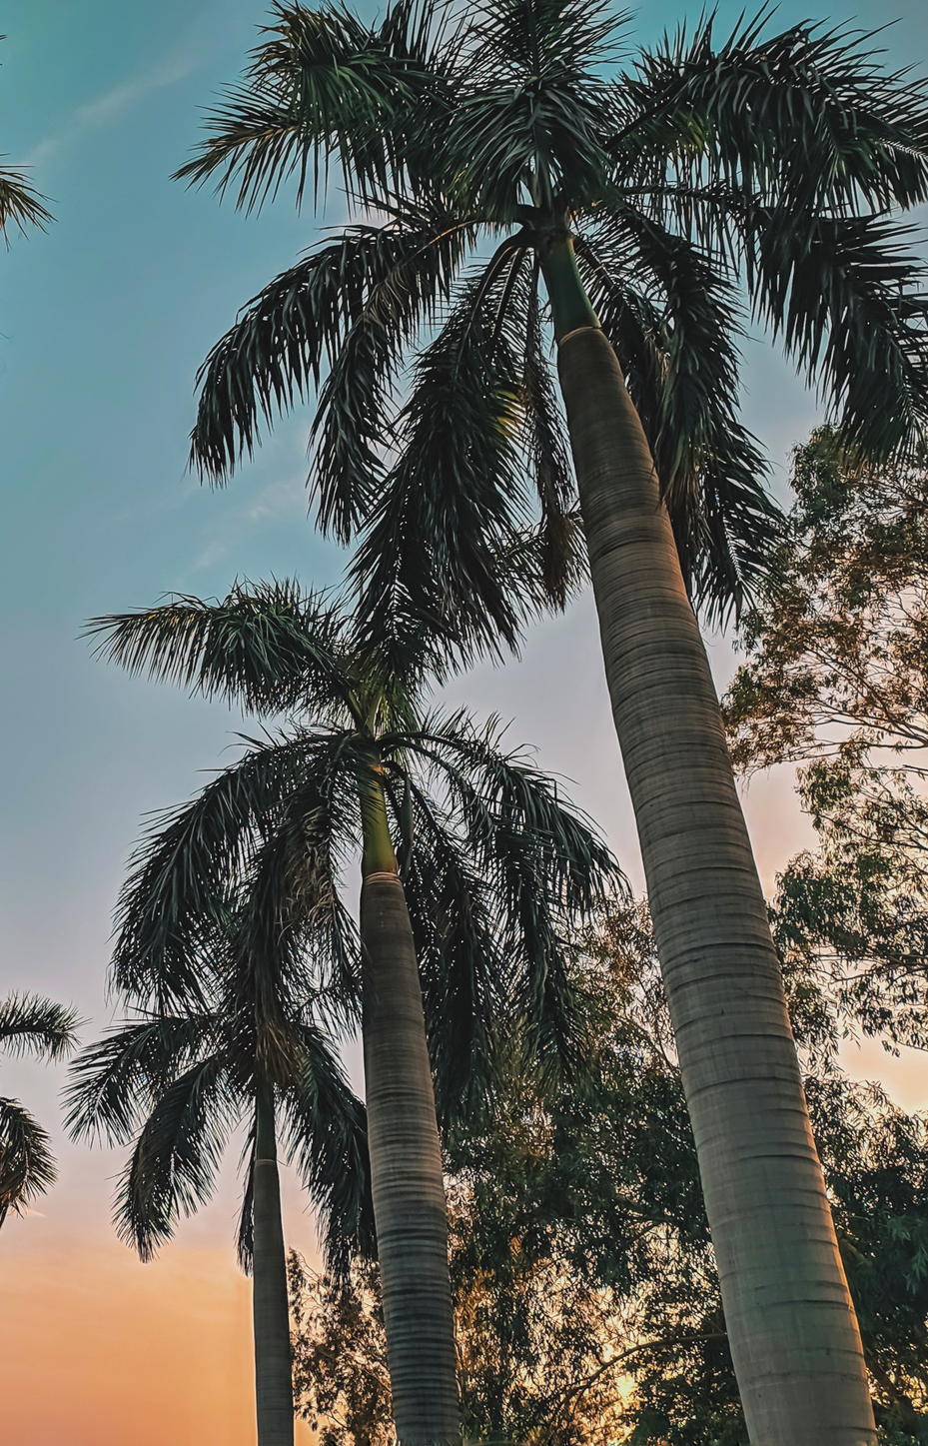
HIGHLAND
Top Teams
#1
The Lemieux-Stott Team
Team McGuire
#2

Slide 17
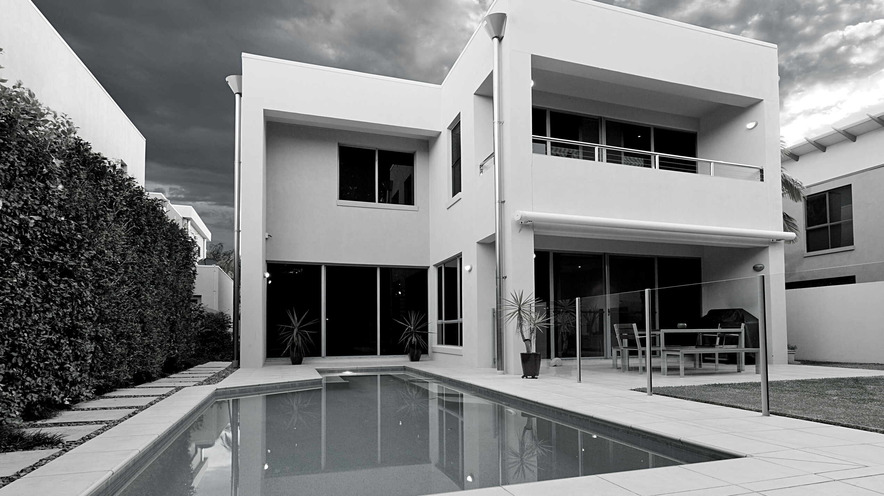
TOP AGENTS + TOP TEAMS
WESTCHESTER

Slide 18
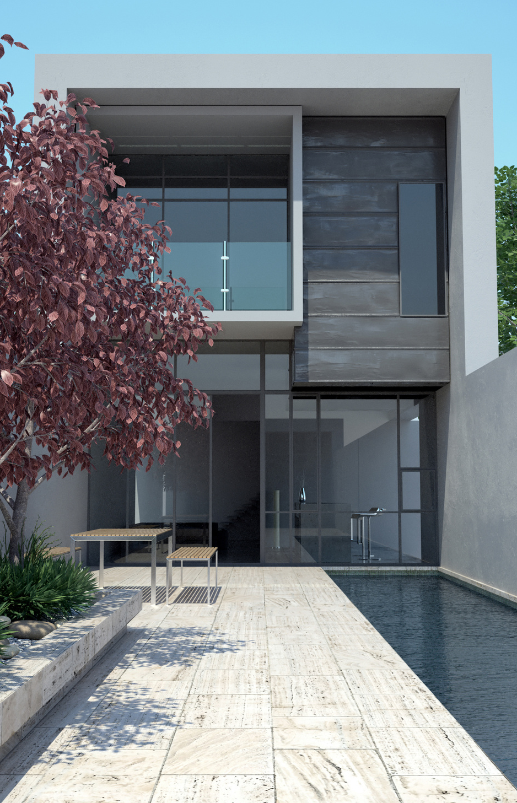
WESTCHESTER
Top Solo Agents
#1
Laura Mattick
Robert Meadows
Nanci Edwards
#2
#3

Slide 19
WESTCHESTER
Top Teams
#1
Alex & Kate Eychis Team
Kevin and Kaz Gallaher Team
#2

Slide 20
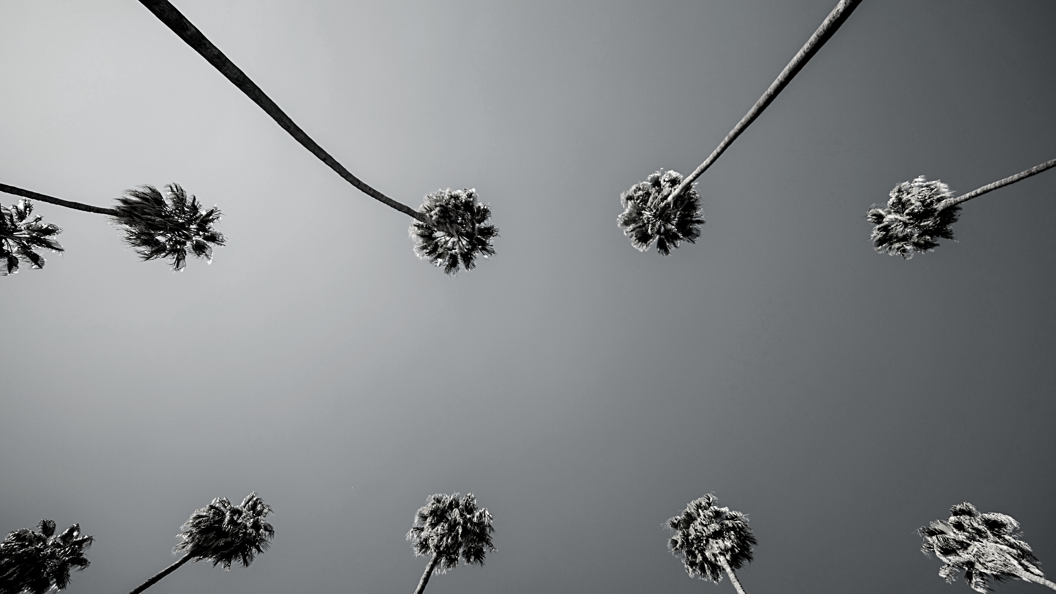
TOP AGENTS + TOP TEAMS
MALGA COVE

Slide 21
MALAGA COVE
Top Solo Agents
#1
Jason Buck
Igor Nastaskin
Jackie Wang-Dojiri
#2
#3

Slide 22
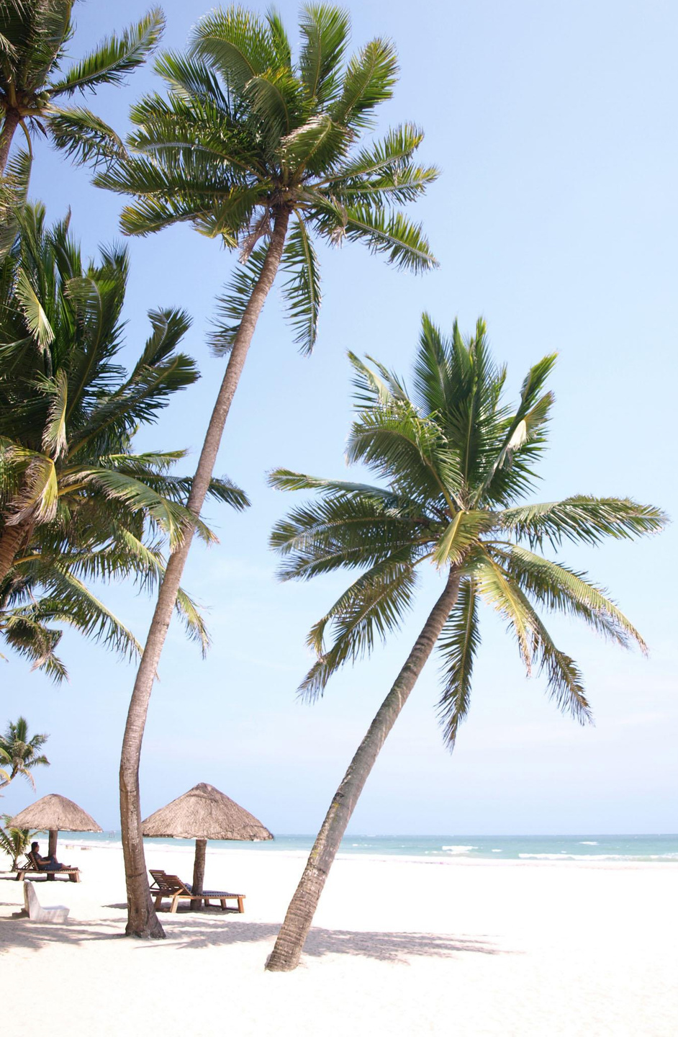
MALAGA COVE
Top Teams
#1
The Chamberlain Team
The Tyndall Team
Kelly Evans & Laura Medina
#2
#3

Slide 23
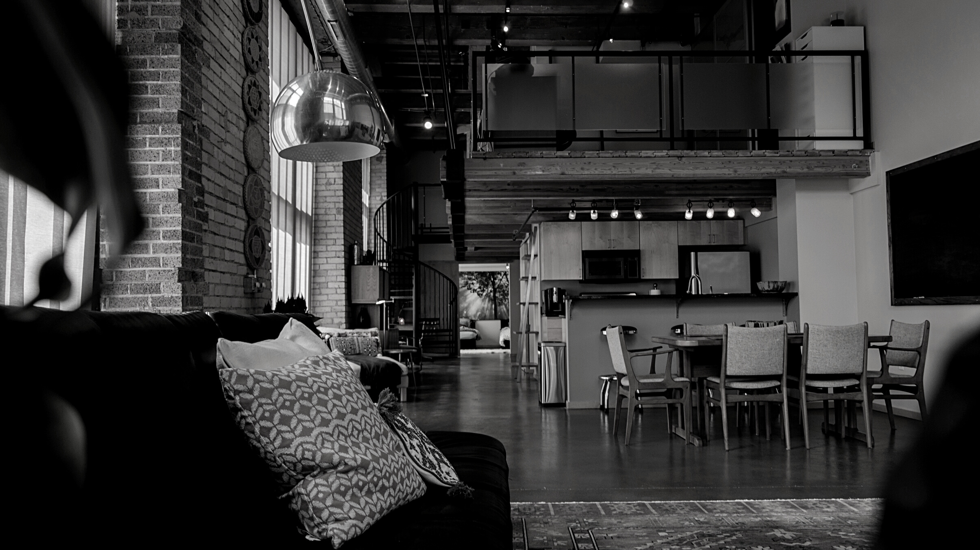
TOP AGENTS + TOP TEAMS
MIRALESTE

Slide 24
MIRALESTE
Top Solo Agents
#1
Sheri McHale
Sunny Rahmani
Phyllis Weitzman
#2
#3

Slide 25
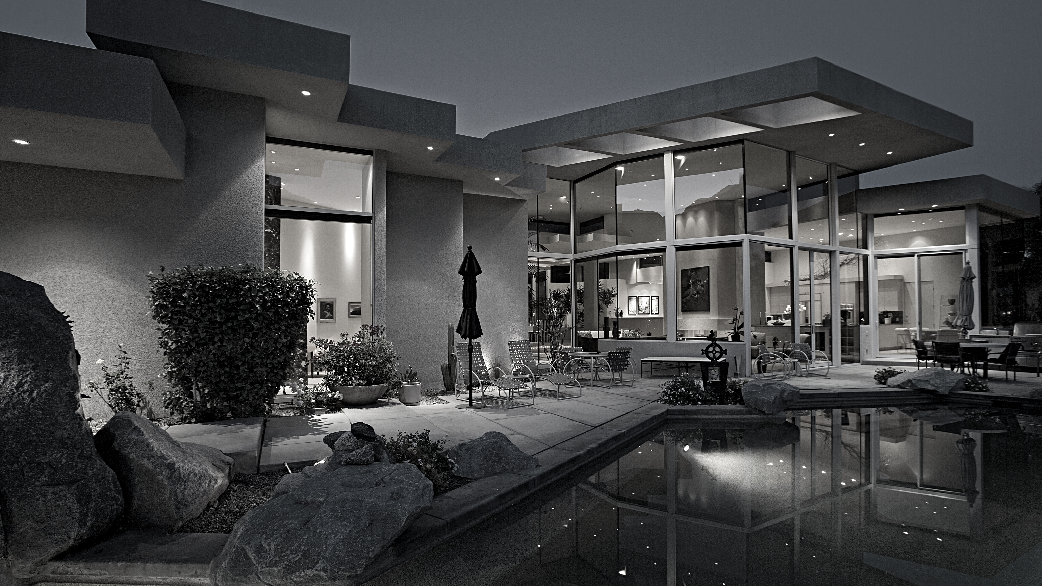
TOP AGENTS + TOP TEAMS
SILVER SPUR

Slide 26
SILVER SPUR
Top Solo Agents
#1
Wendy Sun
Kevin Moen
Norm Lucas
#2
#3

Slide 27
SILVER SPUR
Top Teams
#1
Cindy & Tiffany Kawata Team
#2
Kirby Larson & Haley Larson

Slide 28
TOP AGENTS + TOP TEAMS
SOUTH BAY

Slide 29
SOUTH BAY
Top Solo Agents
#1
Ken Conant
Tiffany McGuinness
Paul Yu
#2
#3

Slide 30
SOUTH BAY
Top Solo Team
#1
The Lockwood Team

Slide 31
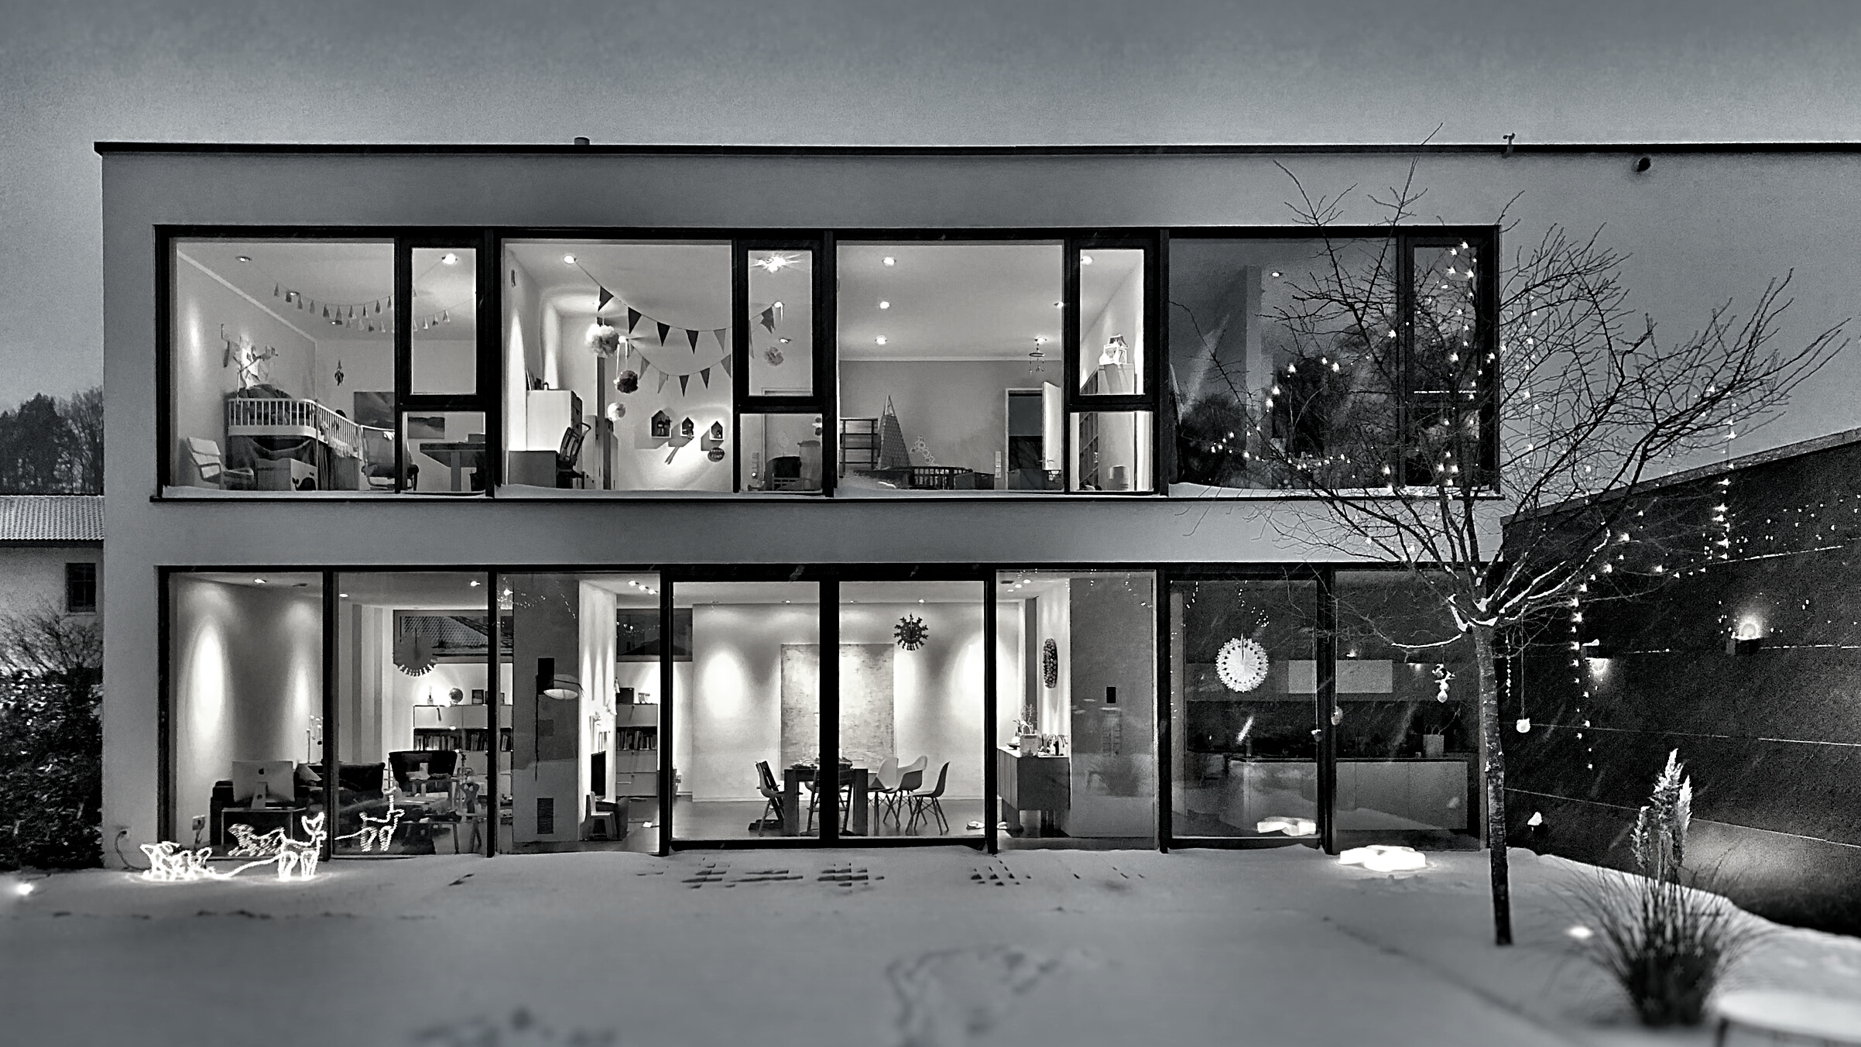
TOP AGENTS + TOP TEAMS
REDONDO BEACH

Slide 32
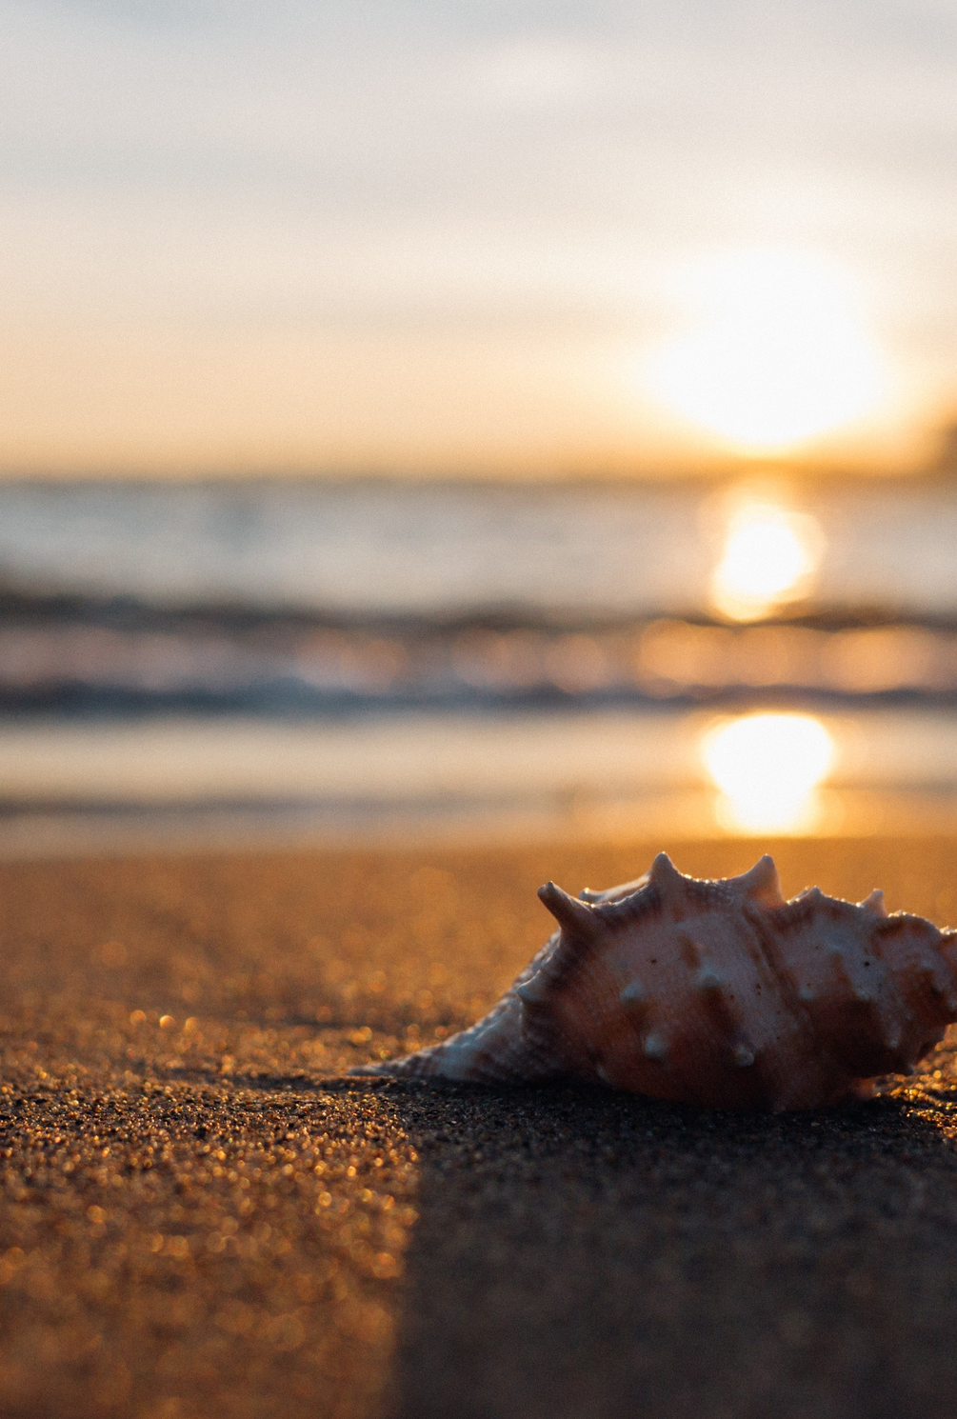
REDONDO BEACH
Top Solo Agents
#1
Darren Chehrazi
Brent Talbot
Brittny Burford
#2
#3

