Slide 1

Notes:
Drag and drop the image in the placeholder
Send to back the image (Right click/Arrange/Send to back )

Slide 2
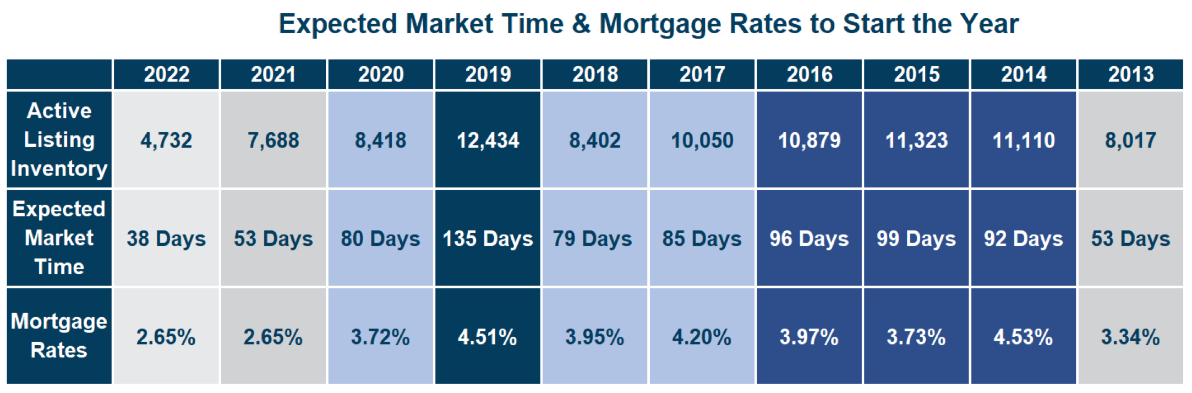

Slide 3


Slide 4


Slide 5
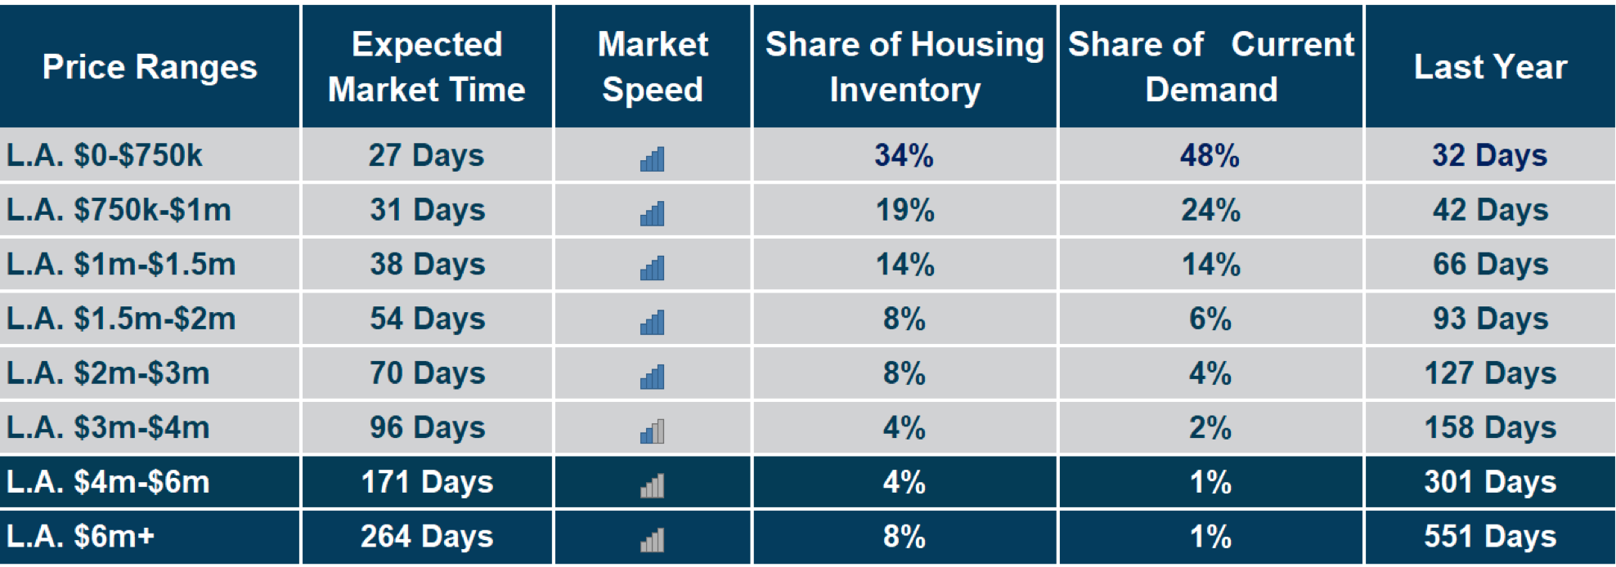

Slide 6

Notes:
Drag and drop the image in the placeholder
Send to back the image (Right click/Arrange/Send to back )

