Slide 1
RE/MAX ESTATE PROPERTIES
TOP PRODUCERS
DECEMBER 2021
Presented by James Sanders

Slide 2
TOP AGENTS + TOP TEAMS
MANHATTAN BEACH

Slide 3
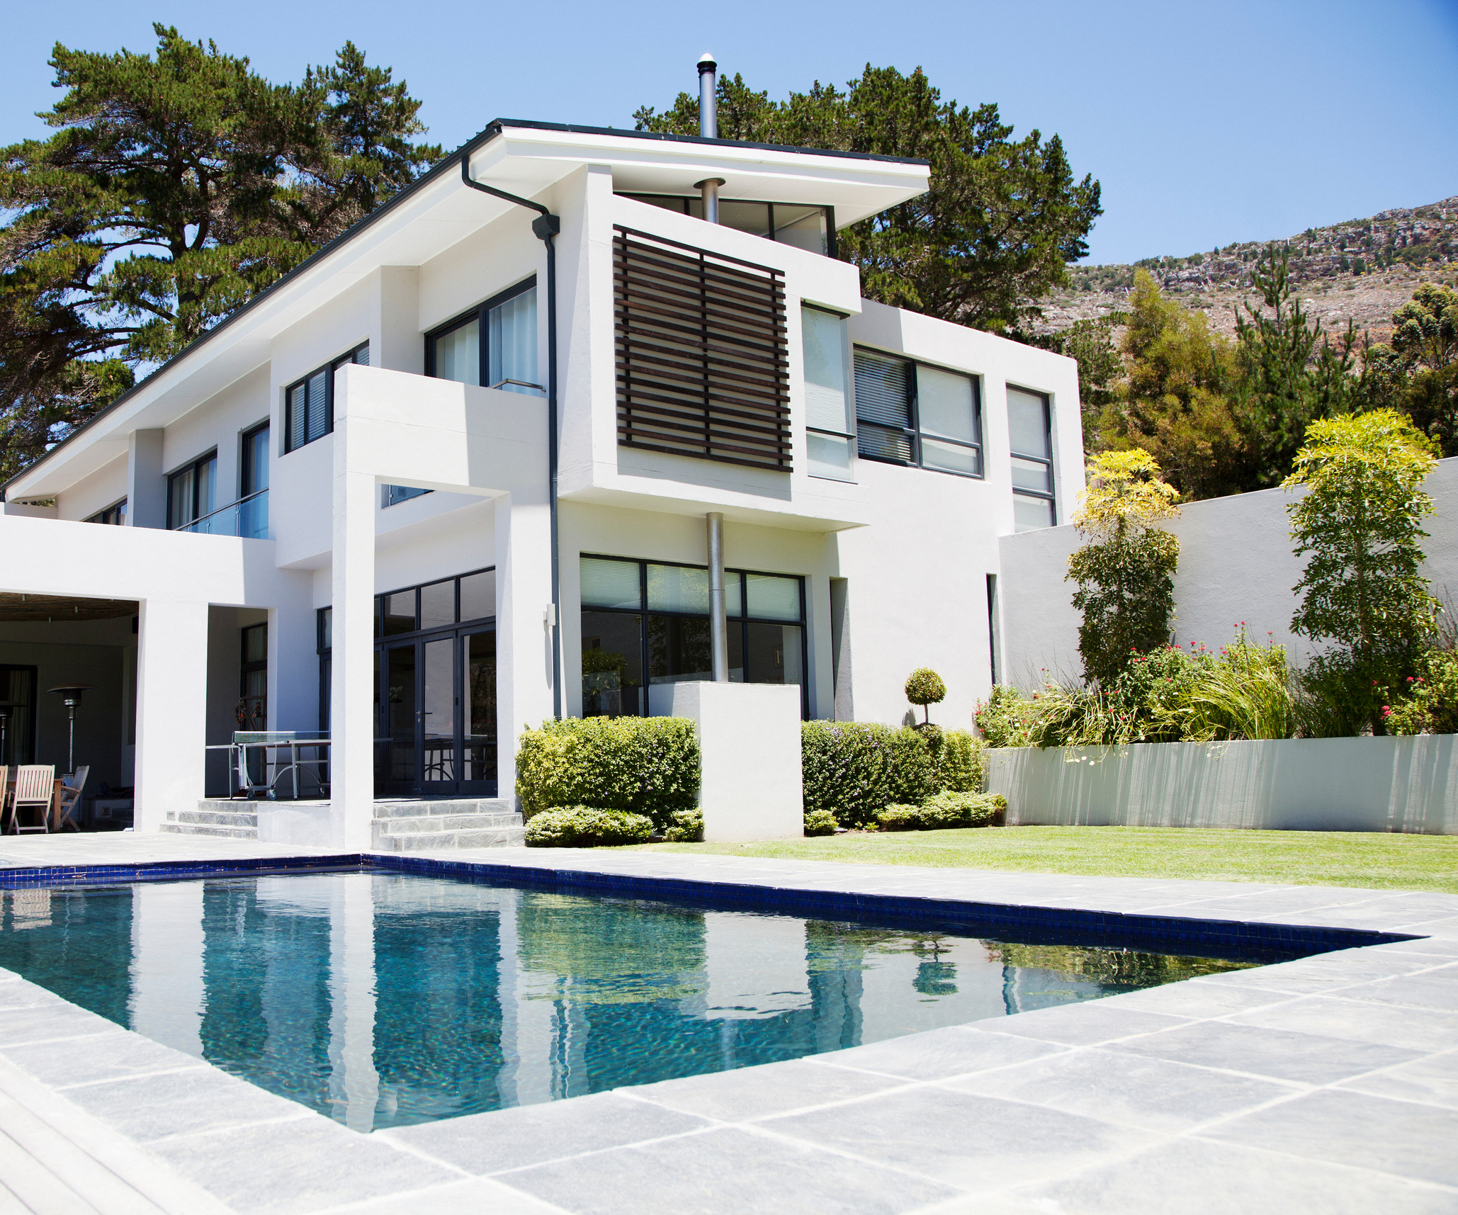
MANHATTAN BEACH
Top Solo Agents
#1
Terri Dunn
Gerard Ravel
Jay Deai
#2
#3

Slide 4
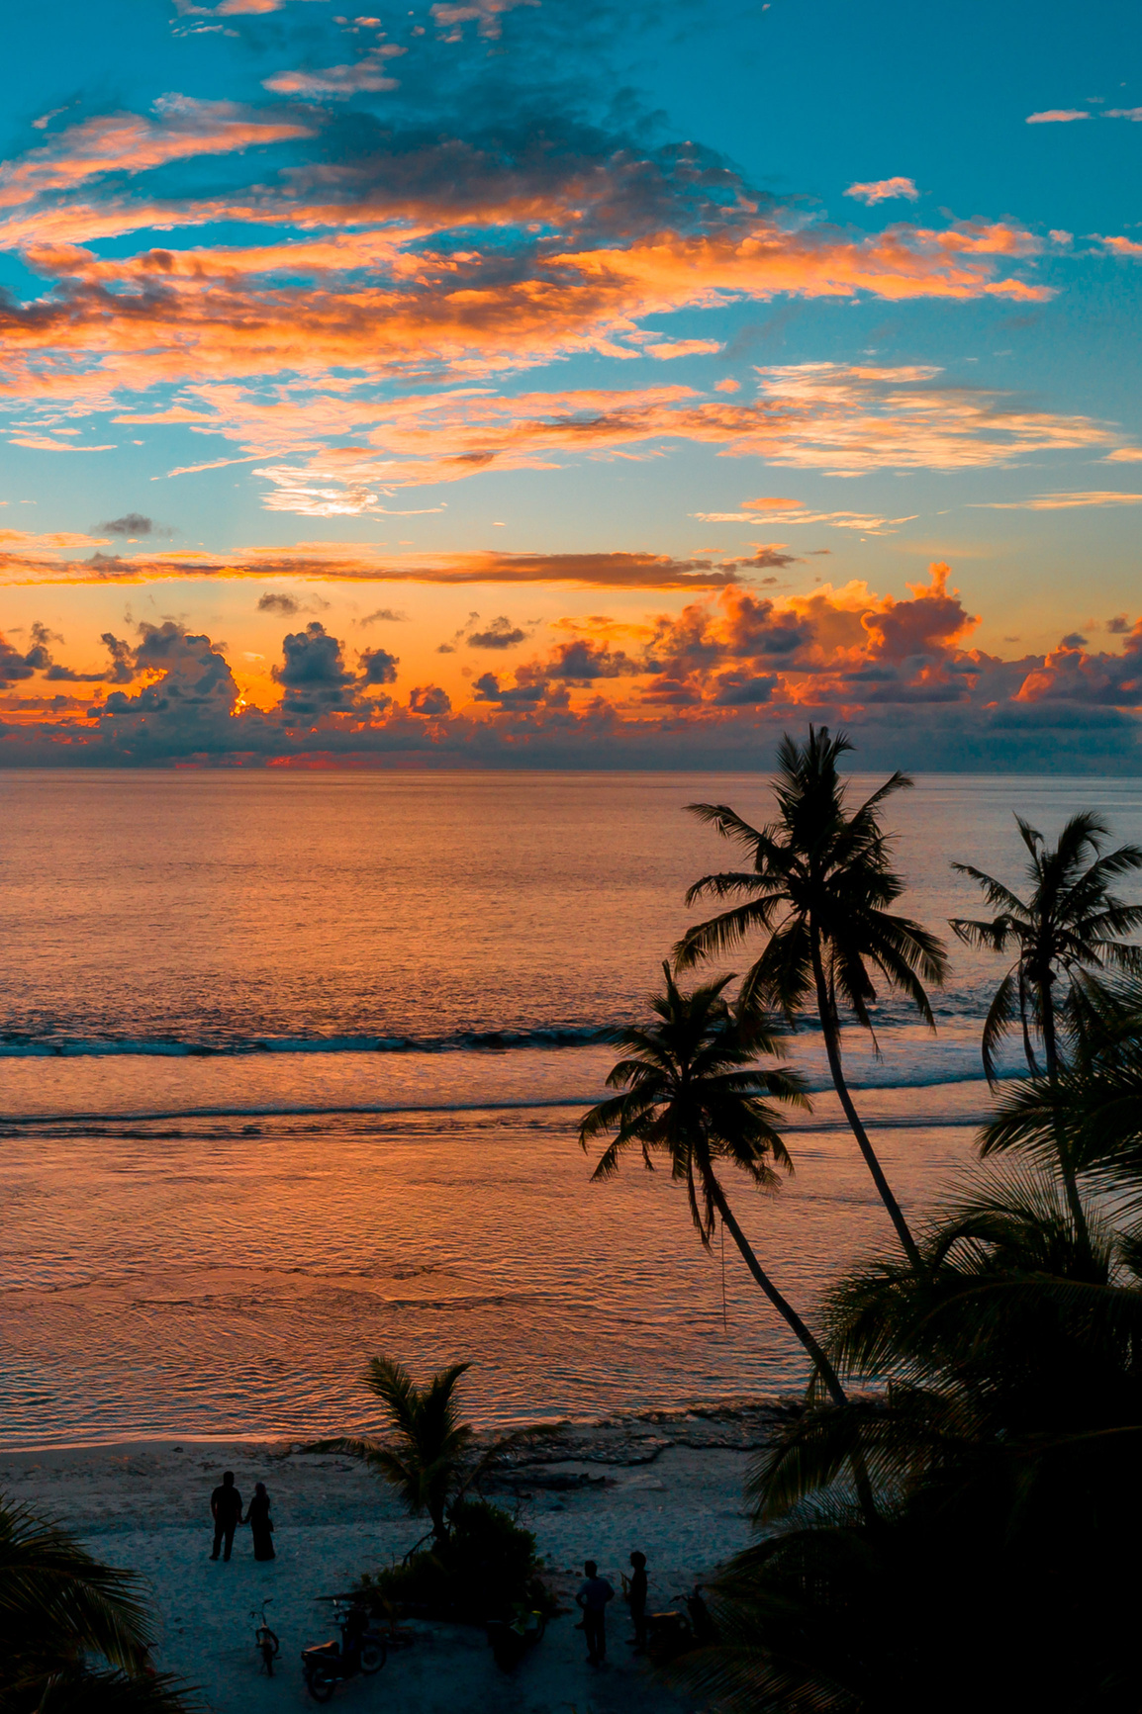
MANHATTAN BEACH
Top Teams
Mike Michalski & Sachi Fujita
#1
#2
The DOR Group

Slide 5
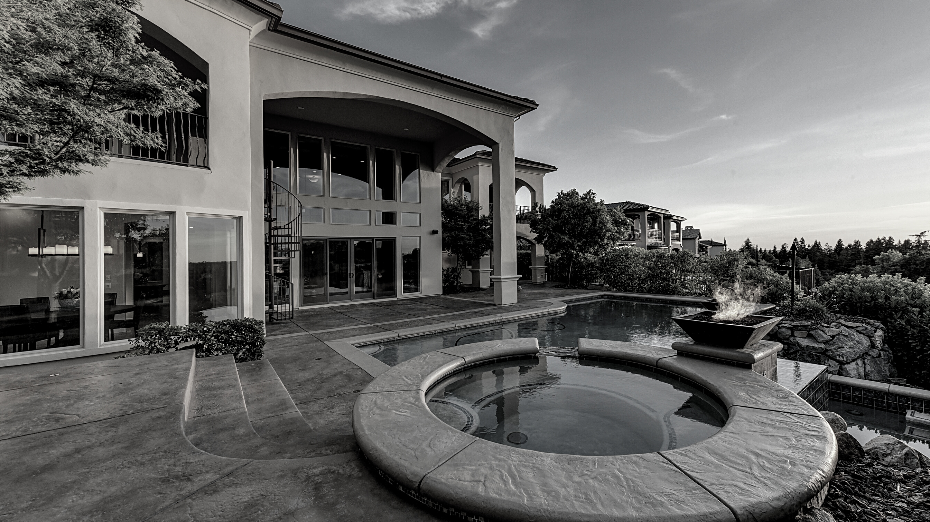
TOP AGENTS + TOP TEAMS
EL SEGUNDO

Slide 6
EL SEGUNDO
Top Solo Agents
#1
Bill Ruane
De Ann Eccles
Jim Marak
#2
#3

Slide 7
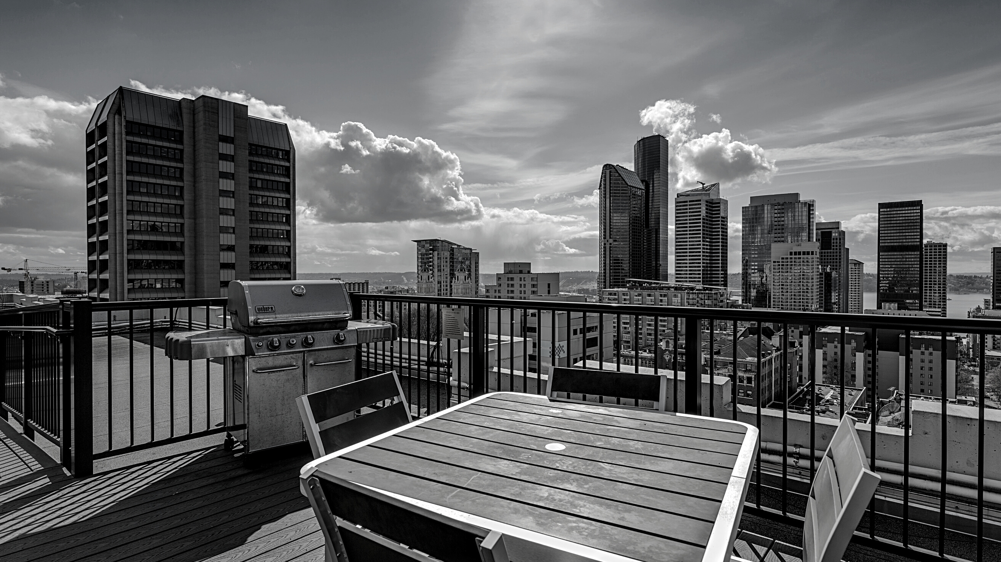
TOP AGENTS + TOP TEAMS
VENICE/ MARINA DEL REY

Slide 8
VENICE/ MARINA DEL REY
Top Solo Agents
#1
Robin Dahlstrom
Lindsey Brooks
Michael Kayem
#2
#3

Slide 9
VENICE/ MARINA DEL REY
Top Team
Berman Kandel Team
#1

Slide 10
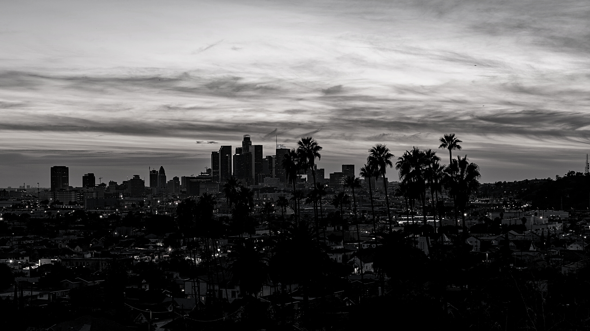
TOP AGENTS + TOP TEAMS
WEST LOS ANGELES

Slide 11
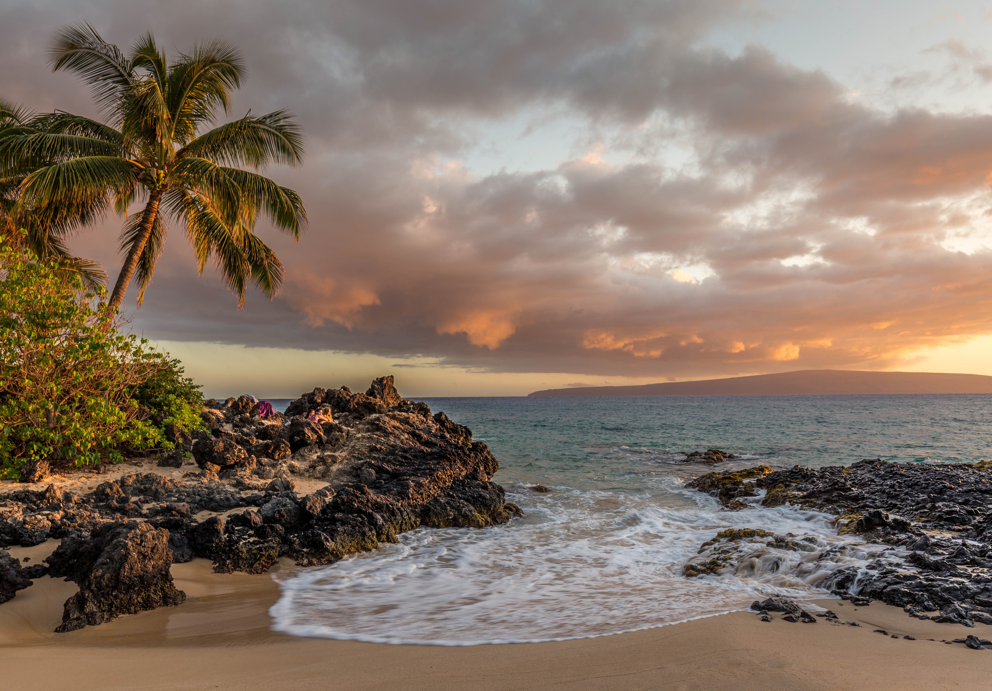
WEST LOS ANGELES
Top Solo Agents
#1
Reid Kaplan
Michele Walman
John Capiro
#2
#3

Slide 12
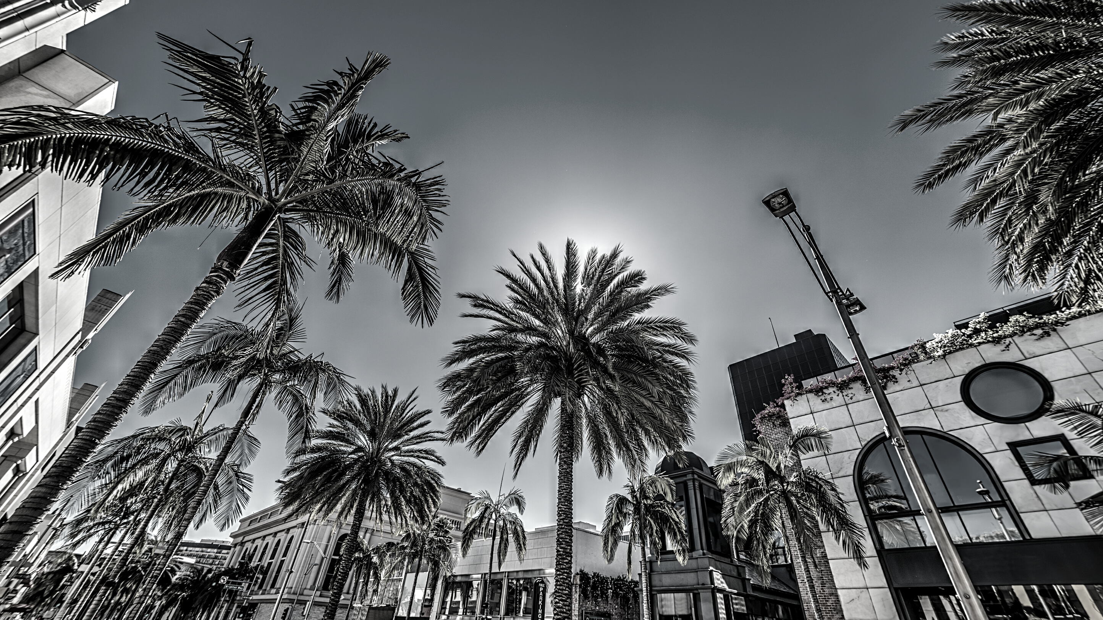
TOP AGENTS + TOP TEAMS
BEVERLY HILLS

Slide 13
BEVERLY HILLS
Top Solo Agents
#1
Saul Larner

Slide 14
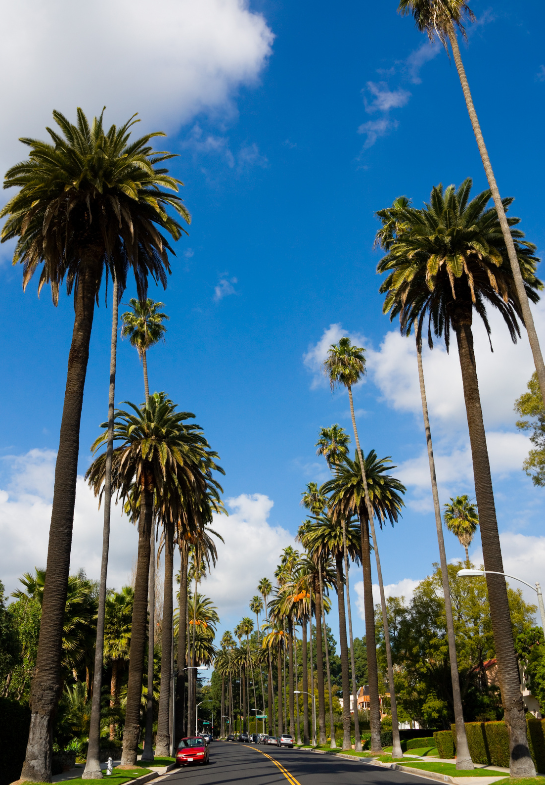
BEVERLY HILLS
Top Team
#1
Pacific Porfolio Properties

Slide 15
TOP AGENTS + TOP TEAMS
HIGHLAND

Slide 16
HIGHLAND
Top Solo Agents
#1
Jane Sager
Mike Pennings
Charles Fisher
#2
#3

Slide 17
HIGHLAND
Top Team
#1
Team McGuire
The Lemieux-Stott Team
#2

Slide 18
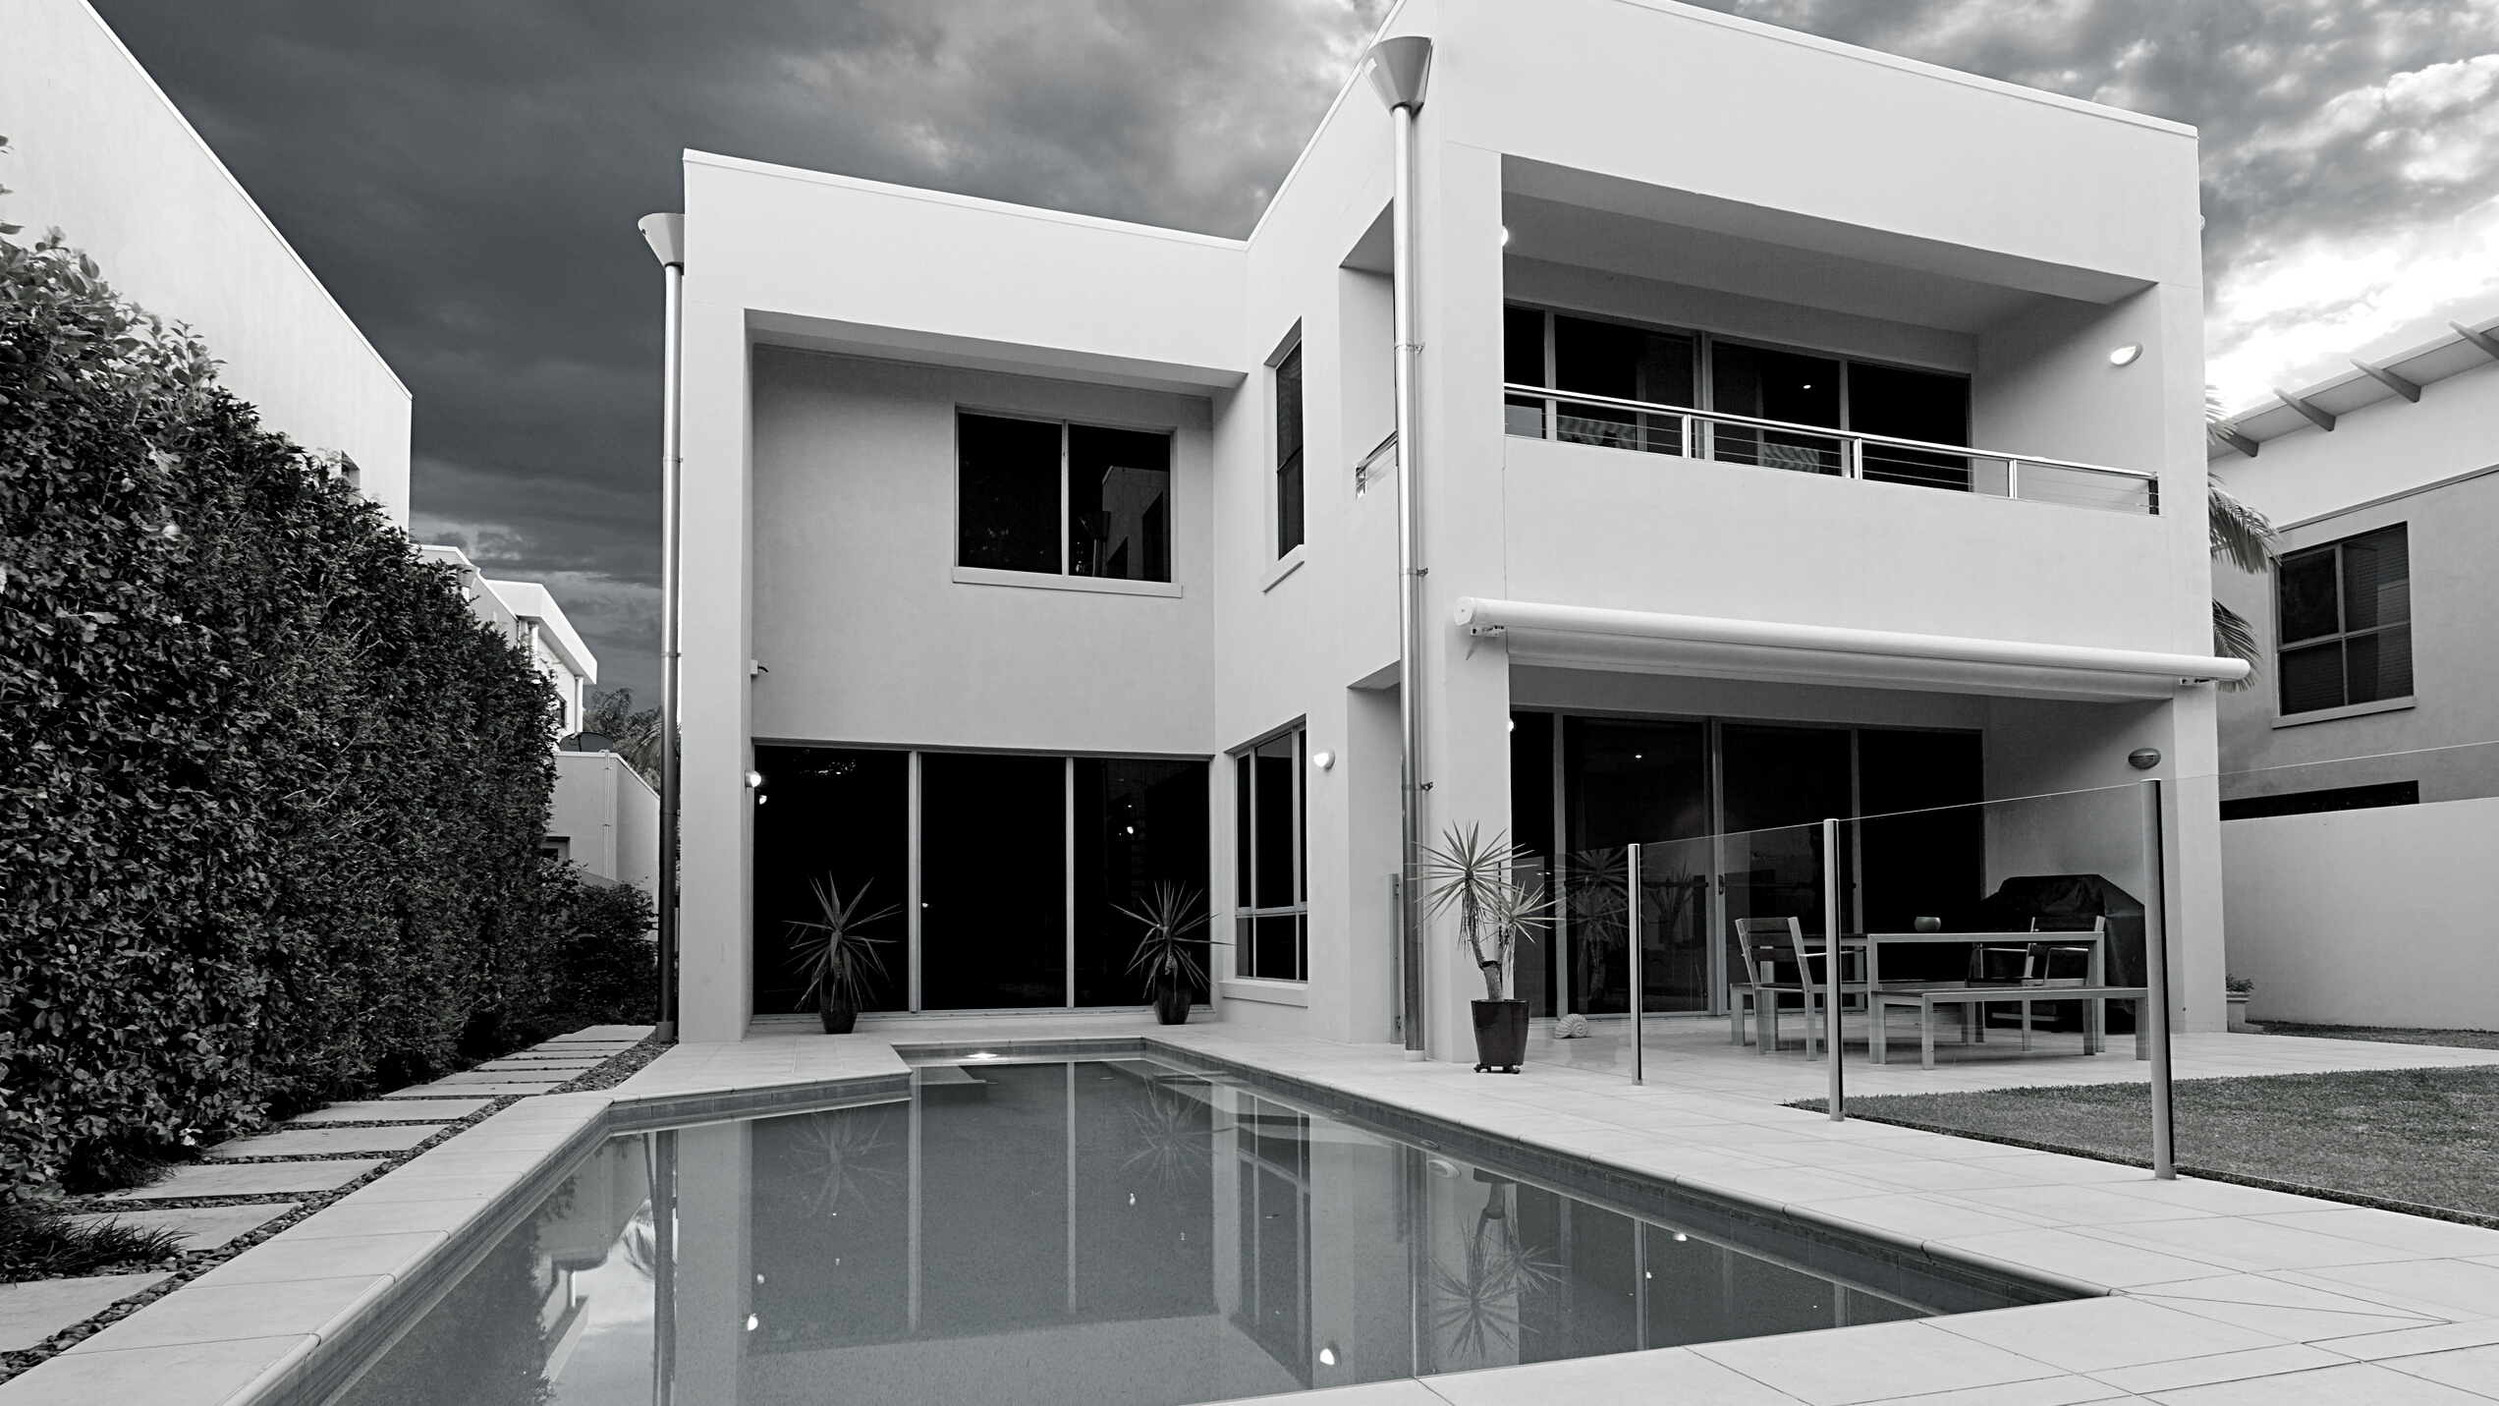
TOP AGENTS + TOP TEAMS
SILICON BEACH

Slide 19
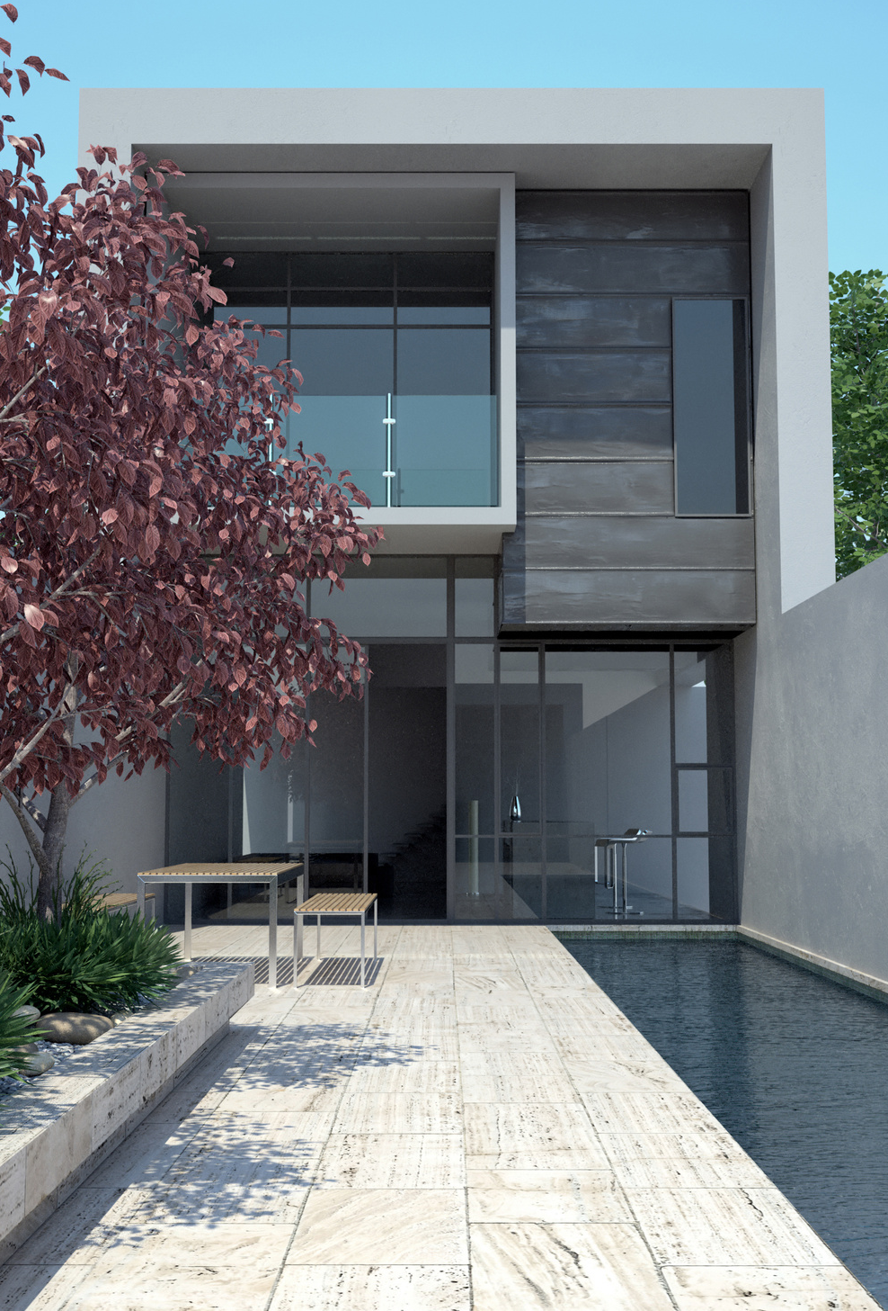
SILICON BEACH
Top Solo Agents
#1
Justin Dutchover
Theresa Lehr
Laura Mattick
#2
#3

Slide 20
SILICON BEACH
Top Teams
#1
RCRE Group
The Williamson & Pagan Group
Alex and Kate Eychis Team
#2
#3

Slide 21
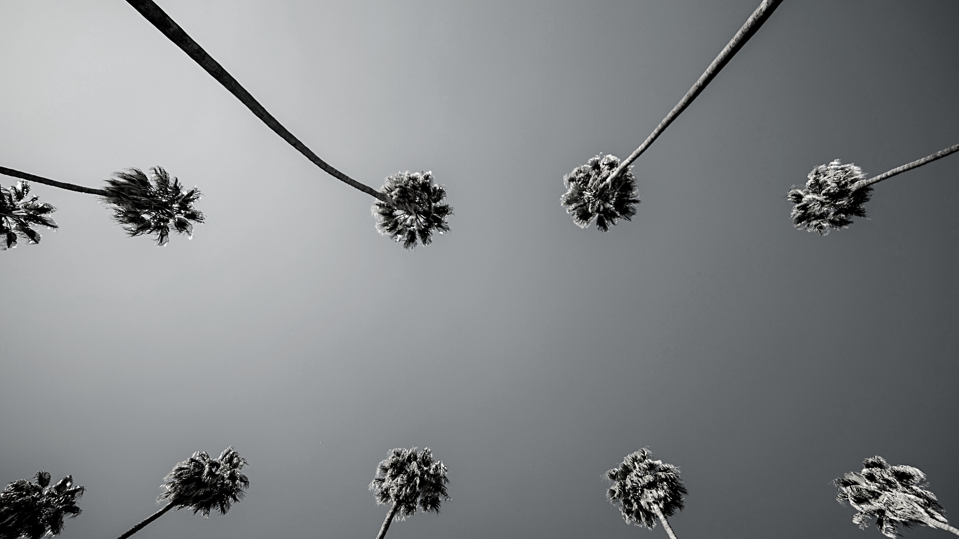
TOP AGENTS + TOP TEAMS
MALGA COVE

Slide 22
MALAGA COVE
Top Solo Agents
#1
Jackie Wang-Dojiri
Elaine Carlson
Steve Simonetti
#2
#3

Slide 23
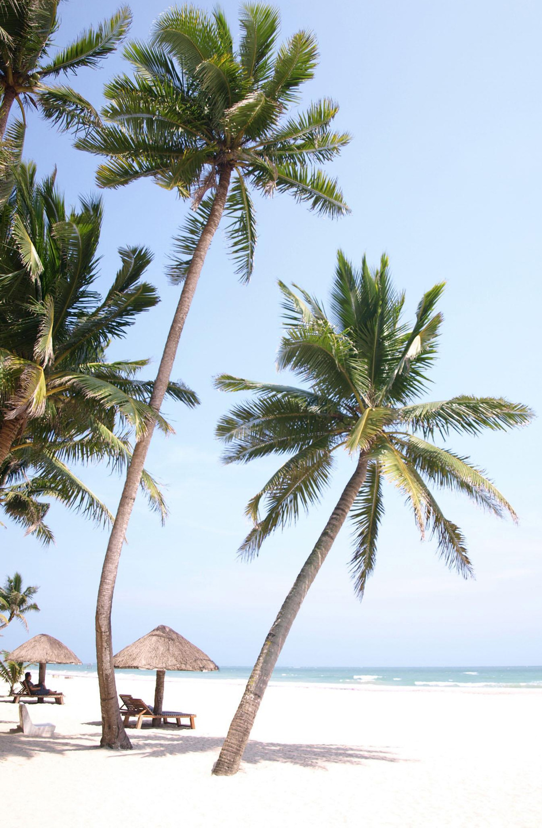
MALAGA COVE
Top Teams
#1
The Chamberlain Team

Slide 24
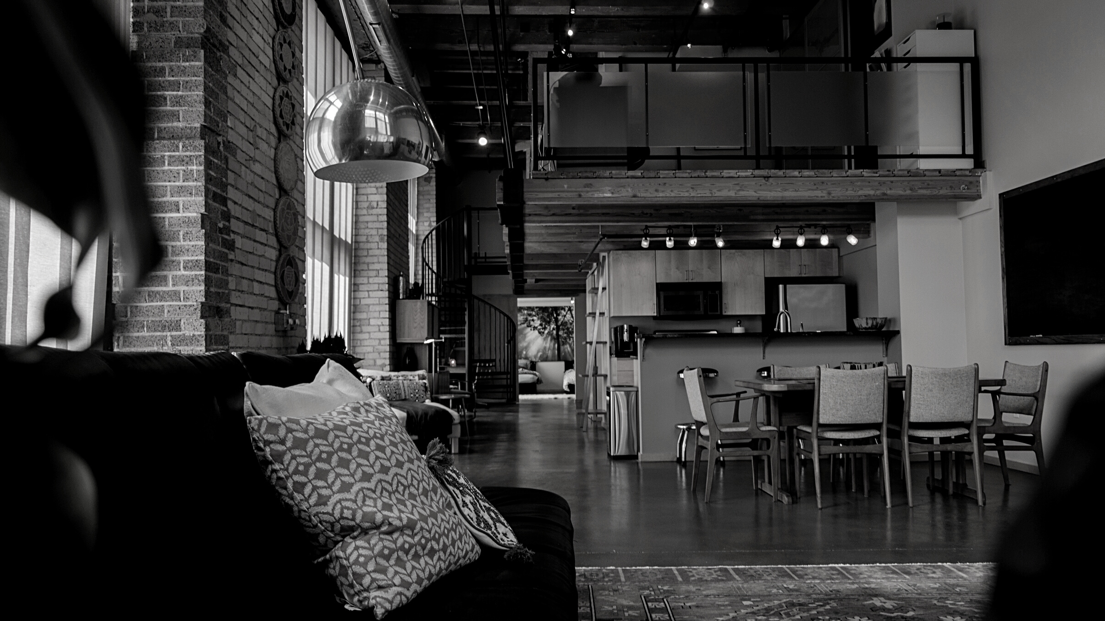
TOP AGENTS + TOP TEAMS
MIRALESTE

Slide 25
MIRALESTE
Top Solo Agents
#1
Sunny Rahmani
Letty Rivera
Shari Bakotich
#2
#3

Slide 26
MIRALESTE
Top Teams
#1
Jerry and Laura Yutronich Team

Slide 27
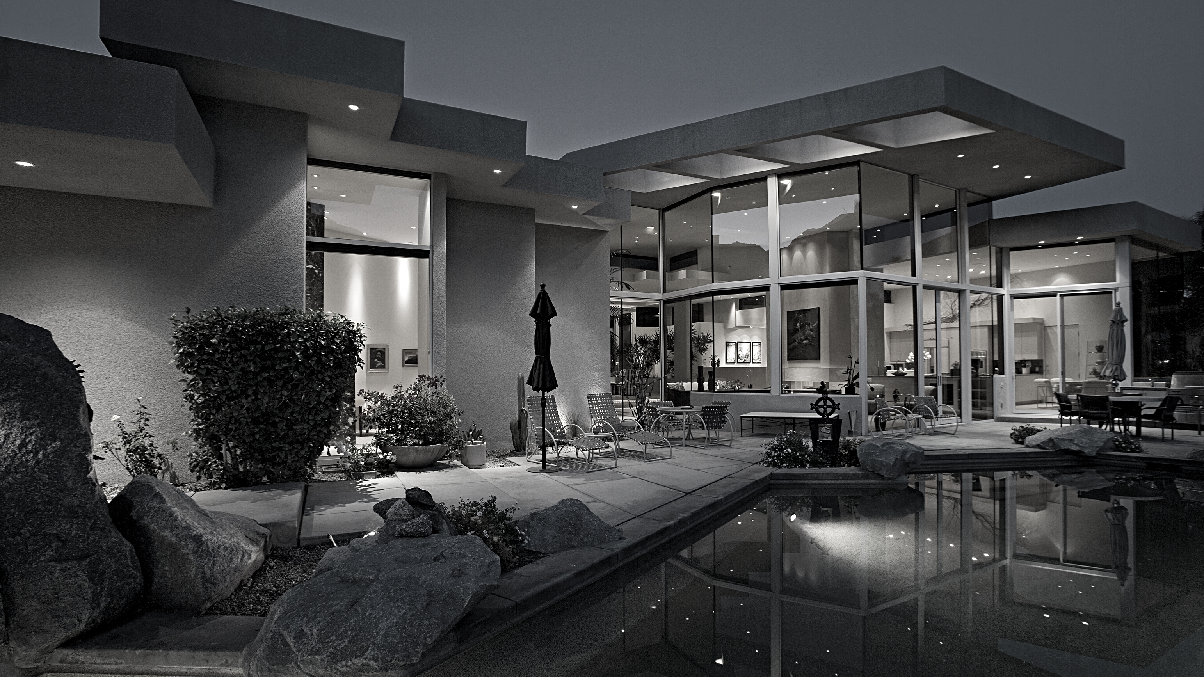
TOP AGENTS + TOP TEAMS
SILVER SPUR

Slide 28
SILVER SPUR
Top Solo Agents
#1
Lynn Lord
Pete Stefanelli
Michele Nelson
#2
#3

Slide 29
SILVER SPUR
Top Teams
#1
Cindy & Tiffany Kawata Team
Kirby Larson & Haley Larson
#2

Slide 30
TOP AGENTS + TOP TEAMS
SOUTH BAY

Slide 31
SOUTH BAY
Top Solo Agents
#1
Ken Conant
Tiffany McGuinness
Paul Yu
#2
#3

Slide 32
SOUTH BAY
Top Solo Team
#1
Manny & Marie Archondo

Slide 33
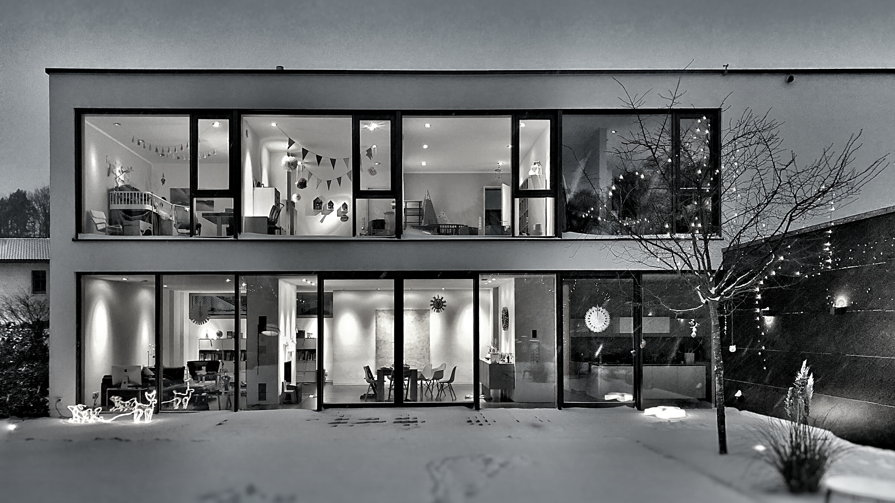
TOP AGENTS + TOP TEAMS
REDONDO BEACH

Slide 34
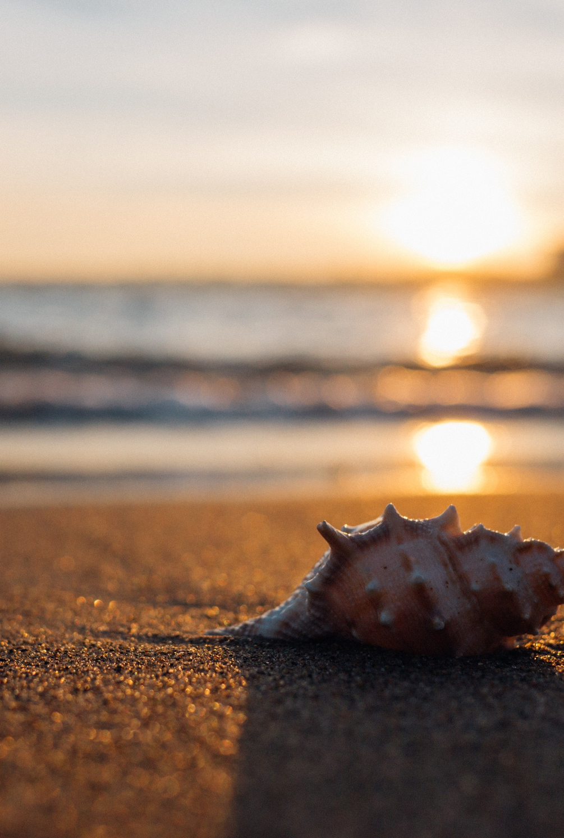
REDONDO BEACH
Top Solo Agents
#1
Mindy Fang
Risa Myers
Liz Broen
#2
#3

