Slide 1
RE/MAX ESTATE PROPERTIES
TOP PRODUCERS
NOVEMBER 2021
Presented by James Sanders

Slide 2
TOP AGENTS + TOP TEAMS
MANHATTAN BEACH

Slide 3
MANHATTAN BEACH
Top Solo Agents
#1
Dan Boag
Beau Lazar
Jay Deai
#2
#3

Slide 4
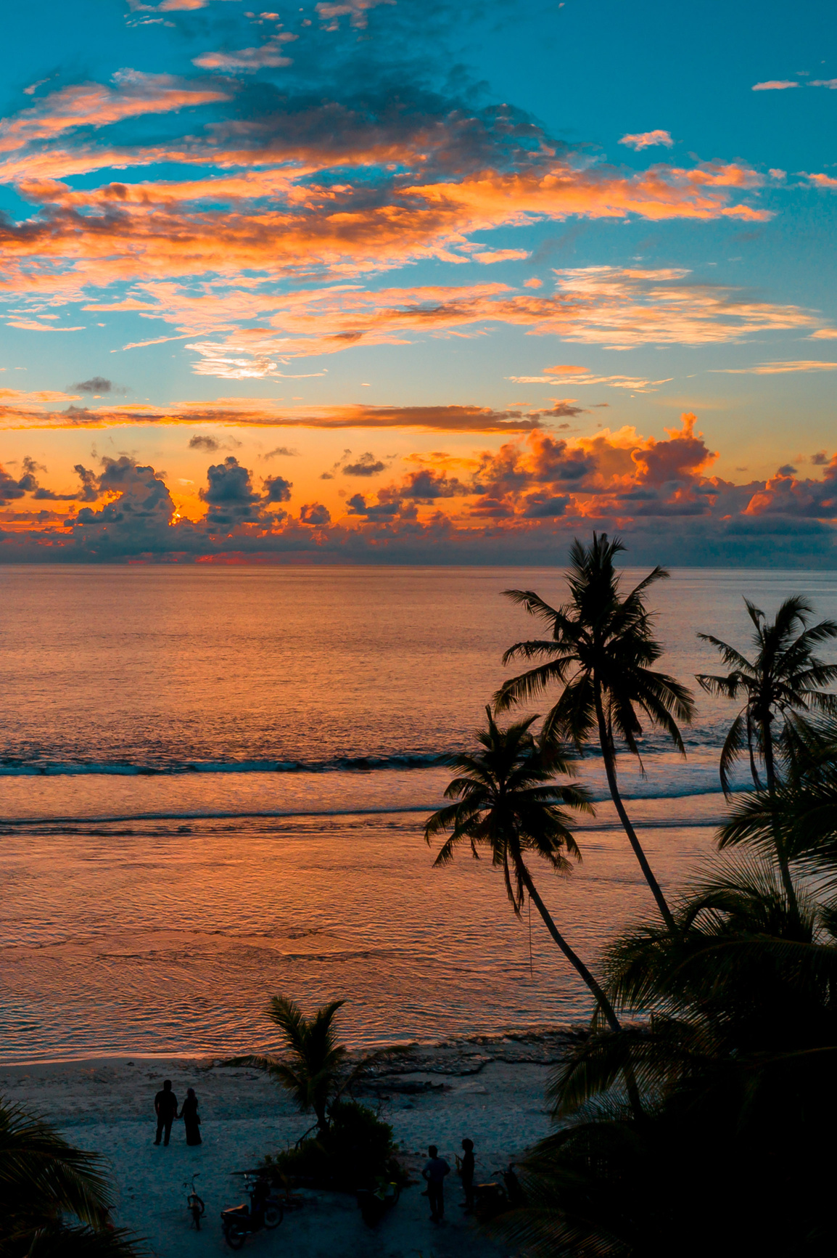
MANHATTAN BEACH
Top Teams
#1
The DOR Group

Slide 5
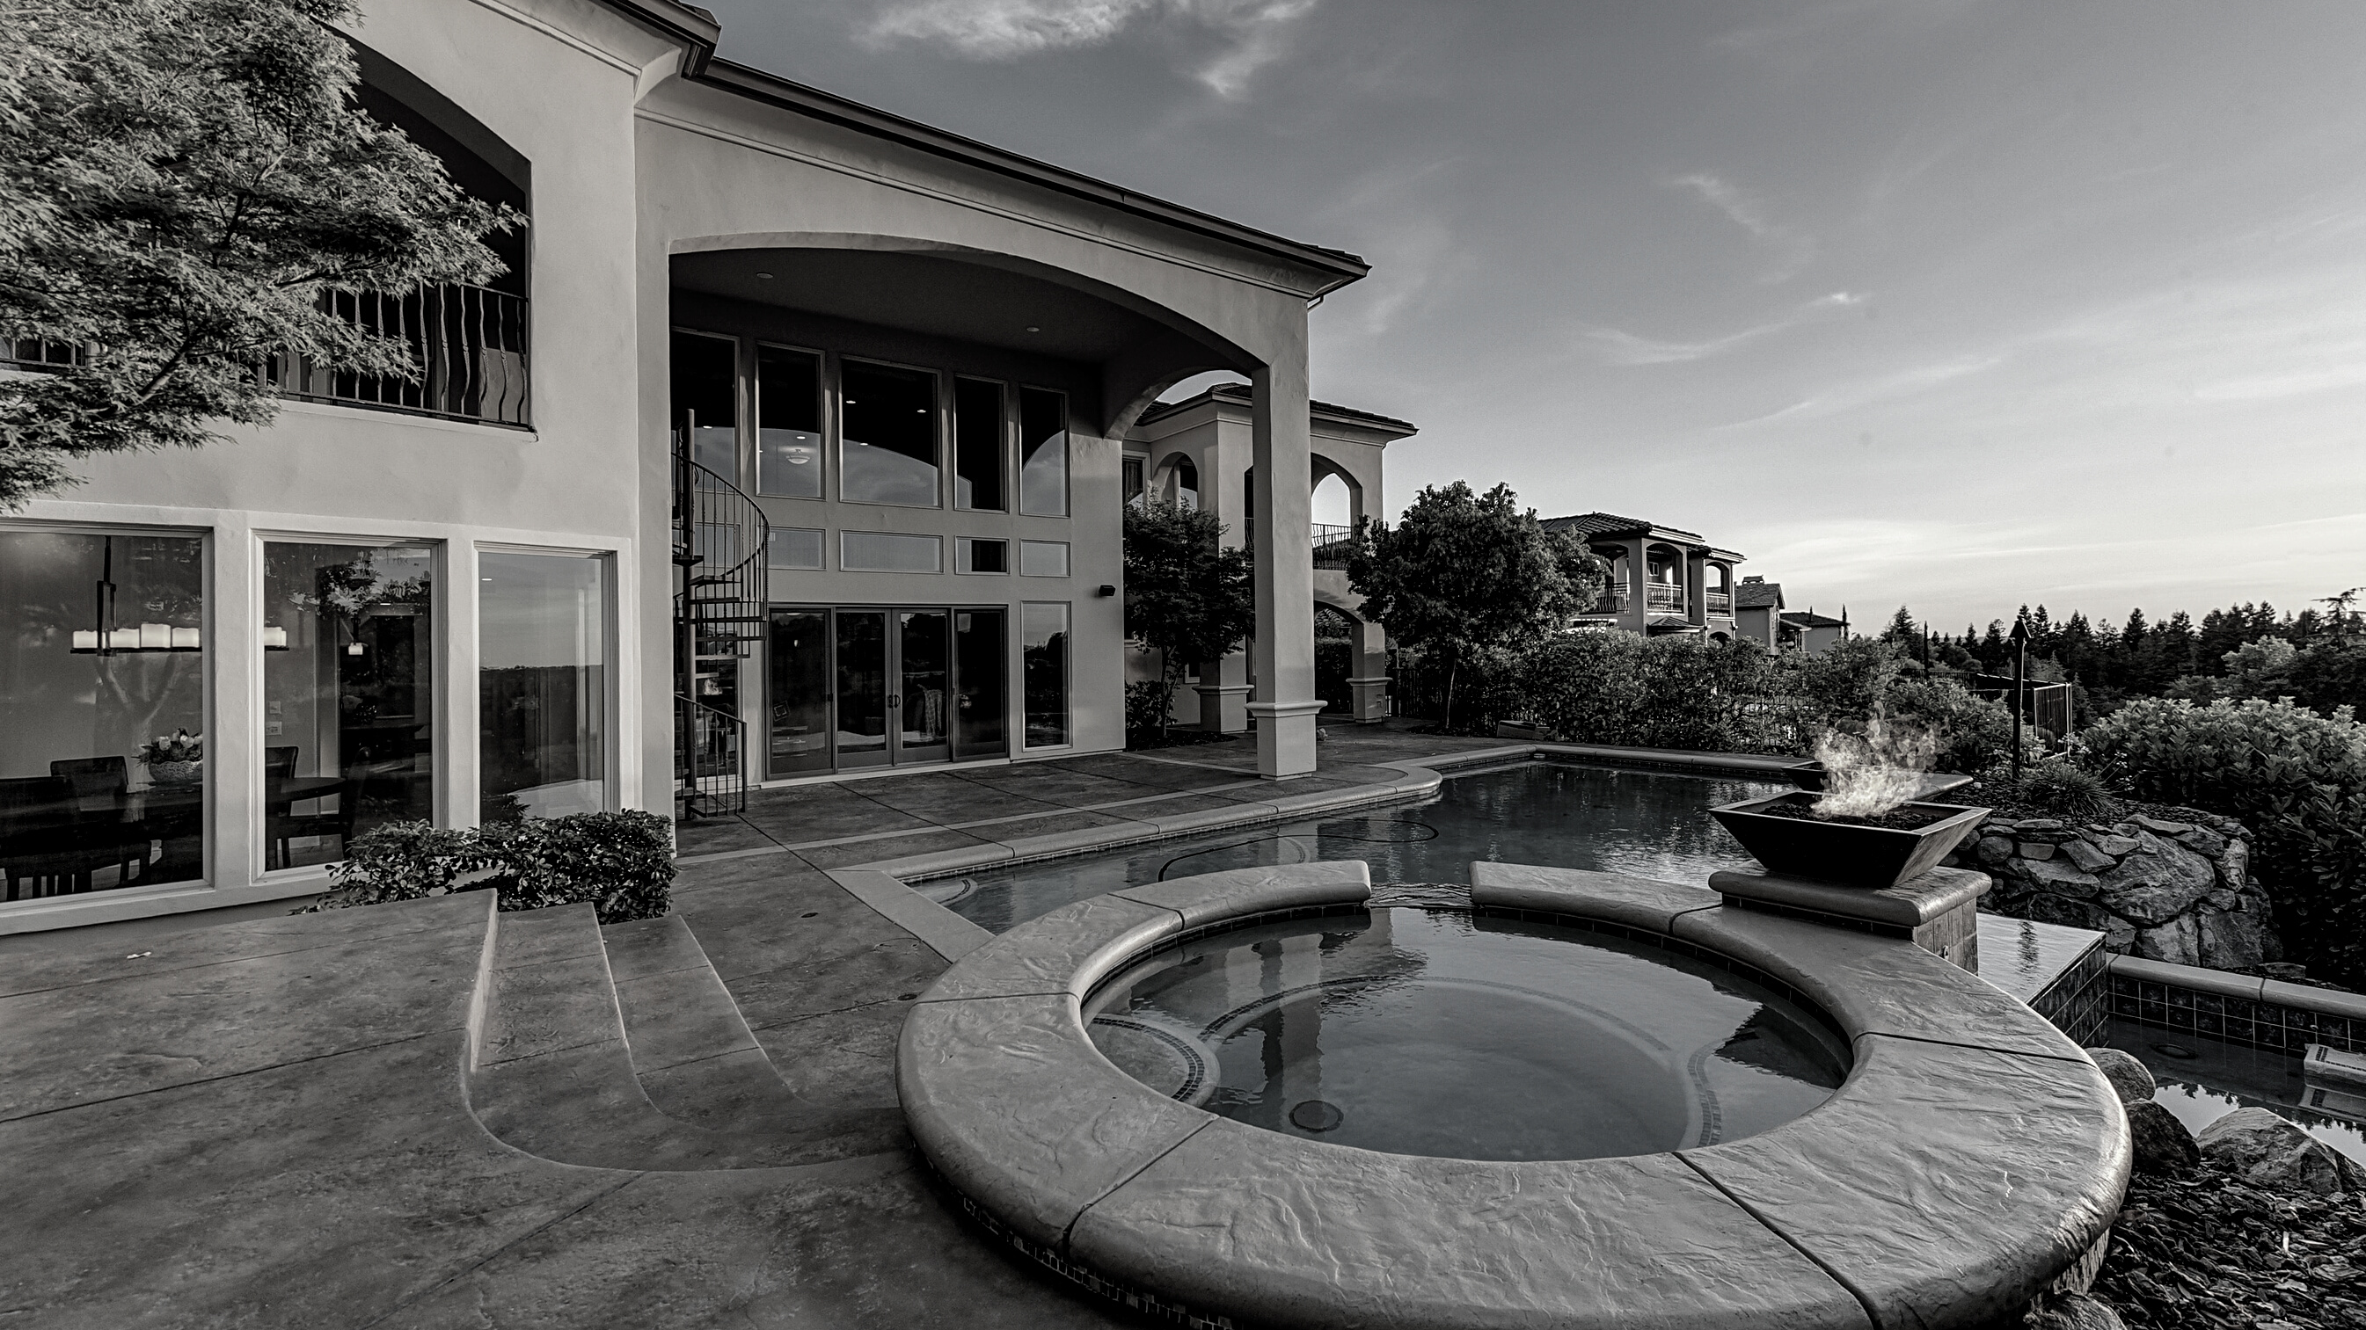
TOP AGENTS + TOP TEAMS
EL SEGUNDO

Slide 6
EL SEGUNDO
Top Teams
#1
Bill Ruane
Jim Marak
De Ann Eccles
#2
#3

Slide 7
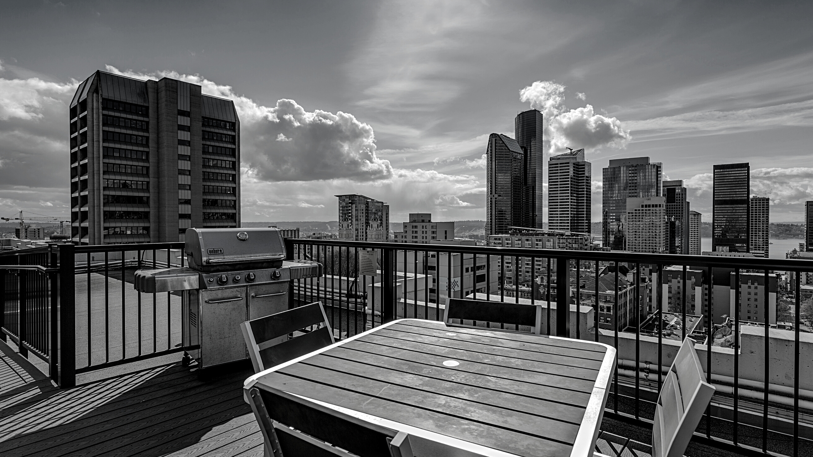
TOP AGENTS + TOP TEAMS
VENICE/ MARINA DEL REY

Slide 8
VENICE/ MARINA DEL REY
Top Solo Agents
#1
Terri Davis
J.D. Songstad
Jane St. John
#2
#3

Slide 9
VENICE/ MARINA DEL REY
Top Team
The Berman Kandel Team
#1

Slide 10
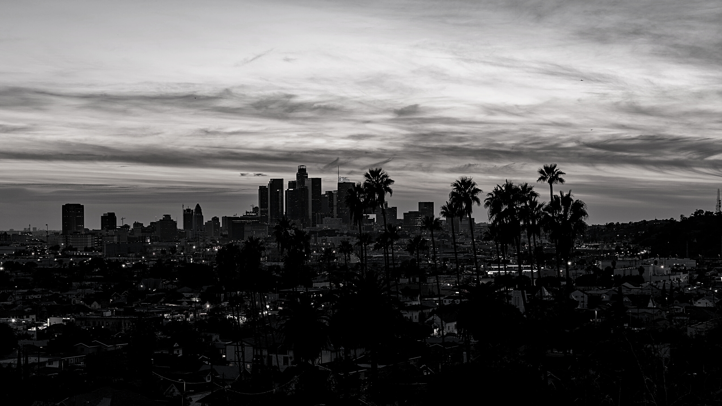
TOP AGENTS + TOP TEAMS
WEST LOS ANGELES

Slide 11
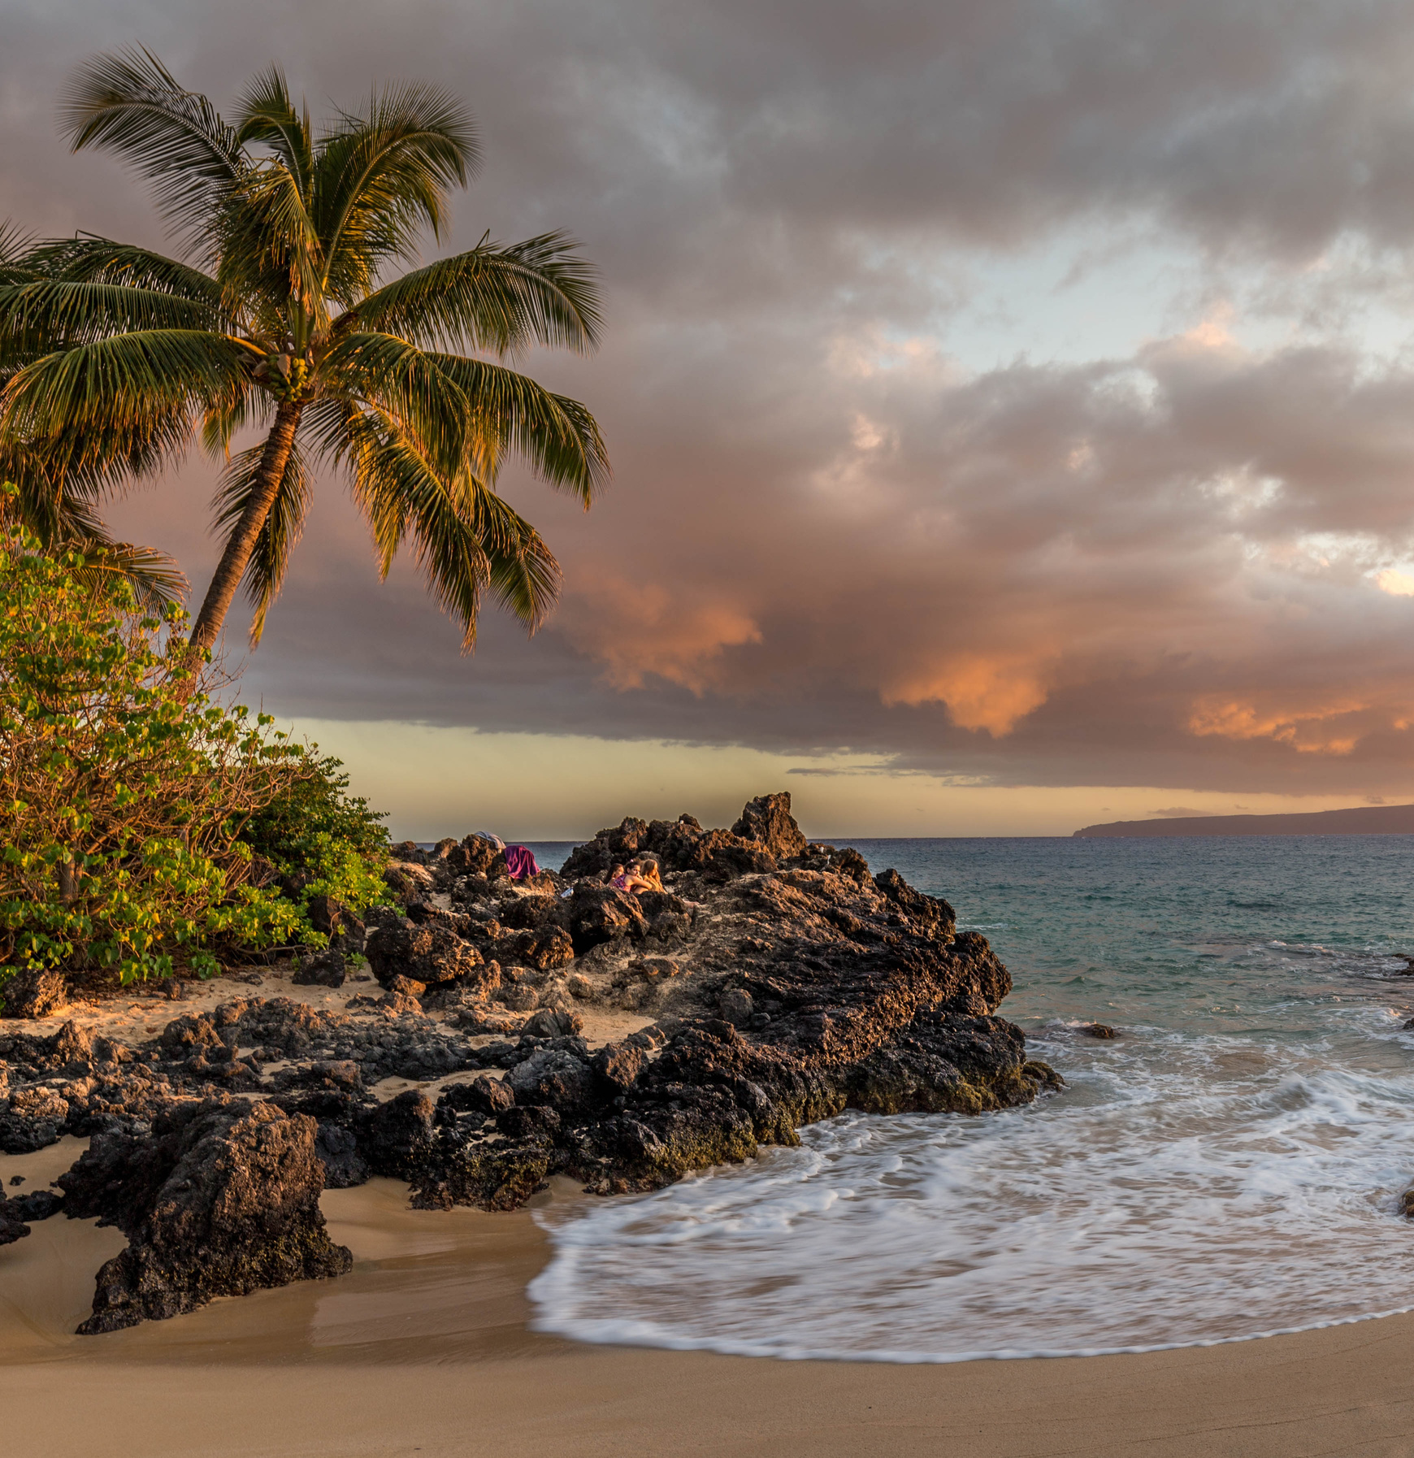
WEST LOS ANGELES
Top Solo Agents
#1
Jose Fregoso
Michele Walman
Elizabeth Marquart
#2
#3

Slide 12
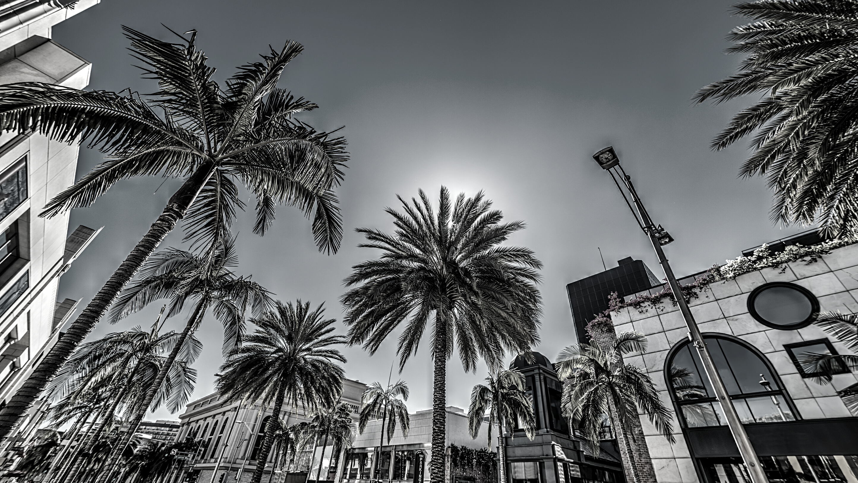
TOP AGENTS + TOP TEAMS
BEVERLY HILLS

Slide 13
BEVERLY HILLS
Top Solo Agents
#1
Mary Chiu

Slide 14
TOP AGENTS + TOP TEAMS
HIGHLAND

Slide 15
HIGHLAND
Top Solo Agents
#1
Jane Sager
Mike Pennings
Gerry Athas-Vazquez
#2
#3

Slide 16
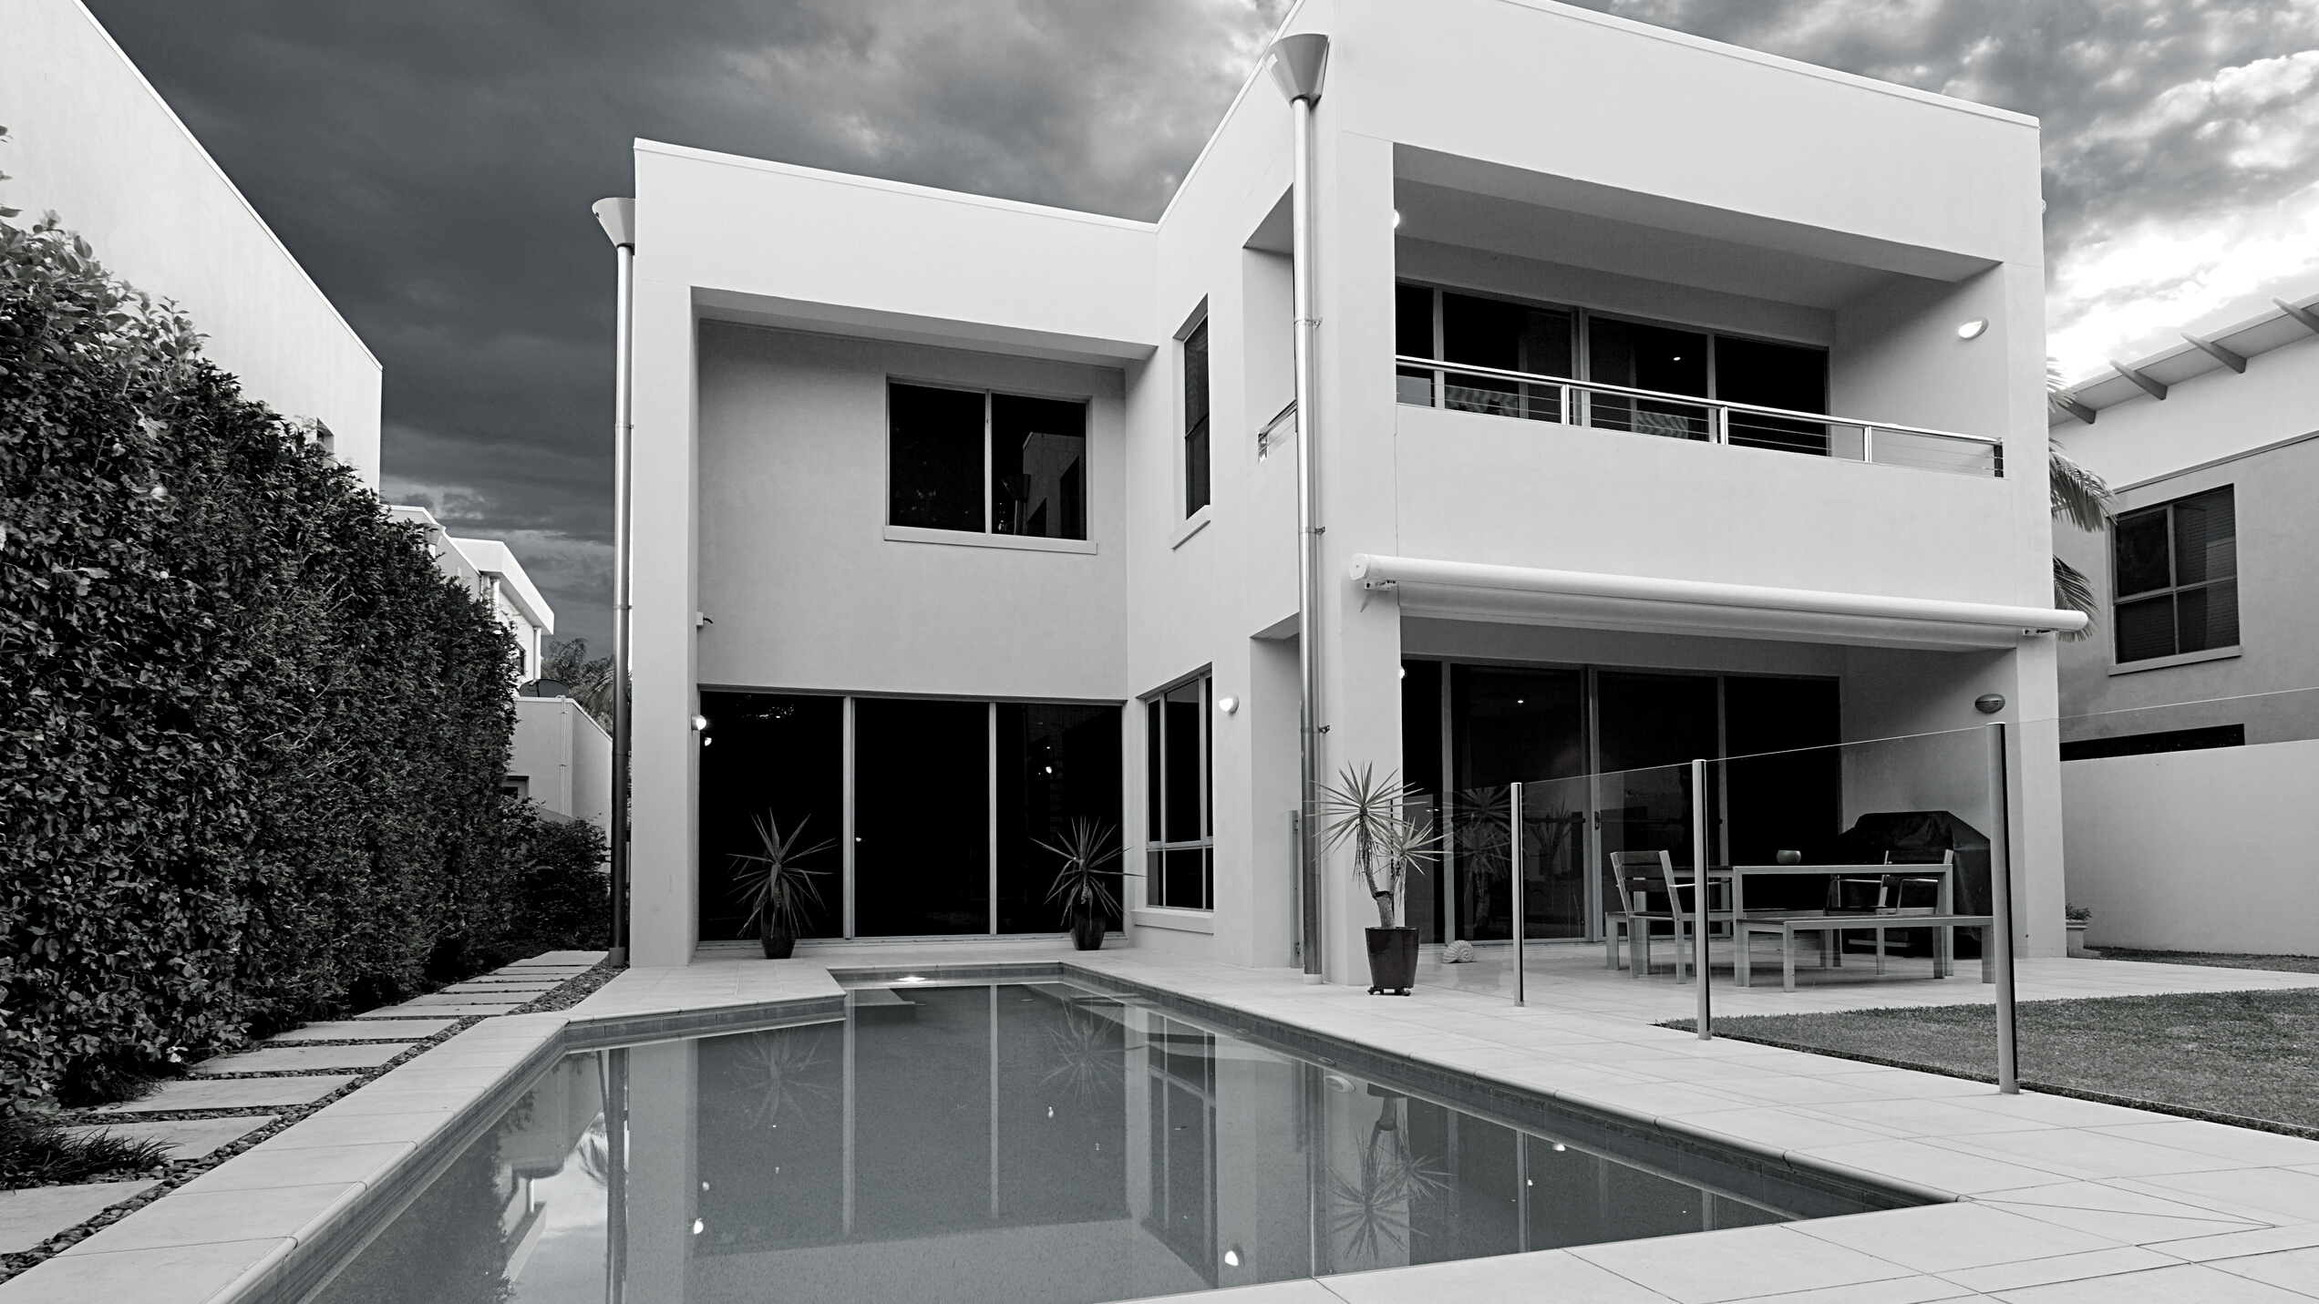
TOP AGENTS + TOP TEAMS
SILICON BEACH

Slide 17
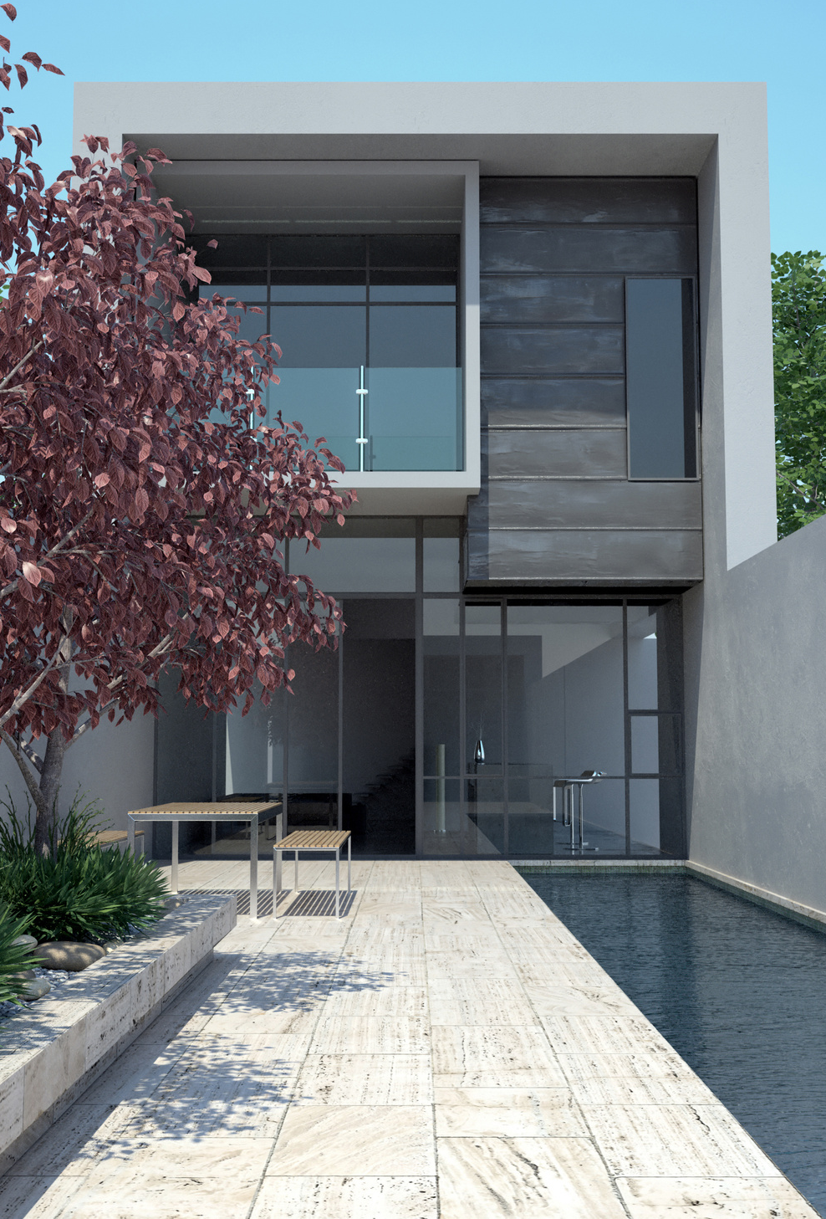
SILICON BEACH
Top Solo Agents
#1
Elizabeth Campos Layne
Theresa Lehr
Carl Izbicki
#2
#3

Slide 18
SILICON BEACH
Top Teams
#1
Kevin and Kaz Gallaher Team

Slide 19
TOP AGENTS + TOP TEAMS
MALGA COVE

Slide 20
MALAGA COVE
Top Solo Agents
#1
Jackie Wang-Dojiri
Michael Talbot
Tuba Ghannadi
#2
#3

Slide 21
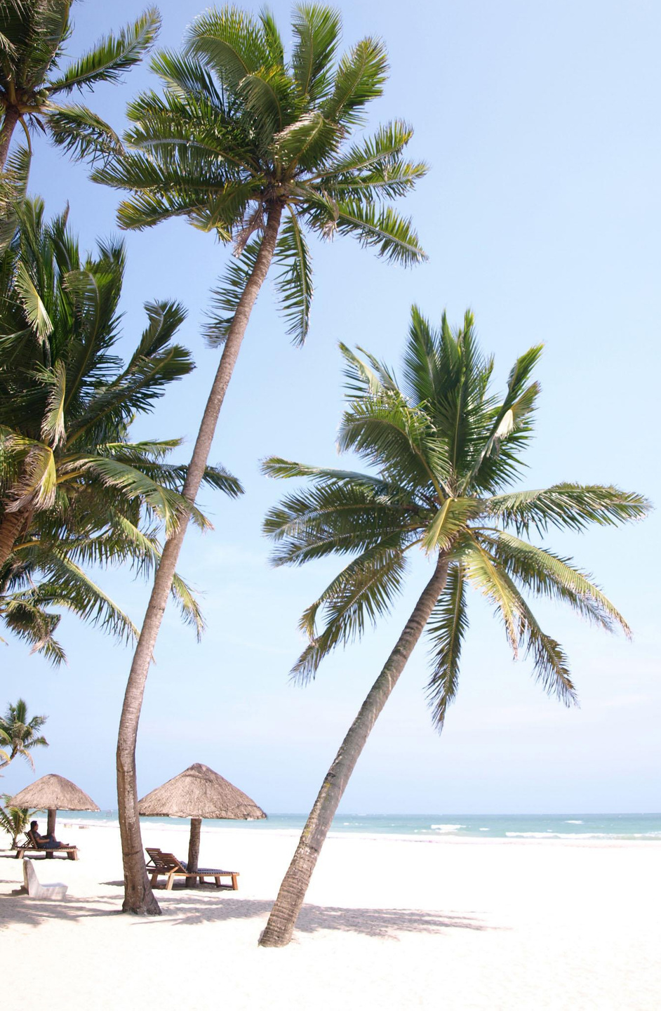
MALAGA COVE
Top Teams
#1
Kelly Evans & Laura Medina
The Tyndall Team
The Chamberlain Team
#2
#3

Slide 22
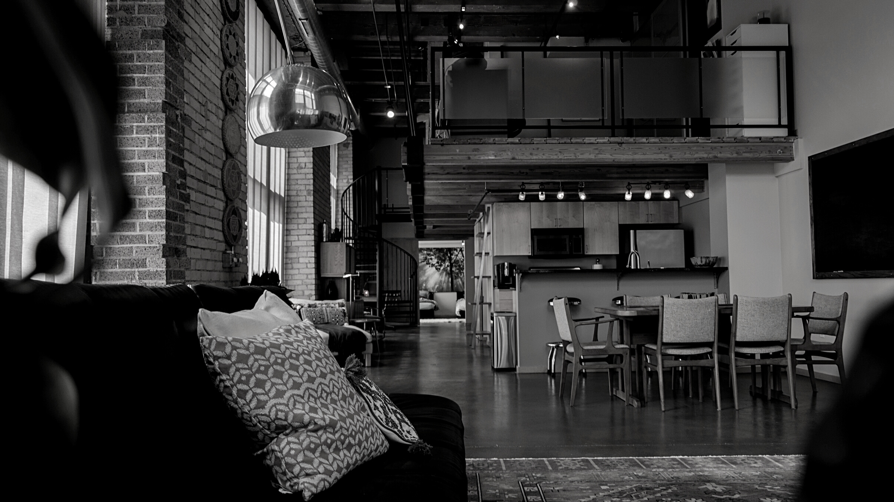
TOP AGENTS + TOP TEAMS
MIRALESTE

Slide 23
MIRALESTE
Top Solo Agents
#1
Sheri McHale
Gordon Teuber
Letty Rivera
#2
#3

Slide 24
MIRALESTE
Top Teams
#1
Jerry and Laura Yutronich Team
The Todora Team
#2

Slide 25
TOP AGENTS + TOP TEAMS
SILVER SPUR

Slide 26
SILVER SPUR
Top Solo Agents
#1
Kevin Moen
Gayle Probst
Johannes Steinbeck
#2
#3

Slide 27
SILVER SPUR
Top Teams
#1
Kirby Larson & Haley Larson
Sean & Jon Rodriguez
#2

Slide 28
TOP AGENTS + TOP TEAMS
SOUTH BAY

Slide 29
SOUTH BAY
Top Solo Agents
#1
Ken Conant
Tiffany McGuinness
Paul Yu
#2
#3

Slide 30
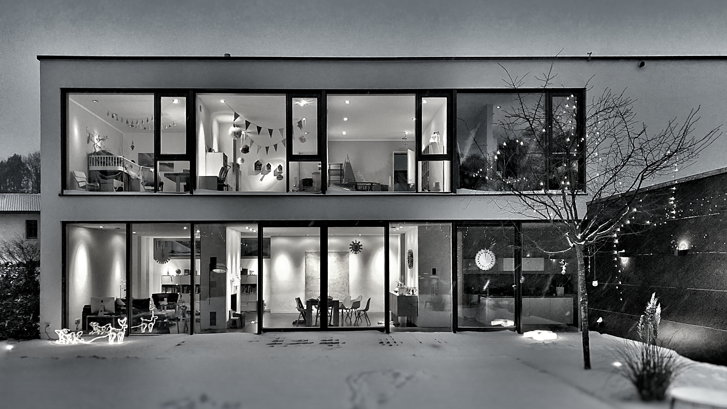
TOP AGENTS + TOP TEAMS
REDONDO BEACH

Slide 31
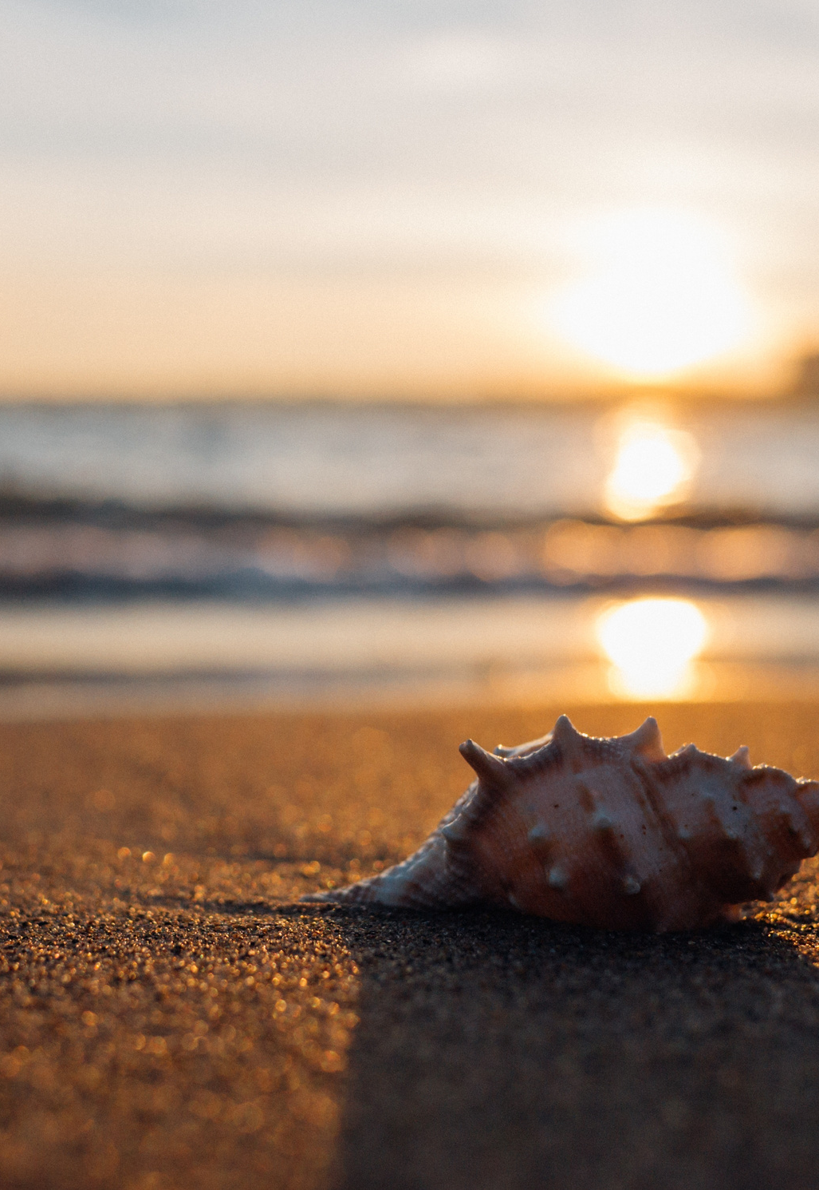
REDONDO BEACH
Top Solo Agents
#1
Nicole Stober
Mickey Turner
Mindy Fang
#2
#3

