Slide 1
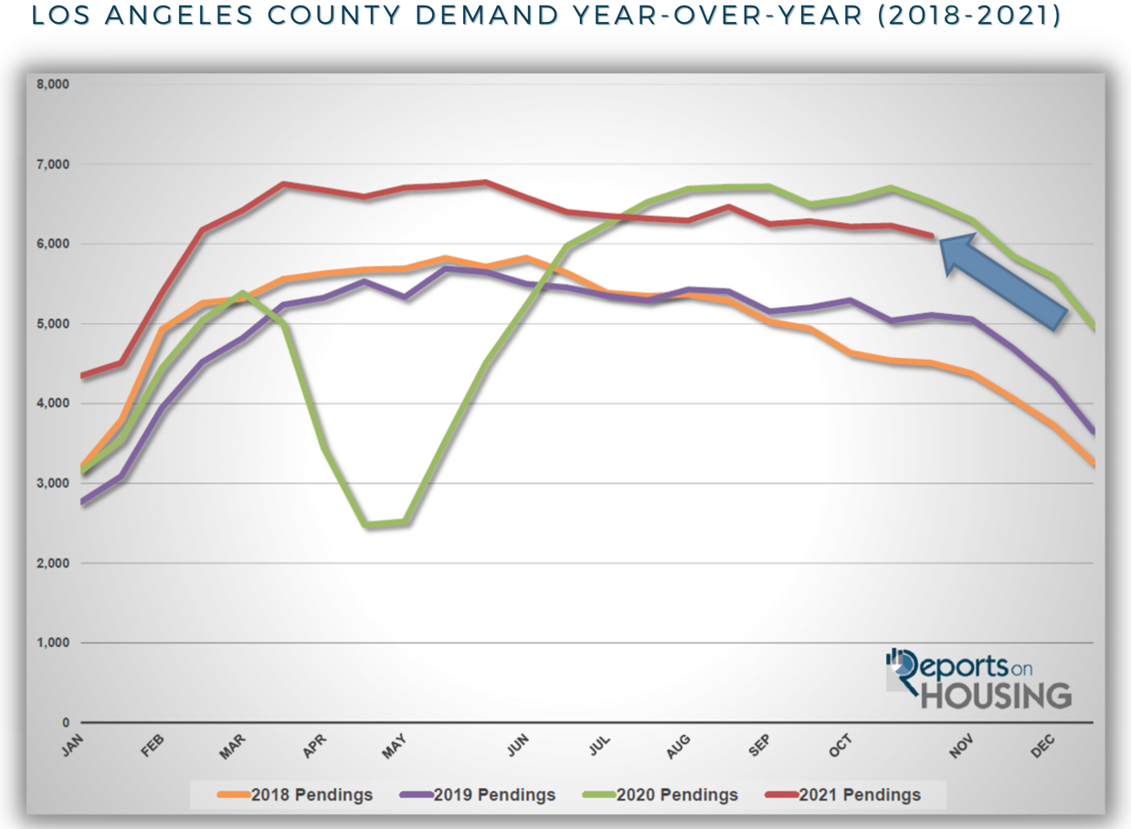

Slide 2
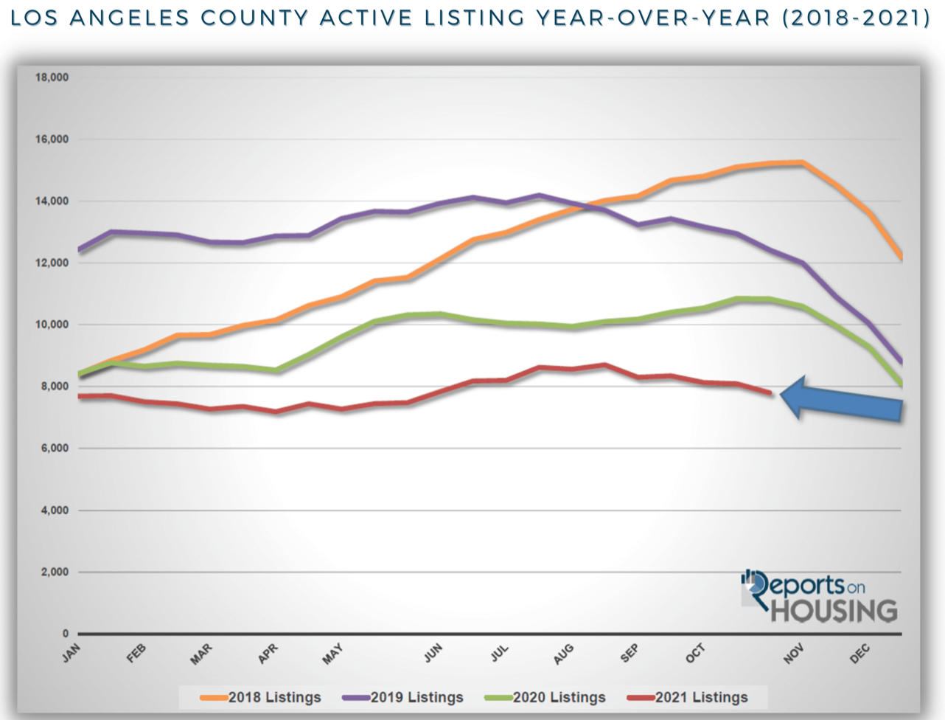

Slide 4
R E / M A X E S T A T E P R O P E R T I E S
TOP PRODUCERS OCTOBER 2021
Presented by James Sanders

Slide 5
TOP AGENTS + TOP TEAMS
MANHATTAN BEACH

Slide 6
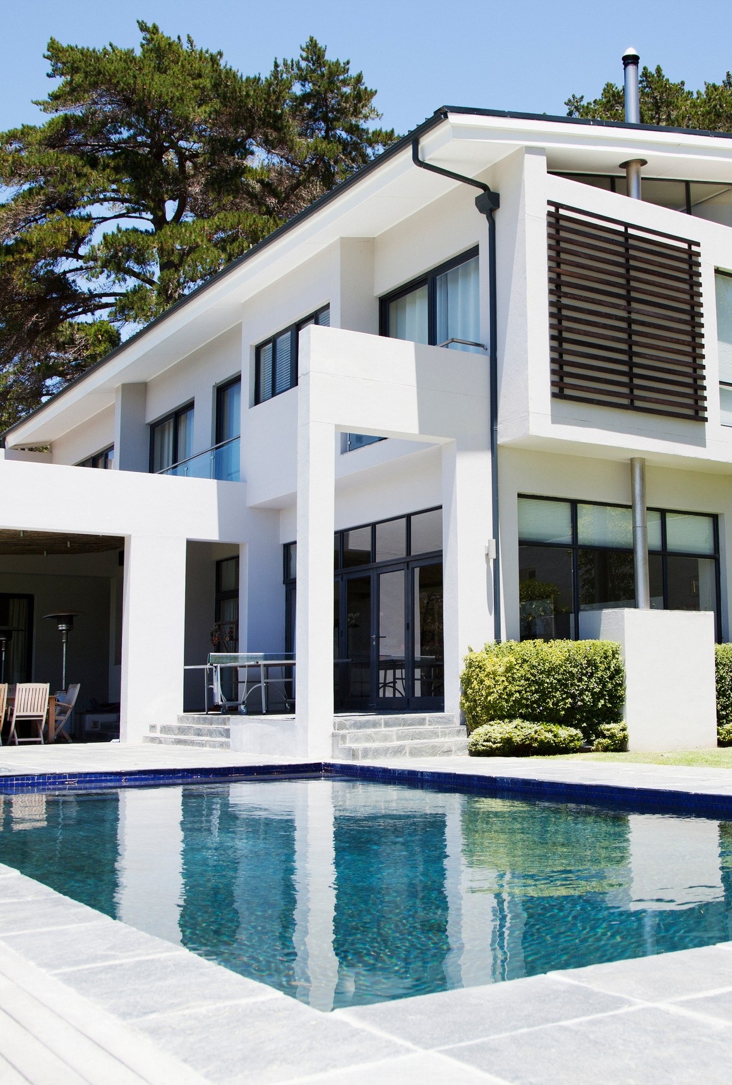
MANHATTAN BEACH
Top Solo Agents
#1 Lauren Perreault
#2 Sheri Kapust
#3 Susan Sweeney

Slide 7
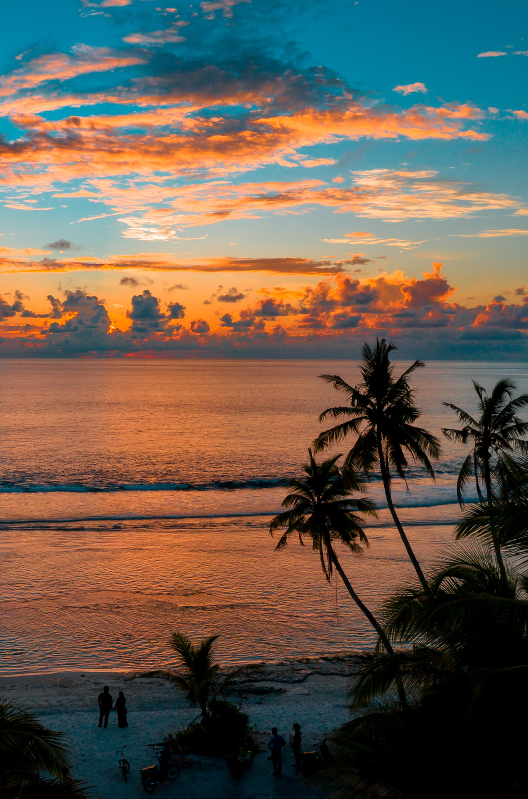
MANHATTAN BEACH
Top Teams
#1 Beach Living Group
#2 The DOR Group

Slide 8
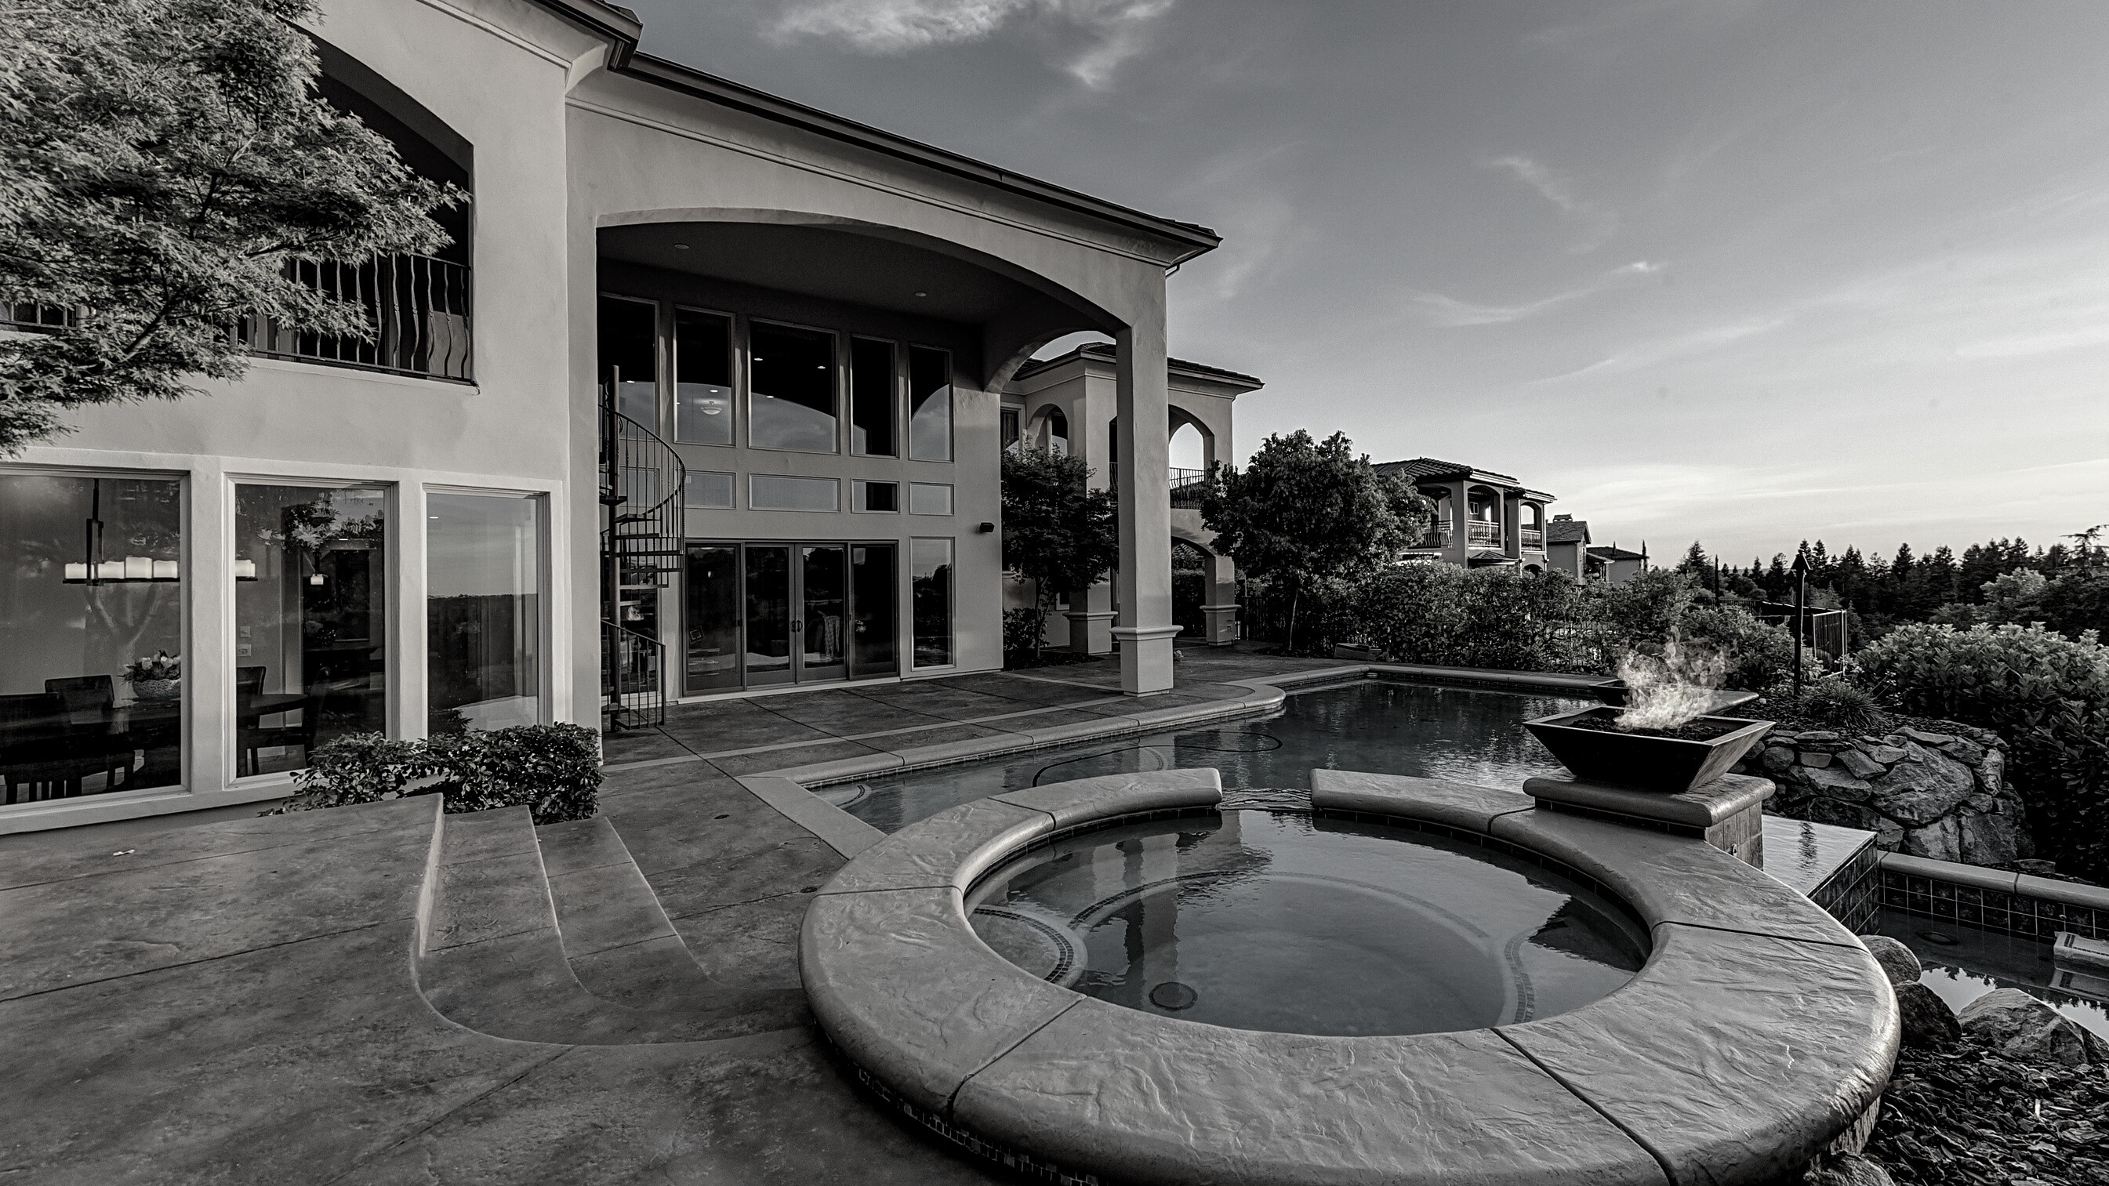
TOP AGENTS + TOP TEAMS
EL SEGUNDO

Slide 9
EL SEGUNDO
Top Teams
#1
Bill Ruane
#2 De Ann Eccles

Slide 10
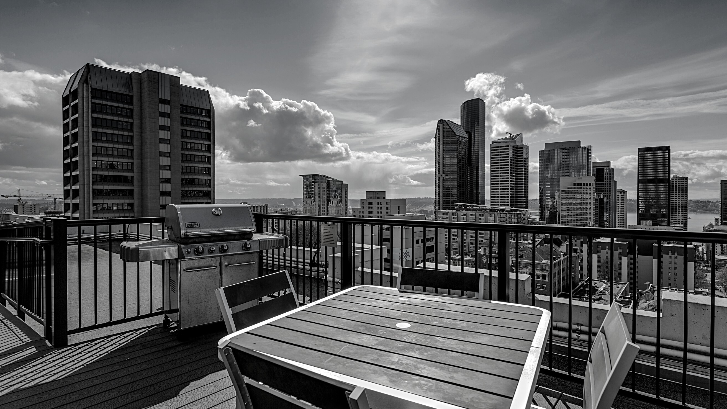
TOP AGENTS + TOP TEAMS
VENICE/ MARINA DEL REY

Slide 11
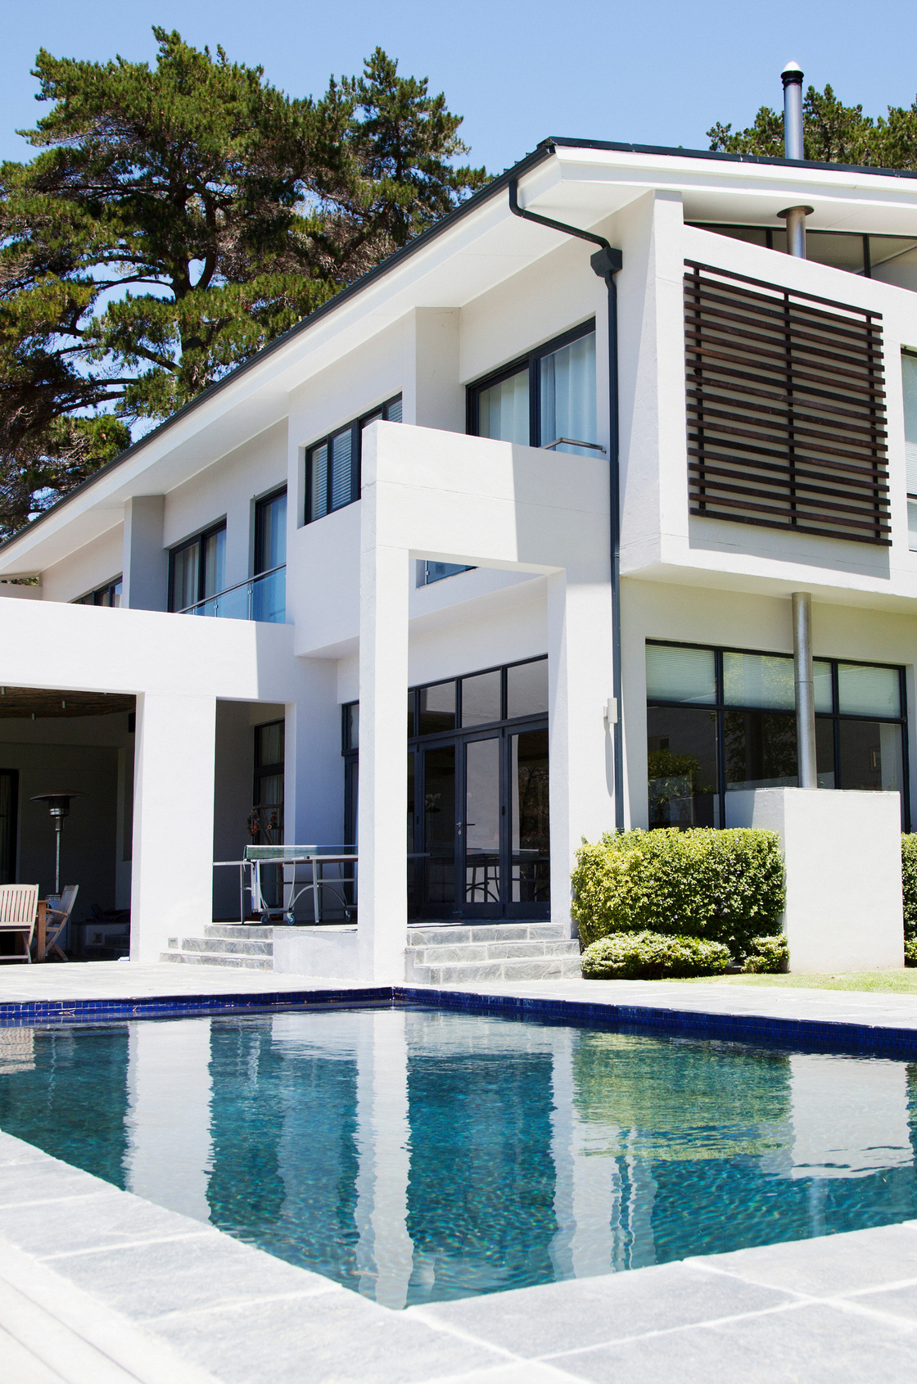
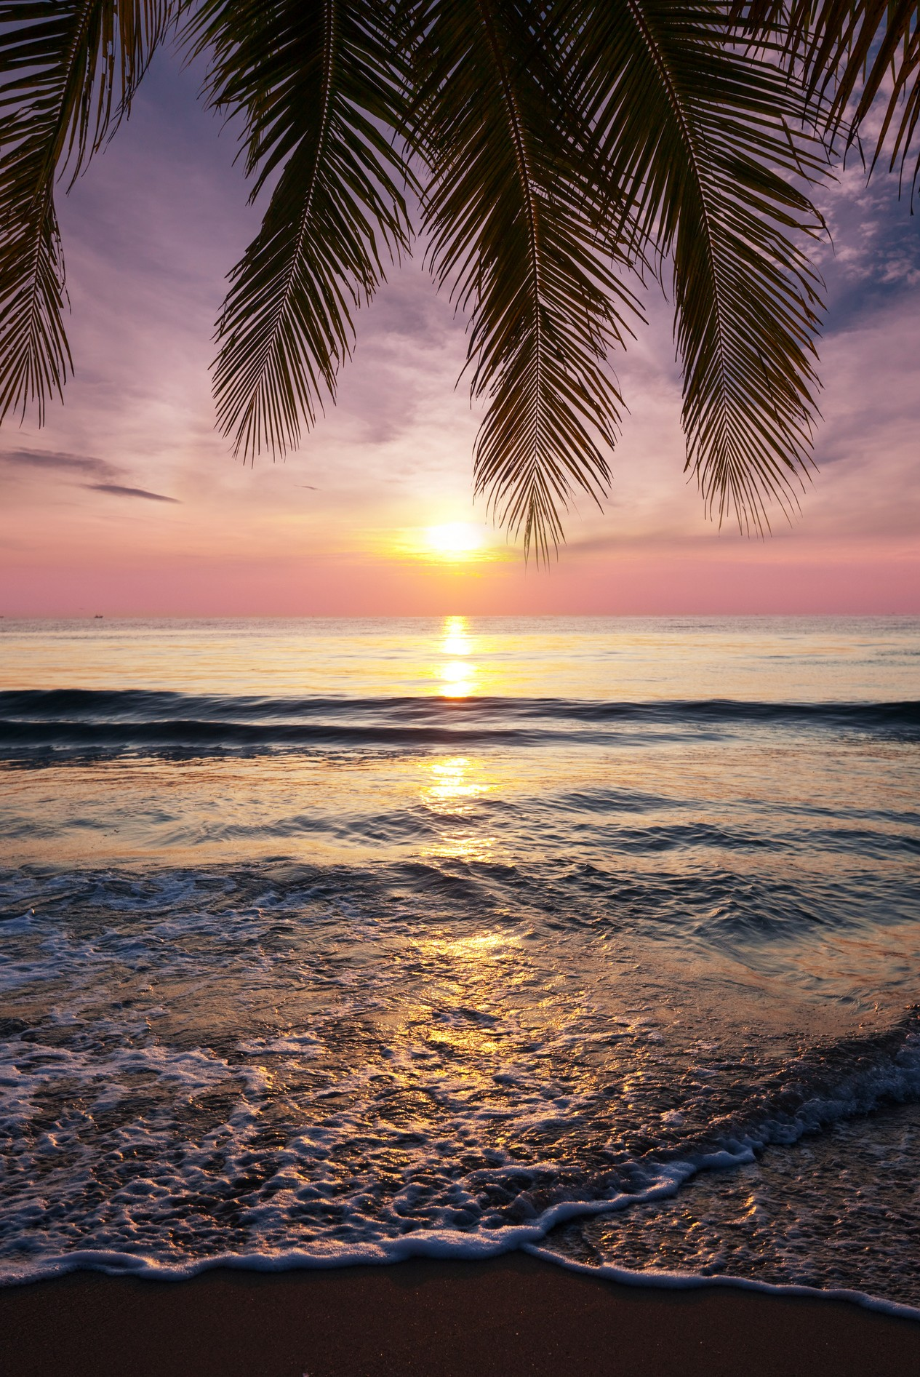
VENICE/ MARINA DEL REY
Top Solo Agents
#1 Jane St. John #2 David Fowler #3 Colin Kelly

Slide 12
VENICE/ MARINA DEL REY
Top Team
#1
The Berman Kandel Team

Slide 13
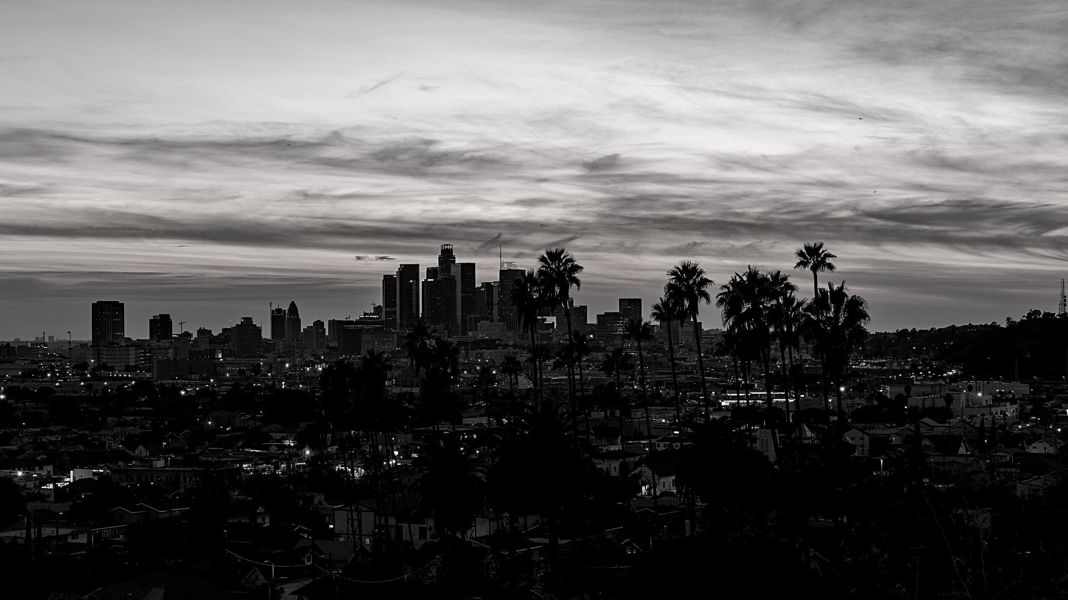
TOP AGENTS + TOP TEAMS
WEST LOS ANGELES

Slide 14
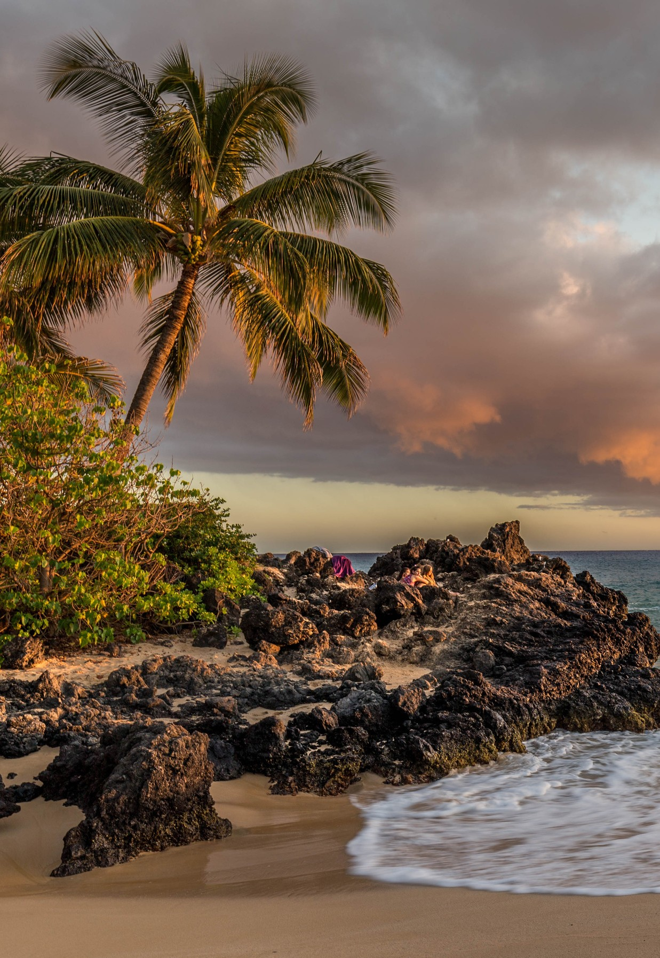
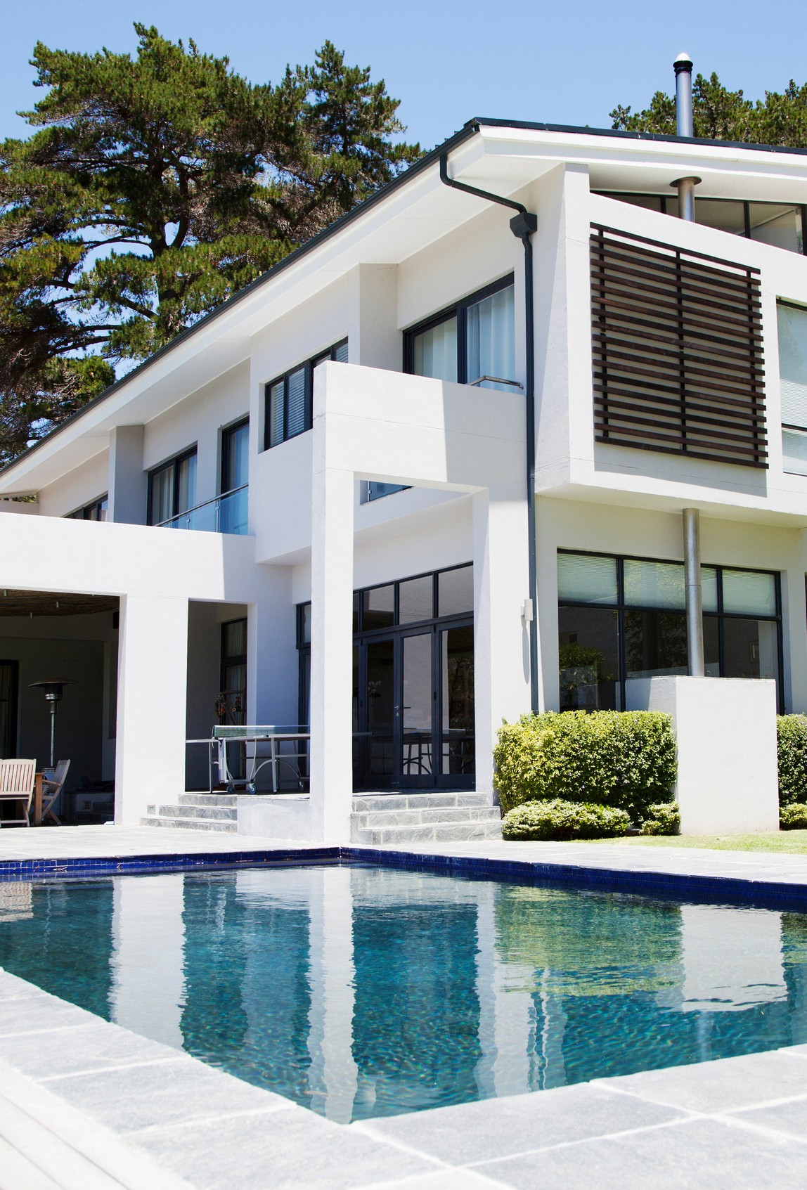
WEST LOS ANGELES
Top Solo Agents
#1 Michele Walman #2 Elizabeth Marquart #3 Reid Kaplan

Slide 15
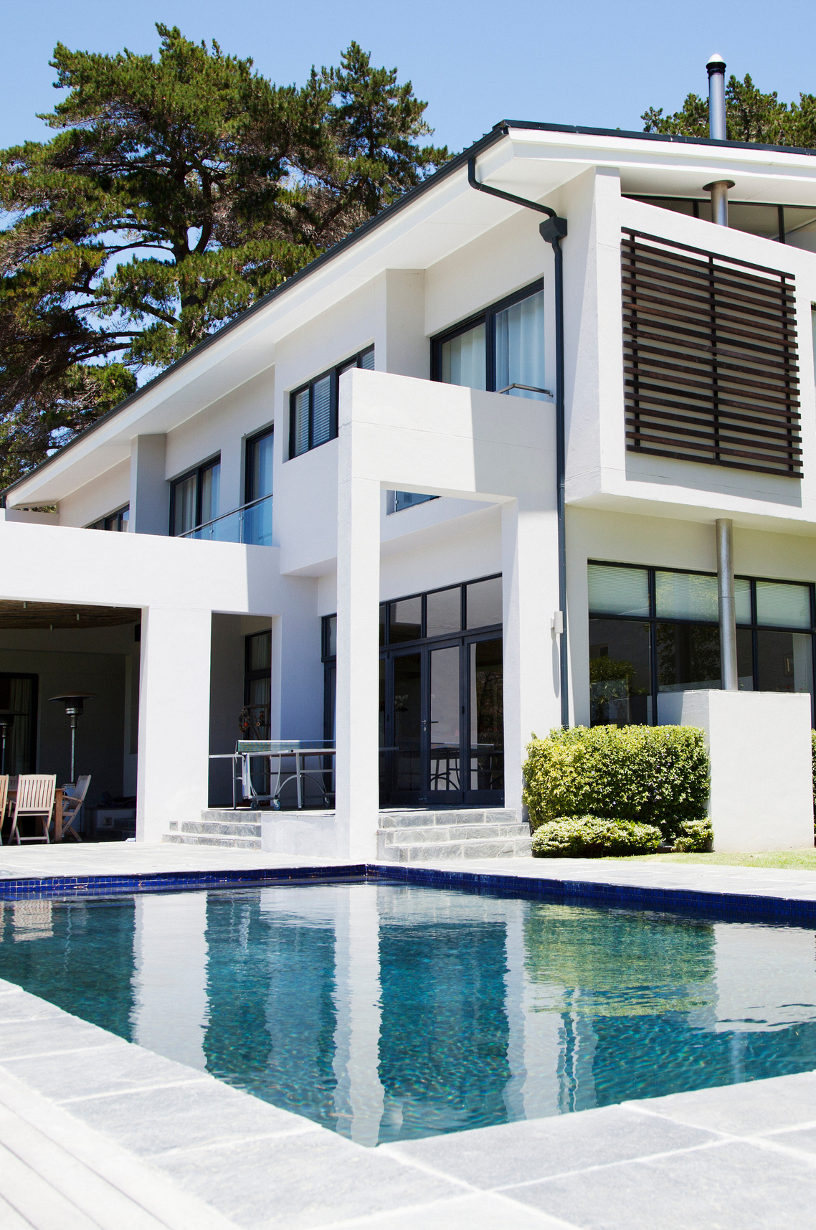
WEST LOS ANGELES
Top Teams
#1 Rory Posin & Kristian Bonk

Slide 16
TOP AGENTS + TOP TEAMS
HIGHLAND

Slide 17
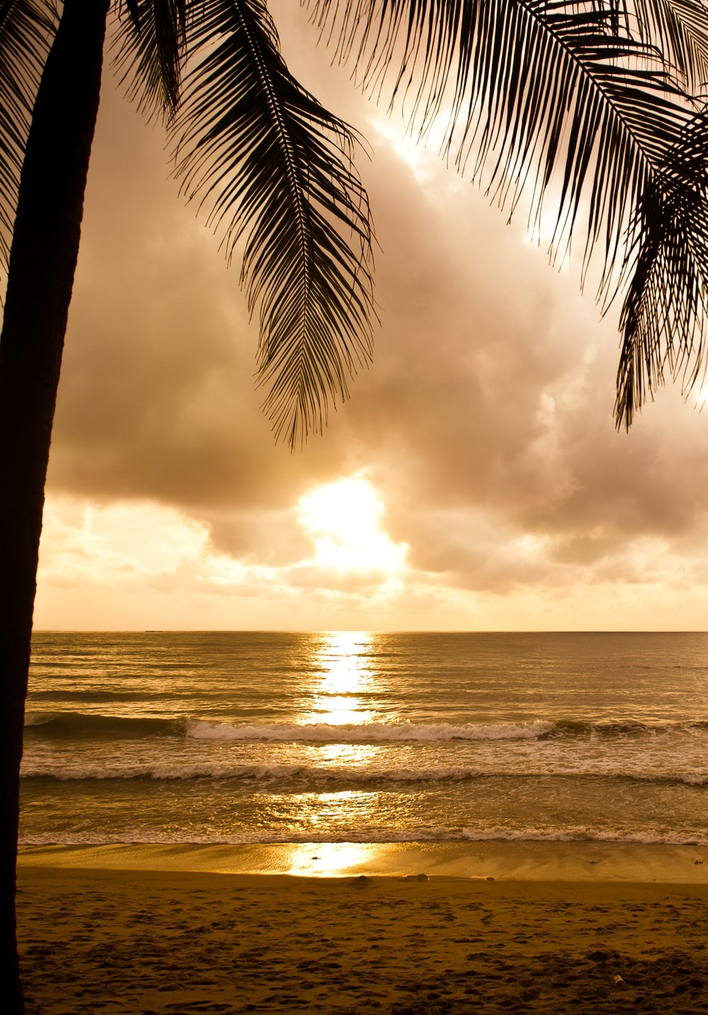
HIGHLAND
Top Solo Agents
#1 Jane Sager
#2 Charles Fisher
#3 Julie DeCoste

Slide 18
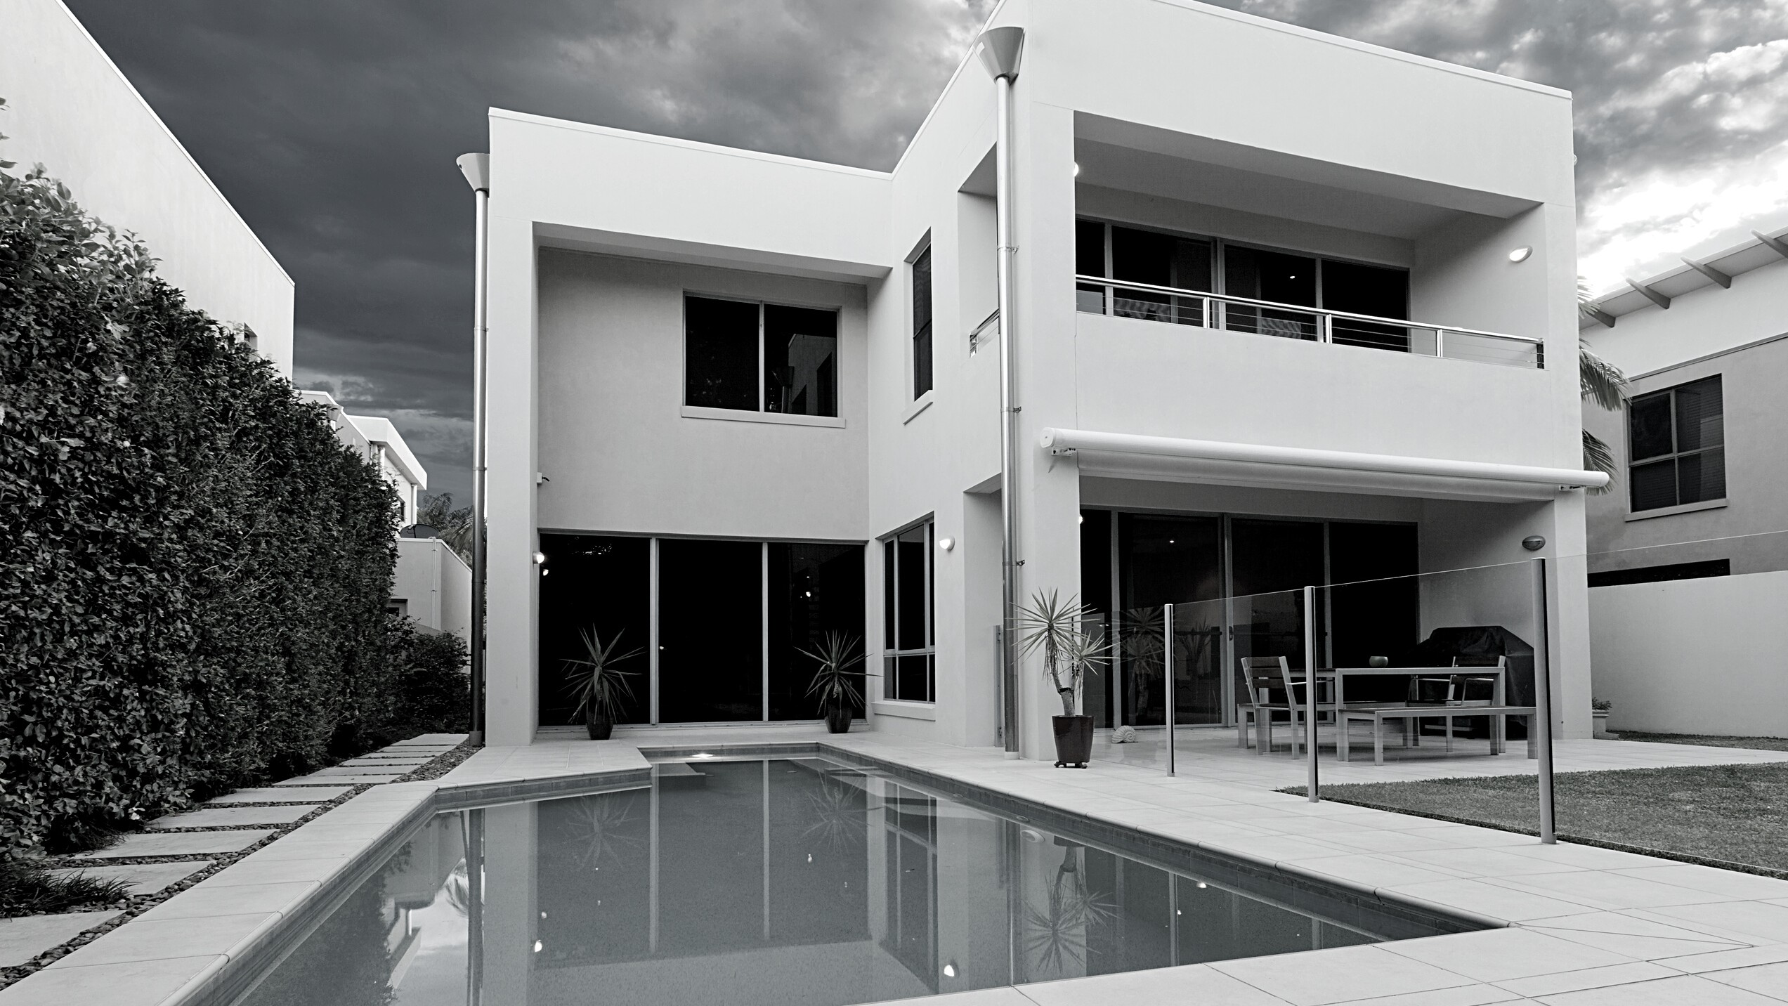
TOP AGENTS + TOP TEAMS
SILICON BEACH

Slide 19
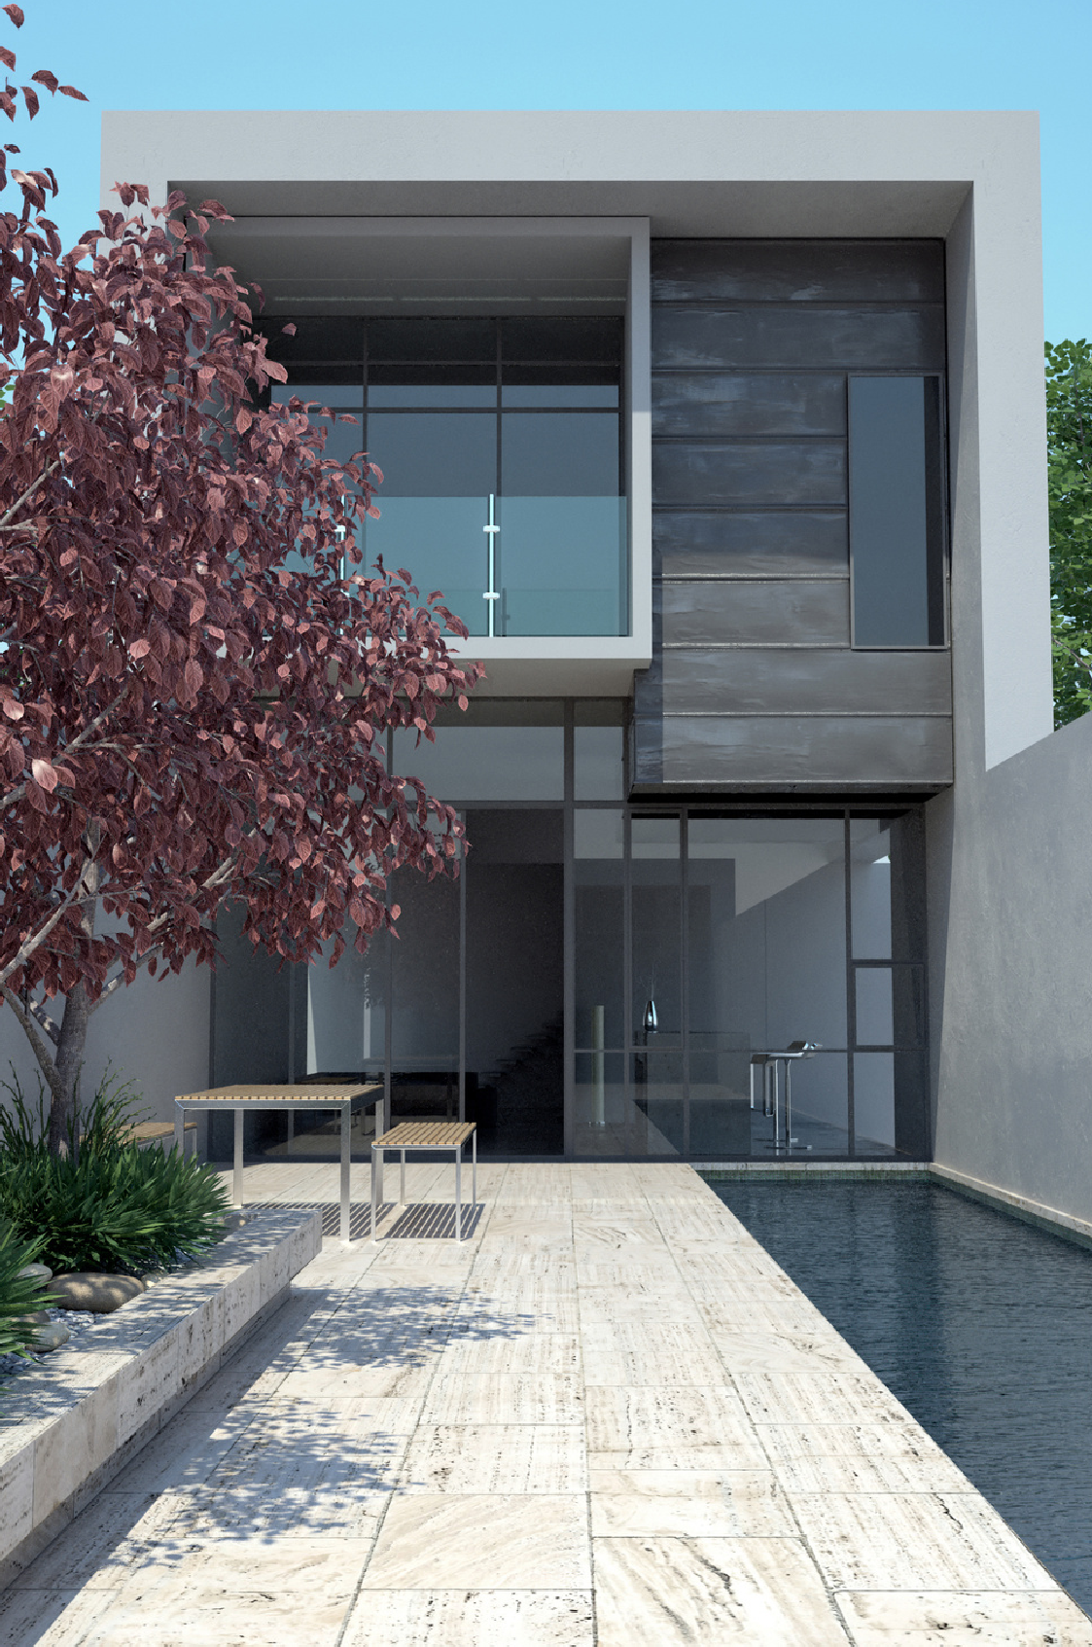
SILICON BEACH
Top Solo Agents
#1 Rebecca Saenz #2 Theresa Lehr #3 Nanci Edwards

Slide 20
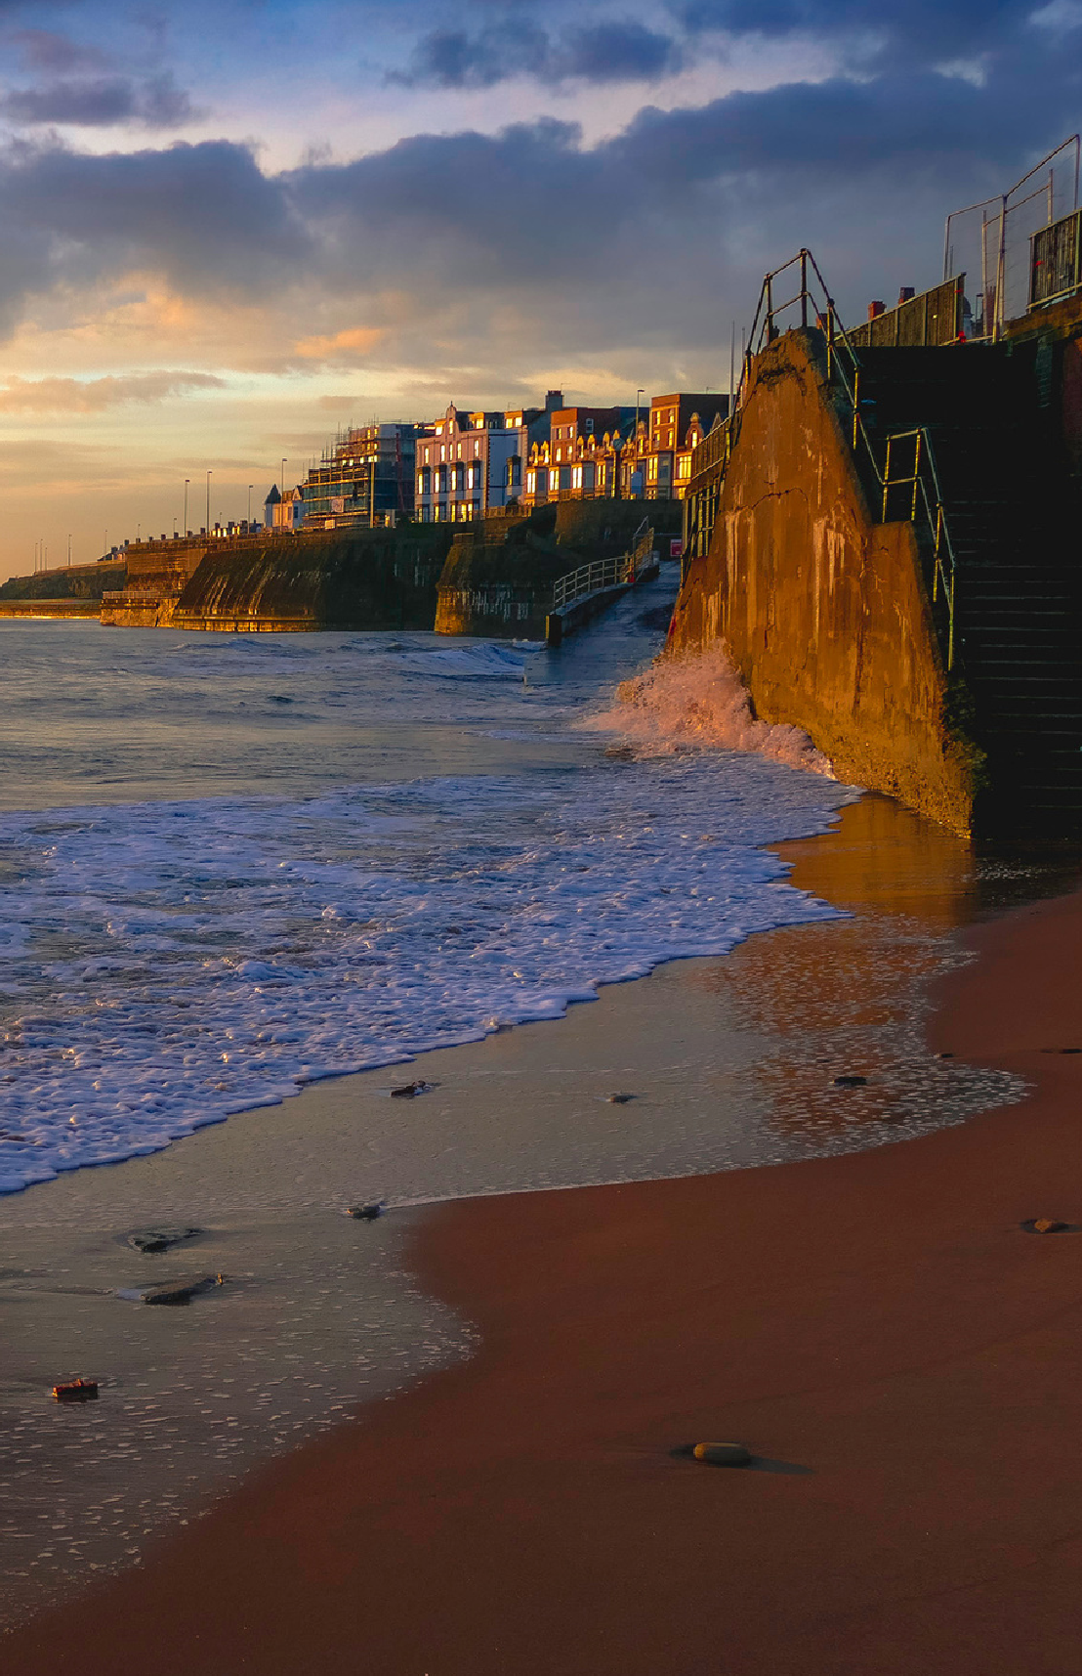
SILICON BEACH
Top Teams
#1 RCRE Group
#2 The Williamson & Pagan Group
#3 Alex and Kate Eychis Team

Slide 21
TOP AGENTS + TOP TEAMS
MALGA COVE

Slide 22
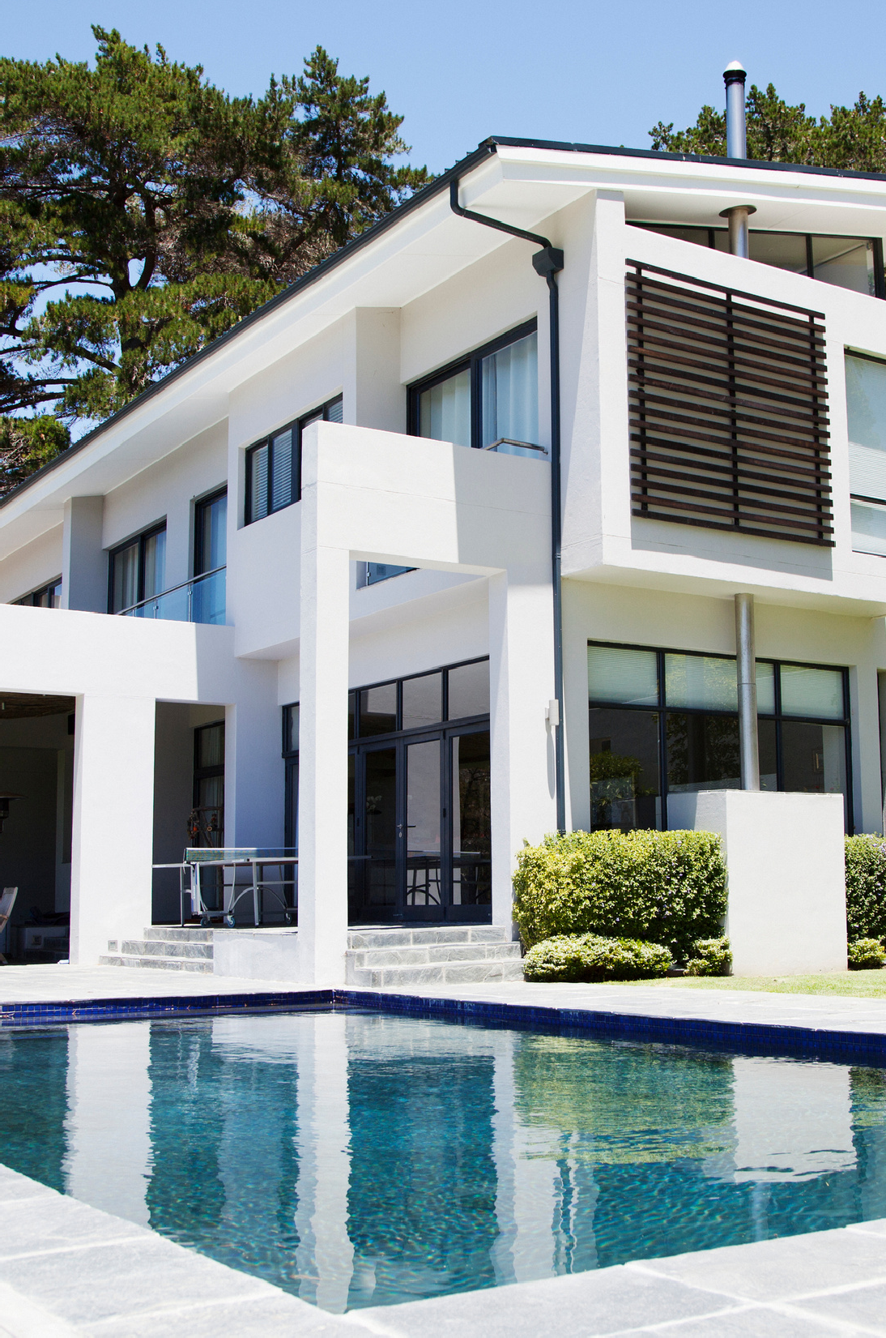
MALAGA COVE
Top Solo Agents
#1 Steve Simonetti #2 Igor Nastaskin #3 Cindy Chew

Slide 23
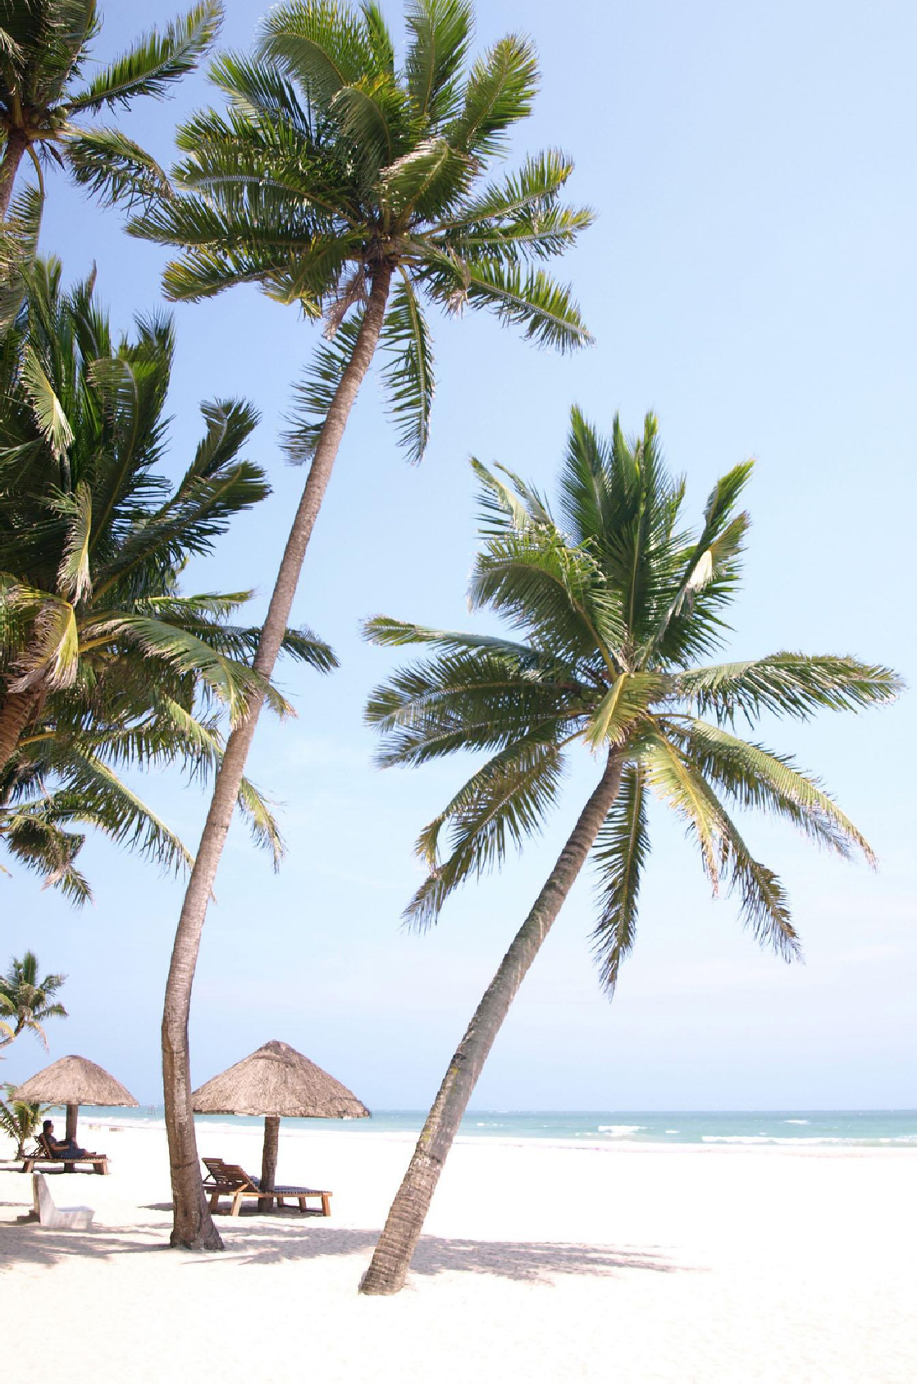
MALAGA COVE
Top Teams
#1 Kelly Evans & Laura Medina
#2 Lisa & Ramsey Oliveras
#3 The Tyndall Team

Slide 24
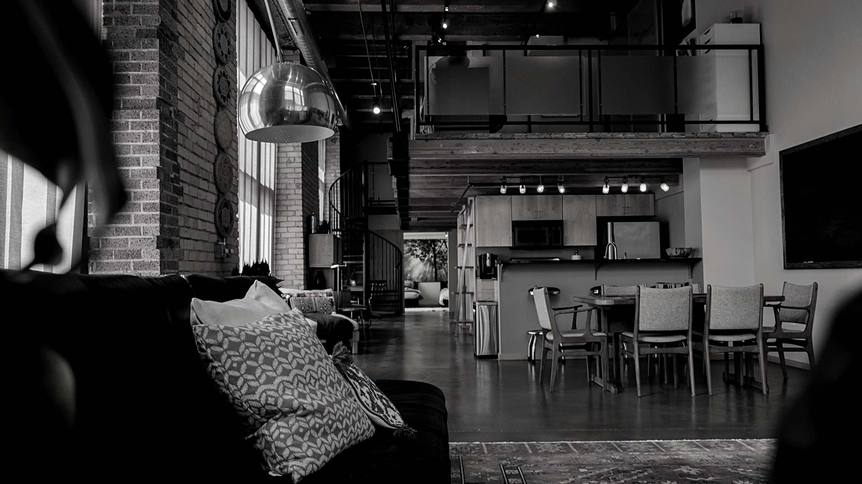
TOP AGENTS + TOP TEAMS
MIRALESTE

Slide 25
MIRALESTE
Top Solo Agents
#1 Phyllis Weitzman
#2 Melissa Resich
#3 Kerry LaPine

Slide 26
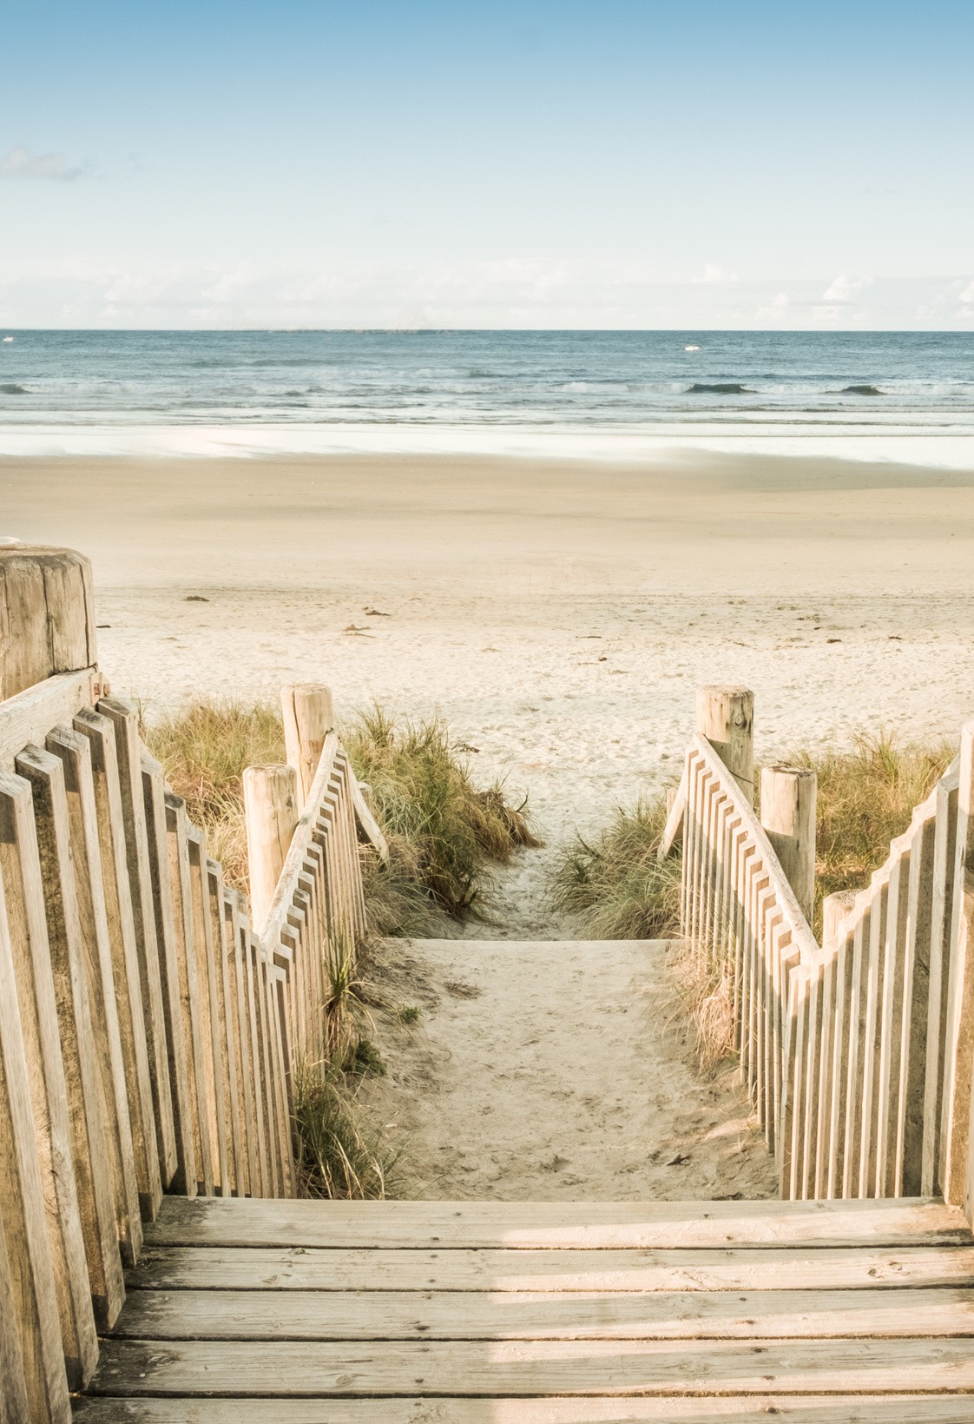
MIRALESTE
Top Teams
#1 Jerry and Laura Yutronich Team

Slide 27
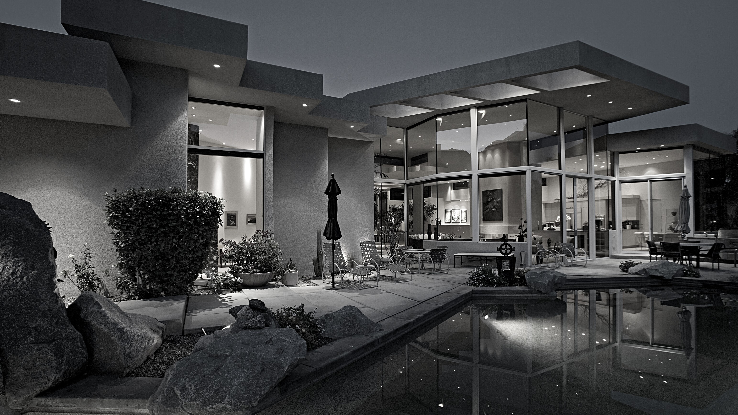
TOP AGENTS + TOP TEAMS
SILVER SPUR

Slide 28
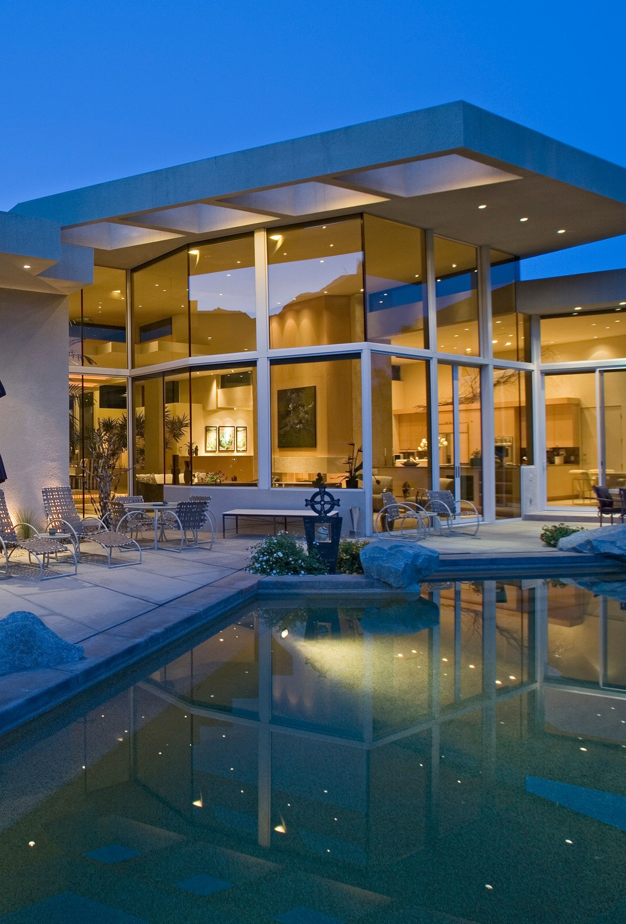
SILVER SPUR
Top Solo Agents
#1 Francoise Dytrt
#2 Wendy Sun
#3 Joe Alessi

Slide 29
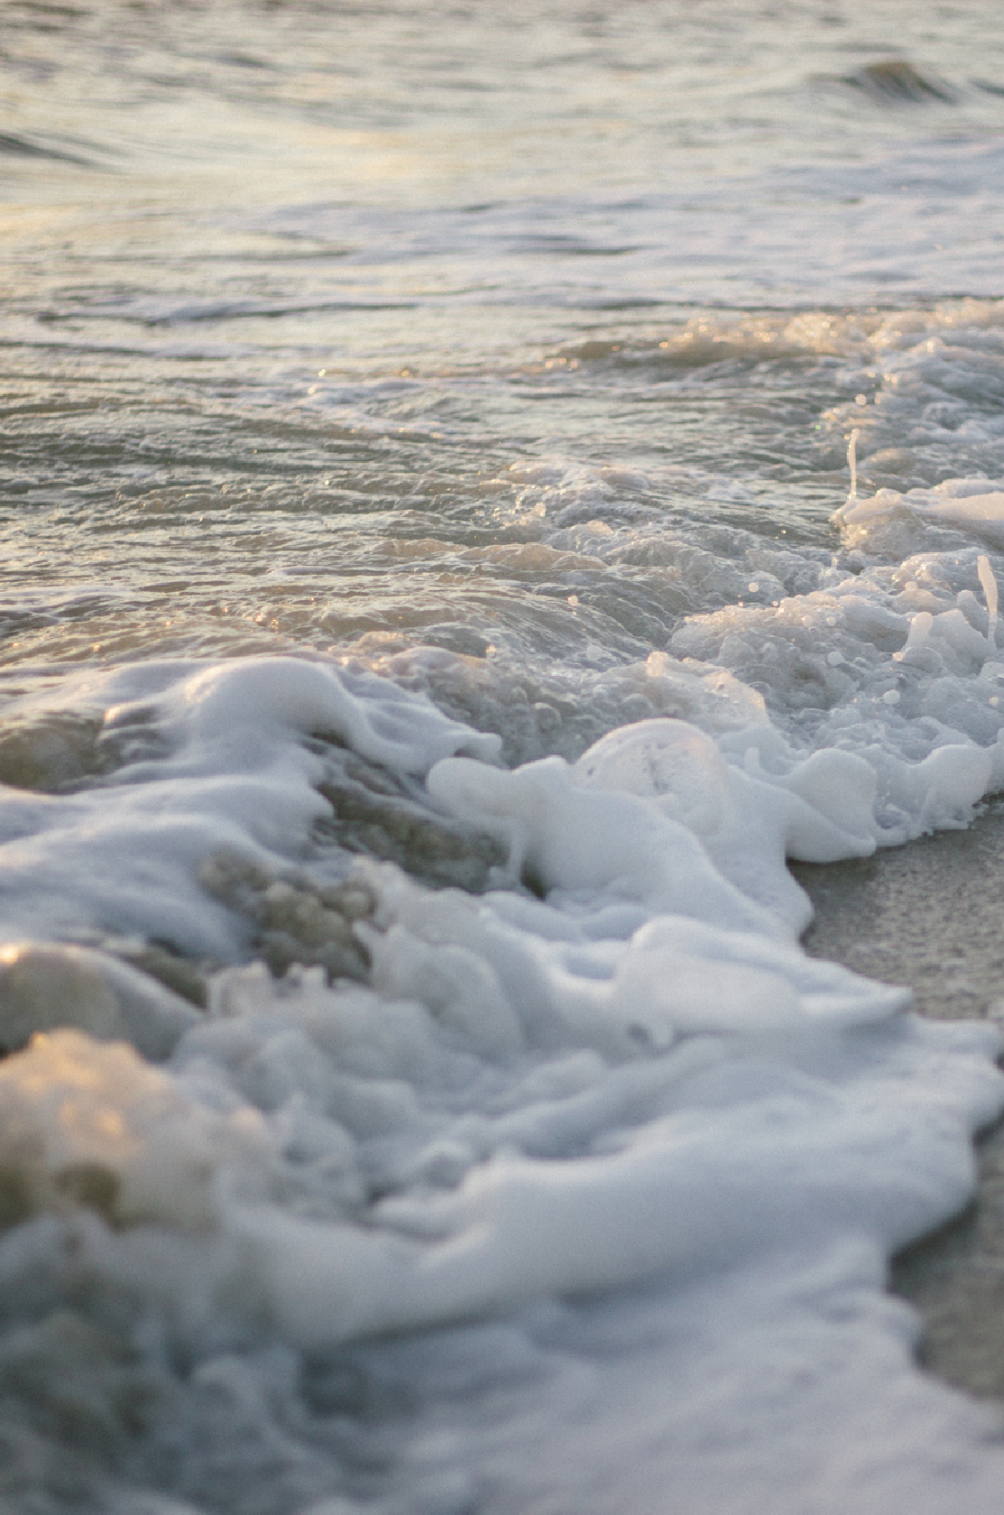
SILVER SPUR
Top Teams
#1 Kirby Larson & Haley Larson
#2 Foster & Foster Team

Slide 30
TOP AGENTS + TOP TEAMS
SOUTH BAY

Slide 31
SOUTH BAY
Top Solo Agents
#1 Ruhki Ghaznavi
#2 Ken Conant
#3 John Briscoe

Slide 32
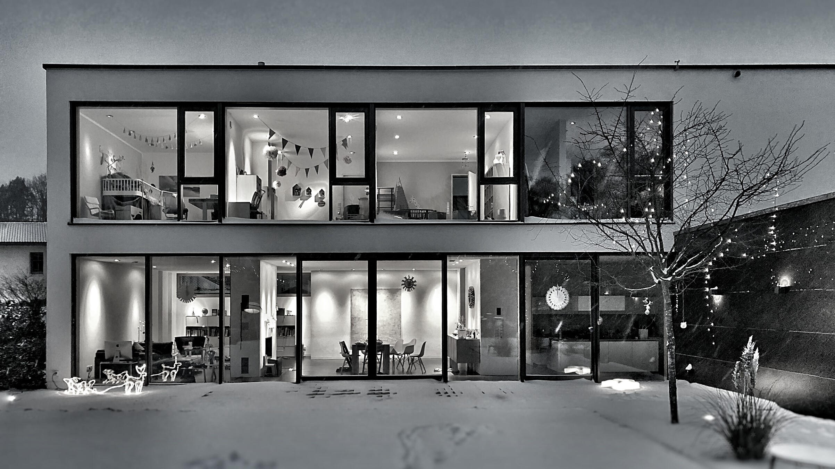
TOP AGENTS + TOP TEAMS
REDONDO BEACH

Slide 33
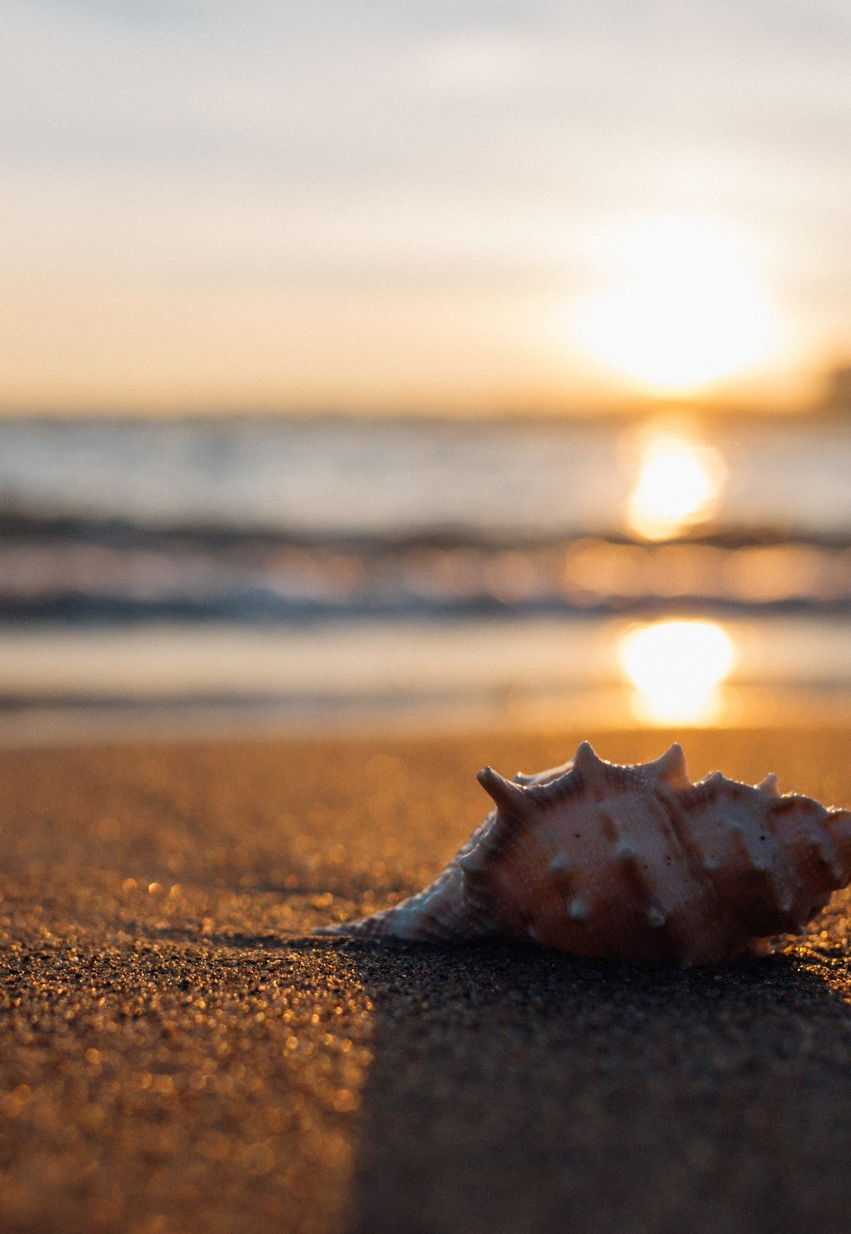
REDONDO BEACH
Top Solo Agents
#1 Mimi Alonso #2 Brent Talbot _{#3} Mickey Turner

