Slide 1
Notes:
Drag and drop the image in the placeholder
Send to back the image (Right click/Arrange/Send to back )

Slide 2
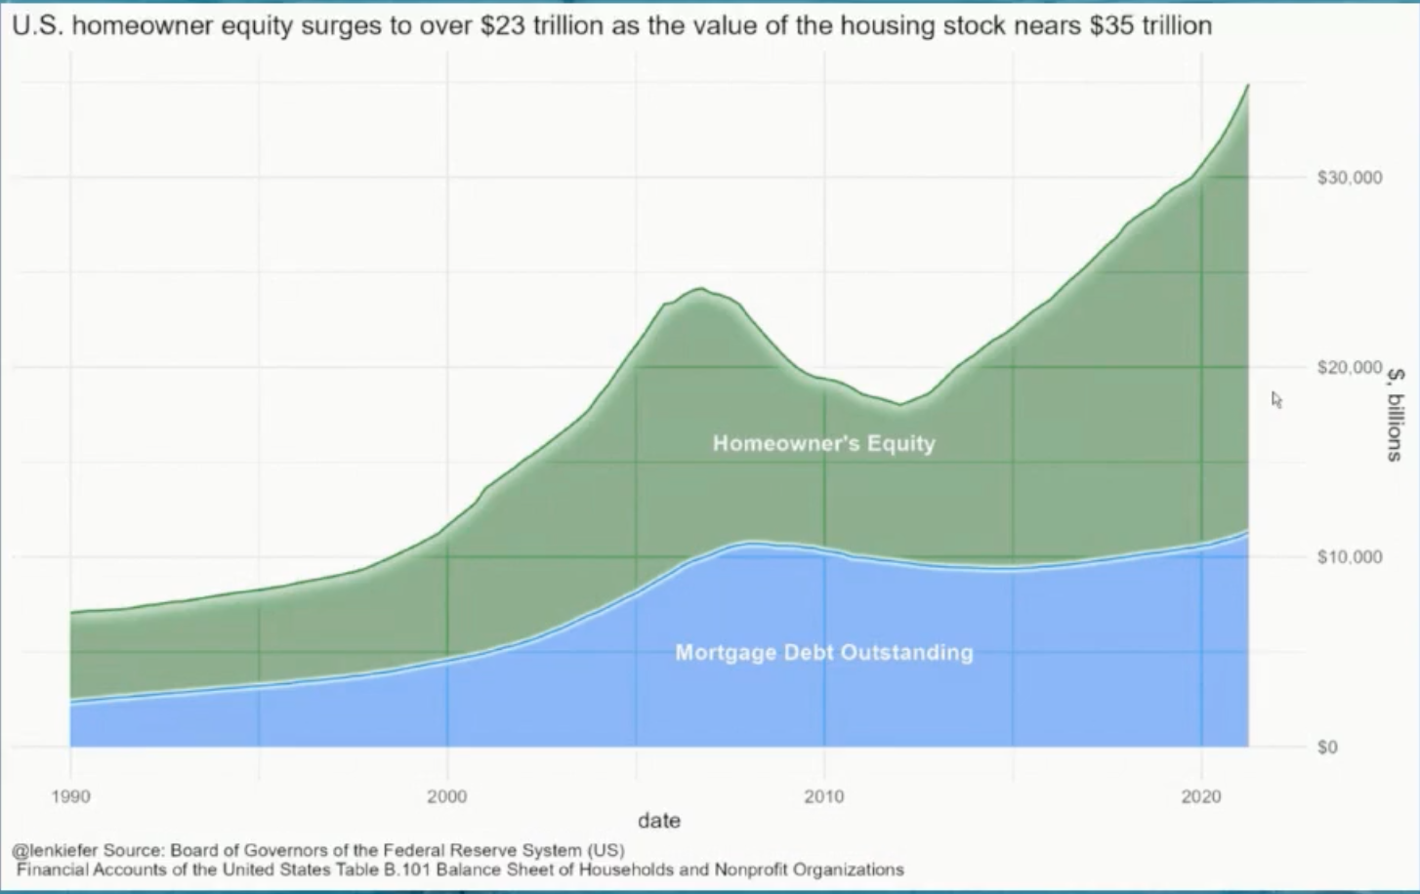
Home prices at a record high - but so is equity…

Slide 4
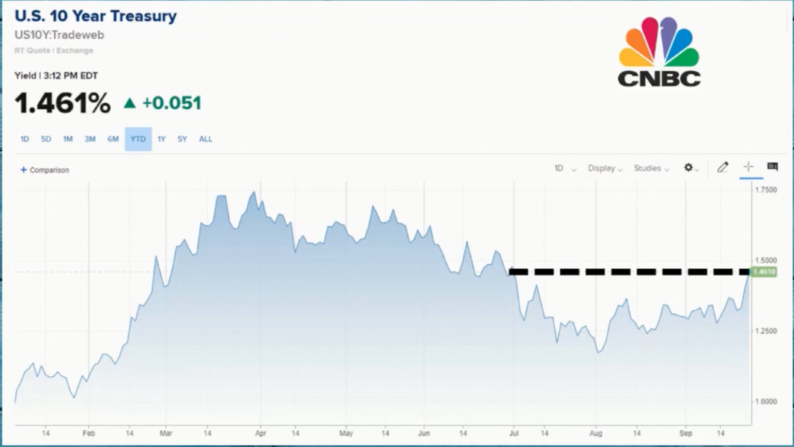

Slide 8
Jared James Coaching

Slide 14
RealScout Market Insights

Slide 15
Notes:
Drag and drop the image in the placeholder
Send to back the image (Right click/Arrange/Send to back )

